Slide 1
Isotope Production
Exotic Beam Summer School 2019: Oak Ridge National Laboratory
Tara Mastren, PhD
Assistant Professor of Nuclear Engineering
University of Utah

Slide 2
Outline
Nuclear Medicine
  Imaging
  Therapy
Traditional Isotope Production Routes
  Small Medical Cyclotrons
  Reactors
Exotic Isotope Production Routes
  Medium-High Energy Cyclotrons
  Linear Accelerators
  Facility for Rare Isotope Beams

Slide 3
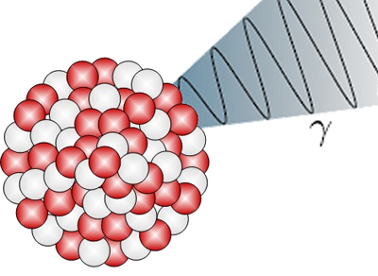
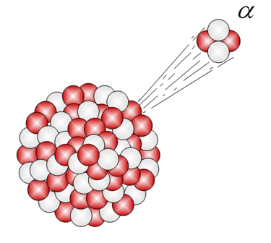
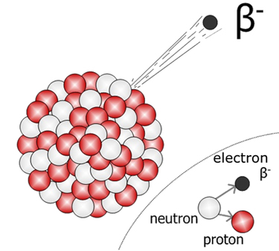
Radioactive Decay modes of Interest to Medicine
Imaging
Therapy
Auger Electron

Slide 4
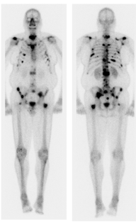
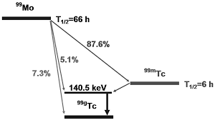
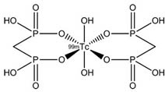
Nuclear Medicine Imaging ^{99m}Tc
Radionuclide | Medical Use | Production Route
^{99m}Tc | Diagnostic (SPECT) | ²³⁵U(n,f)⁹⁹Mo ⁹⁹Mo ^{99m}Tc
β⁻
Over 30 million ^{99m}Tc scans performed annually
Accounts for ~3 billion in nuclear medicine revenue
Utilizes low energy (140 keV) gamma ray for SPECT Imaging
^{99m}Tc-Medronic Acid
(MDP)
^{99m}Tc-MDP Bone Scan
Saylor et al., JNM, 2012, 53(11), 1670-1675

Slide 5
Nuclear Medicine (Imaging)
PET vs SPECT
PET Positron Emission Tomography
  Advantages
    Lower Activities Administered
    High Resolution
  Disadvantages
    High Cost
    Short-lived radionuclides require cyclotron onsite
SPECT Single Photon Emission Computerized Tomography
  Advantages
    Low cost
    Availability
  Disadvantages
    Low Resolution
    Higher Activities Administered

Slide 6
Nuclear Medicine (Imaging)
PET SPECT

Slide 7
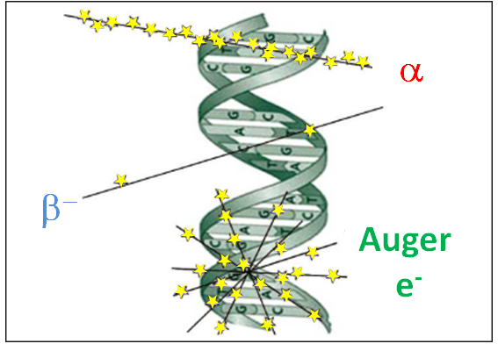
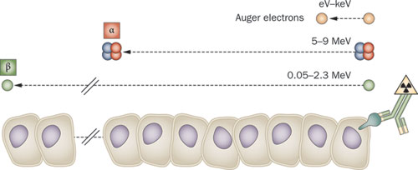
Radiotherapy
Oxygen free radicals and DNA double strand breaks are effective means for killing cancer cells
The energy deposited in cells from radionuclide decay, linear energy transfer (LET), can kill targeted cells and leave healthy cells unperturbed
Decay Mode | Energy Range | Range in Tissue | LET
Auger | eV-keV | nm | ~4-26 keV/μm
α | 5-9 MeV | µm | ~80 keV/μm
β⁻ | 0.05-2.3 MeV | mm | ~0.2 keV/μm
Pouget J.-P. et al., 2011, Nat. Rev. Clin. Oncol.

Slide 8
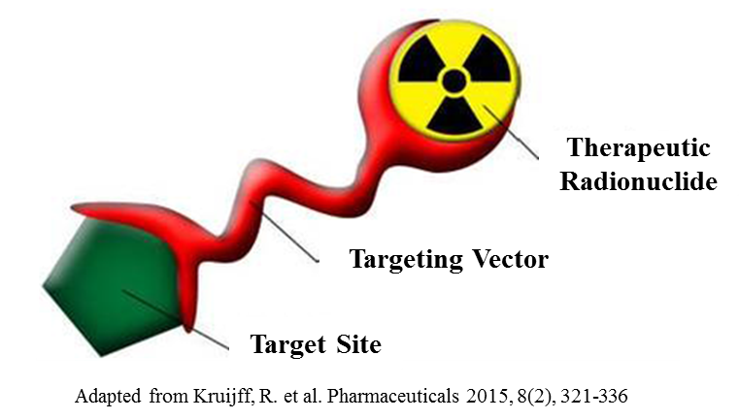
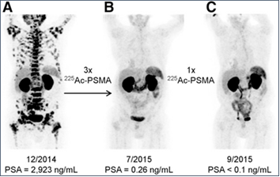
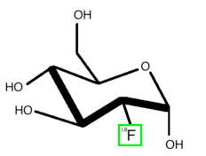
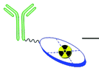
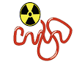
Targeted Radiotherapy
Anatomy of a Radiotherapy Agent
Treatment of End-Stage Prostate Cancer
Targeting Vectors
Kratochwil et al. JNM 2016, 57(12), 1941-44

Slide 9
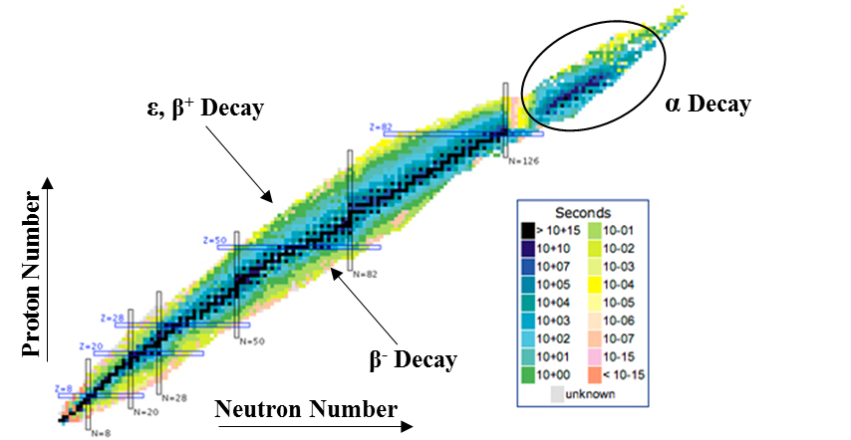
Traditional Toolbox
Legacy Material
Cyclotron
Reactor

Slide 10
Isotope Production
Nuclear Physics
  Nuclear Data
  Targetry
Radiochemistry
  Fast Efficient Separations
  High Specific Activity
  High Purity

Slide 11
Nuclear Reactions
Target(projectile, light products)Heavy Products
  ⁵⁸Ni(p,α)⁵⁵Co
Q-value ΔM(reactants)-ΔM(products)
Threshold Energy
  Minimum energy required for the reaction
Coulomb Barrier
  Energy required to overcome the Coulomb Barrier
Reaction will occur at higher of the two

Slide 12
Excitation Function
⁵⁸Ni(p,α)⁵⁵Co

Slide 13
Yield Calculations
A=R(1-e^{-λt})
R=Ixn’σ
R = the #of reactions/unit time
I = the flux of the incident particle (/s)
x = the target thickness in cm
n’ = the number of target nuclei/cm³
σ = the cross section (cm²)

Slide 14
Radiochemistry
Chemical separation of the product from the target material
Obtain product in high chemical purity
  Minimal stable impurities that could have effect on chemistry, for example metallic impurities that could compete with product radionuclide for chelation.
  High specific activity (as close to theoretical as possible)
    Theoretical specific activity is the radioactivity/µmol assuming all atoms are the product radionuclide
Obtain product in high radionuclidic purity
  Free from long-lived impurities (ideally)
Final product should be in an appropriate chemical form

Slide 15
Considerations for Radioisotopes used for Medical Applications
Chemistry
Half-live
  Comparable to biological half-life of targeting agent
Decay Properties
  What Application?
    PET, SPECT, Therapy
Availability
  Can the radionuclide be obtained in usable quantities
Purity
Specific Activity

Slide 16
Production
Small Medical Cyclotron

Slide 17
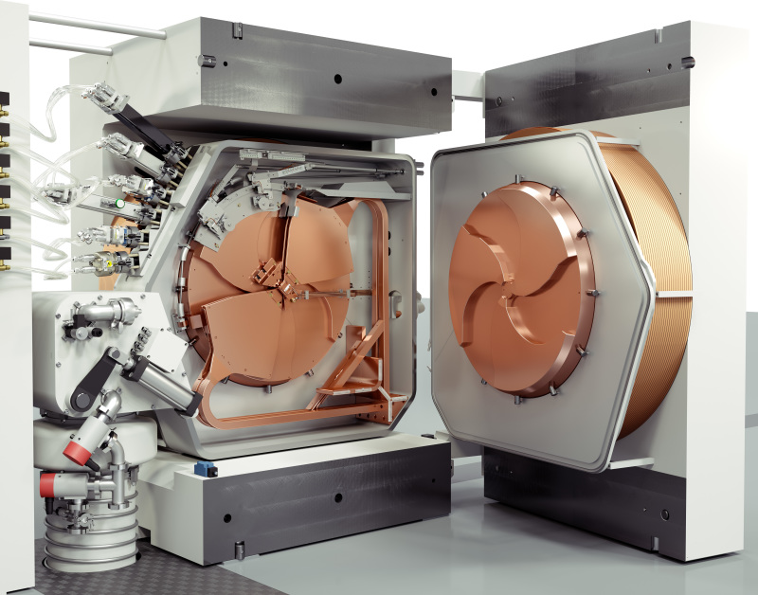
Small Medical Cyclotron (11-24 MeV)

Slide 18
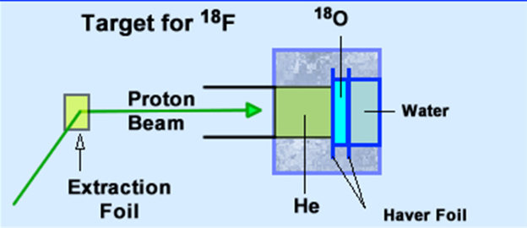
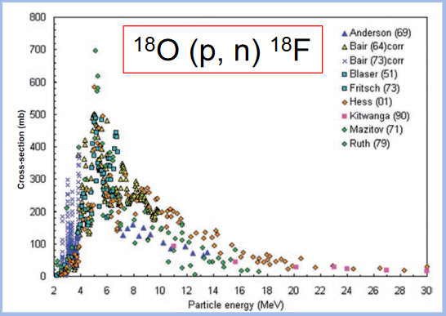
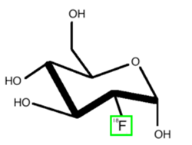
¹⁸F (110m) Production
http://www.people.vcu.edu/~mhcrosthwait/clrs461/cyclotrons.html
Produces [¹⁸F]F⁻ that is separated from water target with a column and then used chemistry applications
[¹⁸F]FDG
(Glucose Derivative)

Slide 19
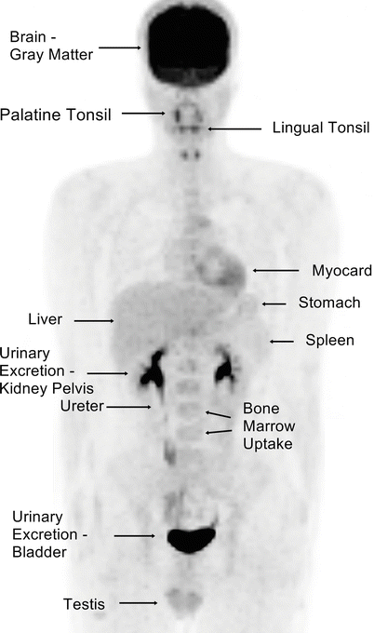
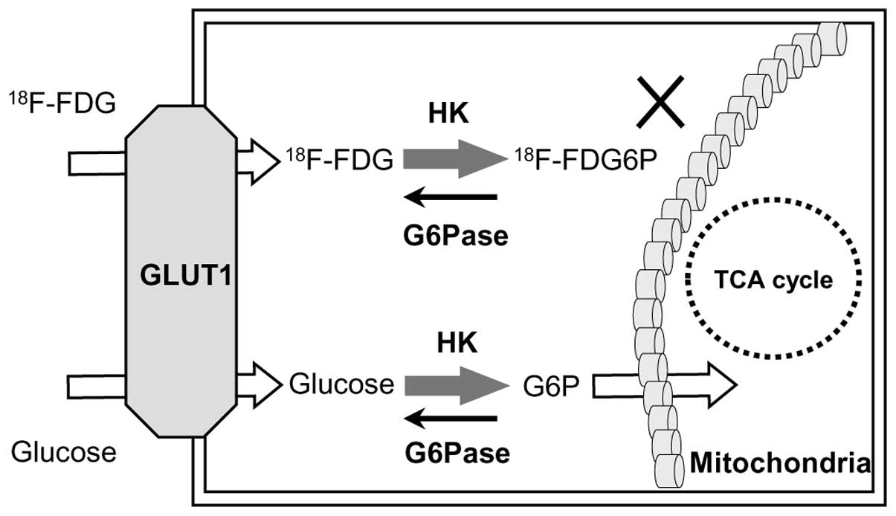
FDG PET Imaging
Izuishi et al., Oncology Reports, 2013
Özülker et al., Atlas of PET-CT Imaging in Oncology, pp 3-19

Slide 20
Nonstandard Radionuclides (Radiometals)
Longer half-lives
Useful for biological agents such as peptides, antibodies, nanobodies, etc. that have longer biological half-lives
Often requires appropriate chelate (chemical cage) to attach radionuclide to biological agent
Examples: ⁸⁹Zr, ⁶⁴Cu, ⁸⁶Y, ⁶⁸Ga

Slide 21
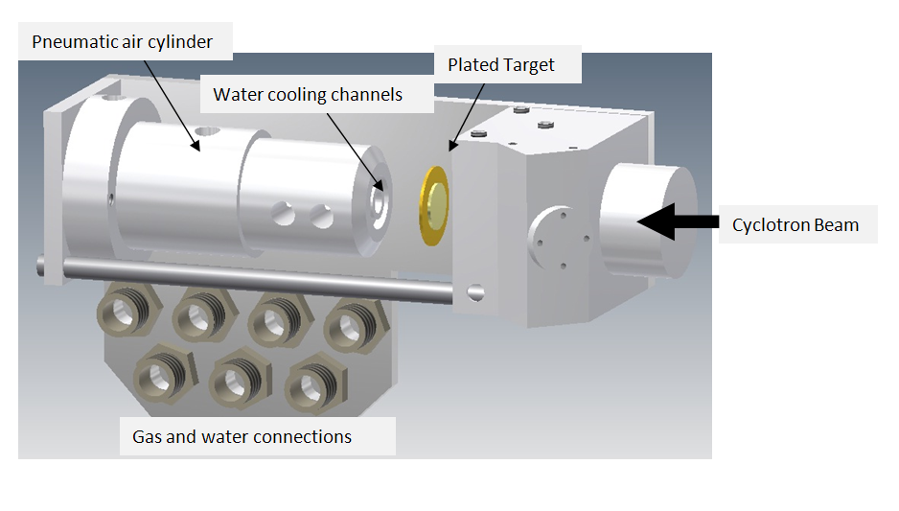
Radiometal Production (Targetry)

Slide 22
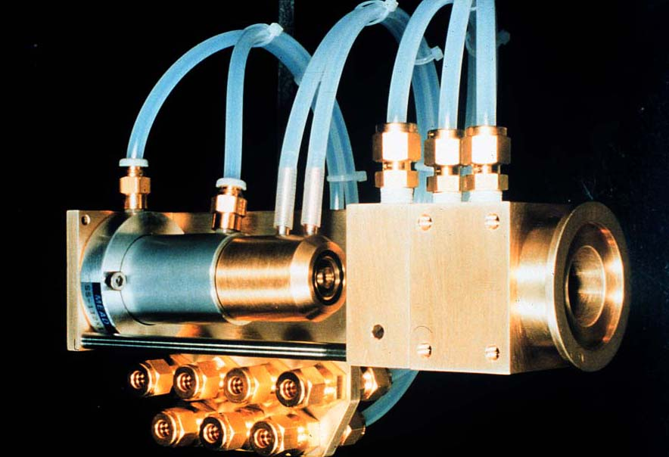
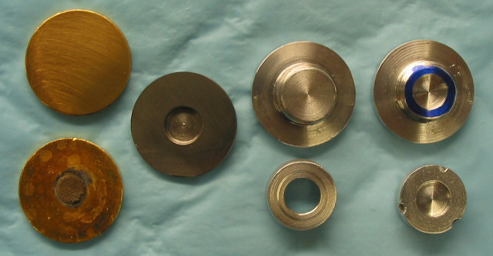
Radiometal Production (Targetry)
Example from Washington University in St Louis

Slide 23
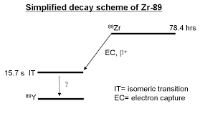
Zirconium-89
  Half-life of 3.27 d – well suited for study of pharmacokinetics of antibodies (achieve optimal biodistribution ~4-5 d)
  Immuno-PET - Scouting in preparation for radioimmunotherapy, confirming tumor targeting, and estimating dosimetry
  Generally inert to biological systems
Decay properties
  EC = 76.6%
  β⁺ = 22.3%
  R_{ave.}(β⁺)= 1.18 mm

Slide 24
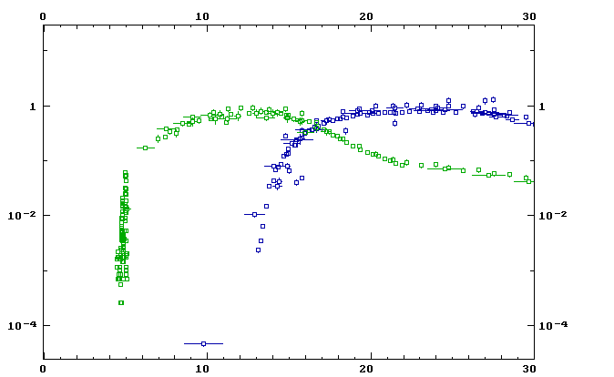
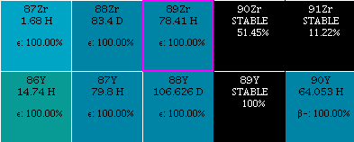
⁸⁹Y(p,xn)^{88,89}Zr
p,2n
Cross Section (Barns)
p,n
Energy (MeV)

Slide 25
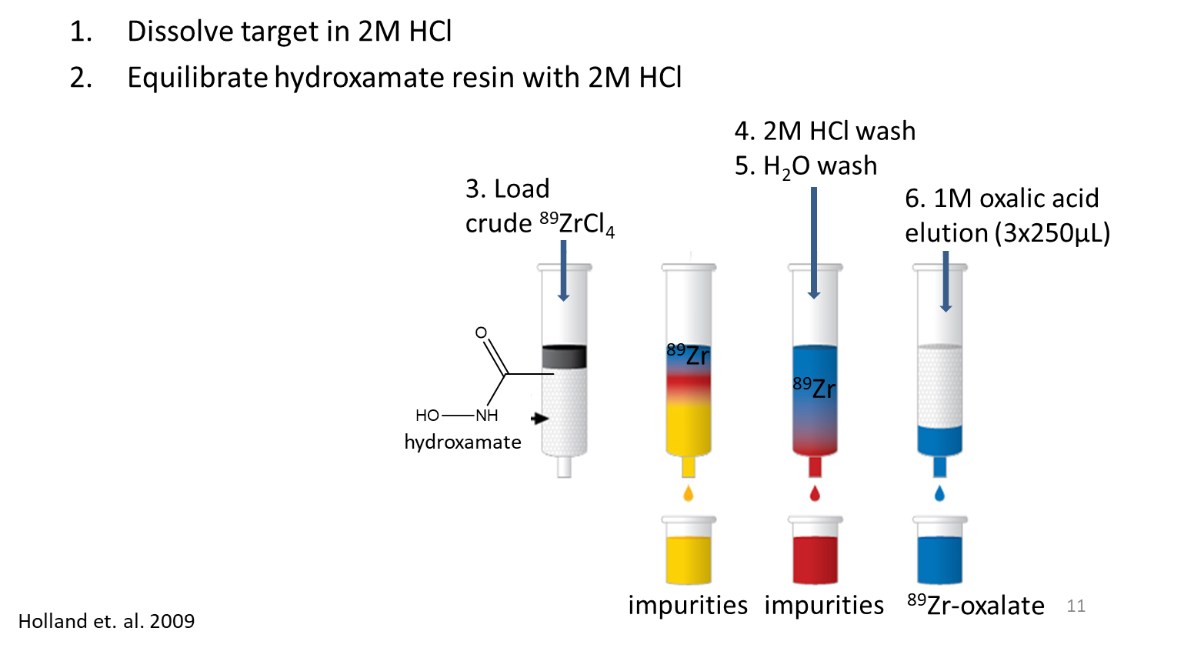
Production and Purification of ⁸⁹Zr
Accell resin
Hydroxamate resin

Slide 26
Production
Reactors

Slide 27
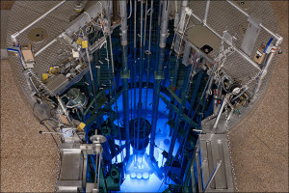
University Reactors (10¹²-10¹⁴ n/s/cm²)
Missouri University Research Reactor

Slide 28
Reactor Production of Radionuclides
Thermal neutron capture reactions
  ¹⁷⁶Lu(n,ϒ)¹⁷⁷Lu
  ¹⁸⁵Re(n,ϒ)¹⁸⁶Re
Direct reactions require large neutron flux rates to obtain usable specific activity
Indirect methods can sometimes be used to make high specific activity radionuclides
  ¹⁷⁶Y(n,ϒ)¹⁷⁷Yb(ϐ⁻, 1.9h)¹⁷⁷Lu
  ¹⁶⁰Gd(n,ϒ)¹⁶¹Gd(ϐ⁻, 3.7m)¹⁶¹Tb
Szilard Chalmers Method
  Target atom is bound to molecule and upon neutron capture reaction, the bond is broken liberating the product radionuclide.

Slide 29
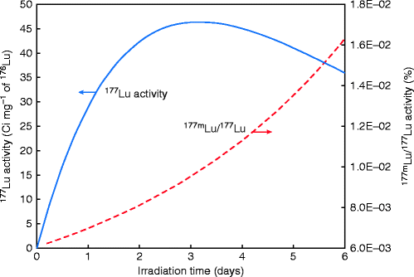
¹⁷⁷Lu (6.65d) Production (Direct)
Only US Supplier is MURR
  ¹⁷⁶Lu(n,ϒ)¹⁷⁷Lu (¹⁷⁶Lu ~2.5% abundant)
High Neutron Capture Cross Section
  Thermal -- ~2065 barns
  Epithermal -- ~1087 barns
FDA approved for the treatment of Neuroendocrine Tumors (¹⁷⁷Lu-DOTATATE) Luthera©
^{177m}Lu (160d) co-produced (Long-lived contaminant)
No chemistry required to purify the target
Can’t recycle enriched target material
Lower specific activity
Mirzadeh et al. Reactor-Produced Medical Radionuclides, Handbook of Nuclear Chemistry 2011

Slide 30
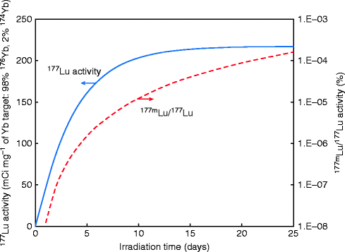
¹⁷⁷Lu (6.65d) Production (Indirect)
¹⁷⁶Y(n,ϒ)¹⁷⁷Yb(ϐ⁻, 1.9h)¹⁷⁷Lu
High Specific Activity
Difficult chemical separation
Recycling of enriched target material
Significantly less ^{177m}Lu co-production
Lower production cross section
  Thermal -- ~2.85 barns
  Epithermal -- ~8 barns
Mirzadeh et al. Reactor-Produced Medical Radionuclides, Handbook of Nuclear Chemistry 2011

Slide 31
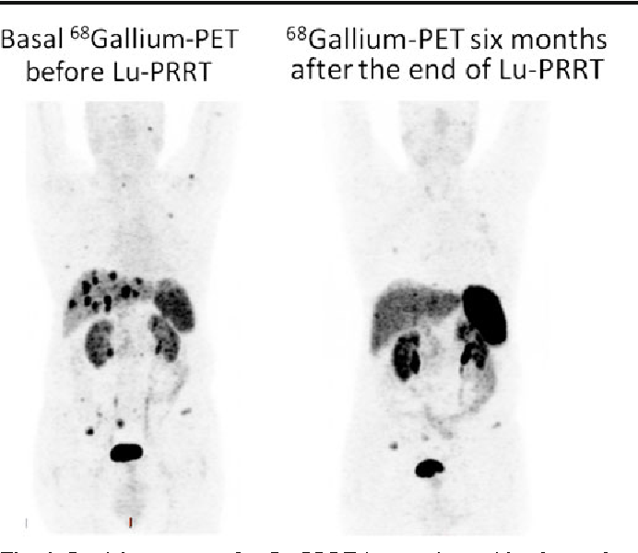
¹⁷⁷Lu-DOTATATE PRRT (peptide receptor radionuclide therapy)
Ianniello et al., EJNMMI, 43(6), 2015

Slide 32
Production
Medium to high energy cyclotrons

Slide 33
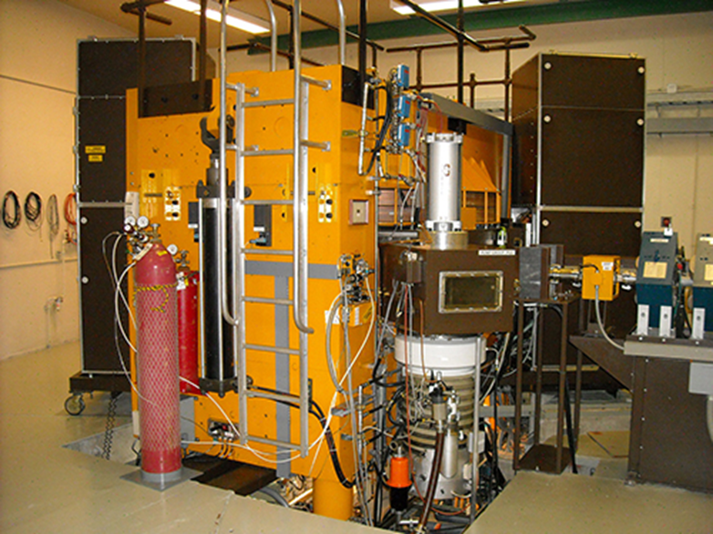
Medium Energy Cyclotrons
Cyclotron such as the one at University of Washington (pictured), can accelerate protons to higher energies in addition to heavier ions such as alpha particles; probing different reaction pathways that are not obtainable on the small medical cyclotrons.

Slide 34
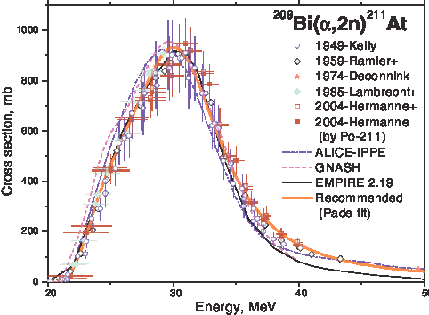
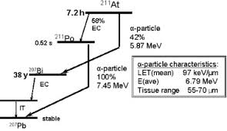
²¹¹At
Alpha beams are of interest for the production of ²¹¹At (7hrs). ²¹¹At is of interest for targeted alpha therapy applications.
²⁰⁹Bi(α,2n)²¹¹At optimal energy (<27 MeV)
Capote et al., IAEA Conference on Nuclear Data for Science and Technology 2007

Slide 35
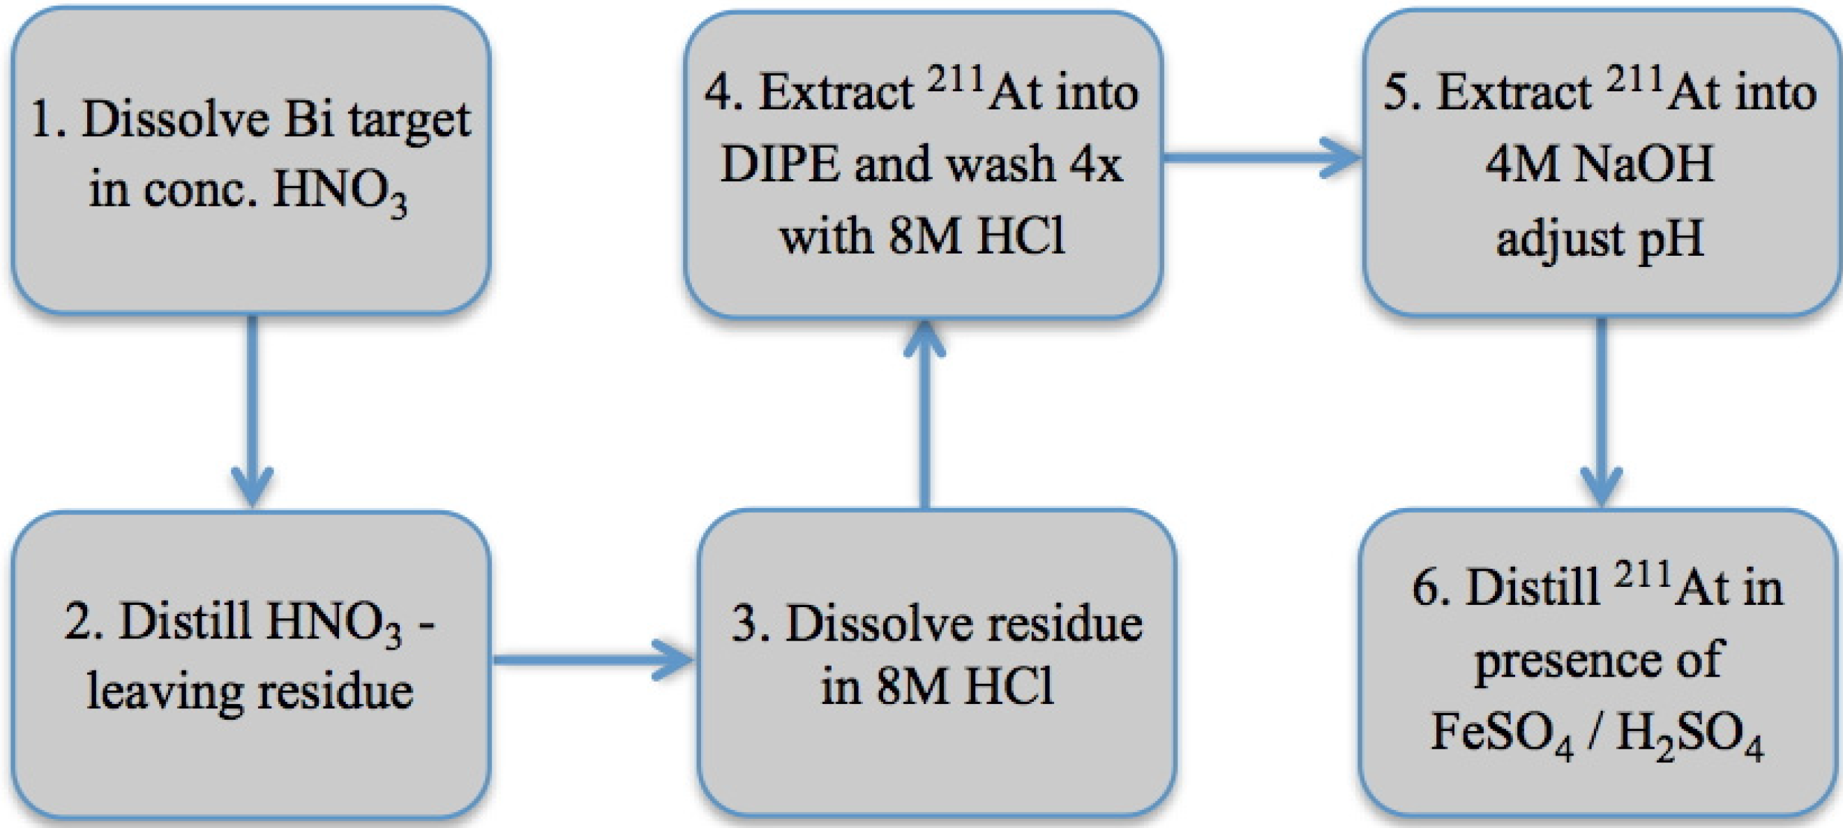
²¹¹At Separation Chemistry
Balkin et al., Appl. Sci. 2013, 3(3)

Slide 36
Production
Linear Accelerators

Slide 37
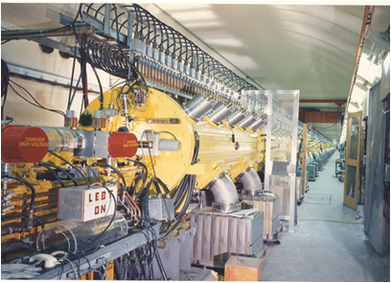
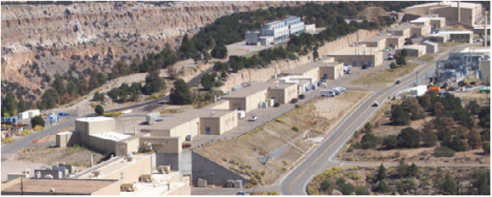
Linear Accelerators
Los Alamos National Laboratory (LANL)
Brookhaven National Laboratory (BNL)

Slide 38
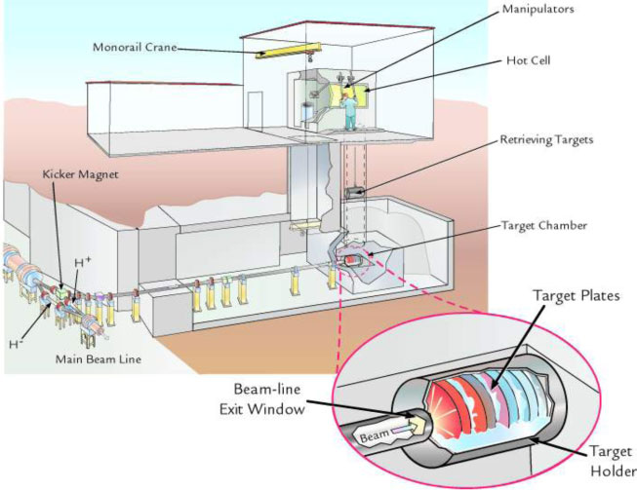
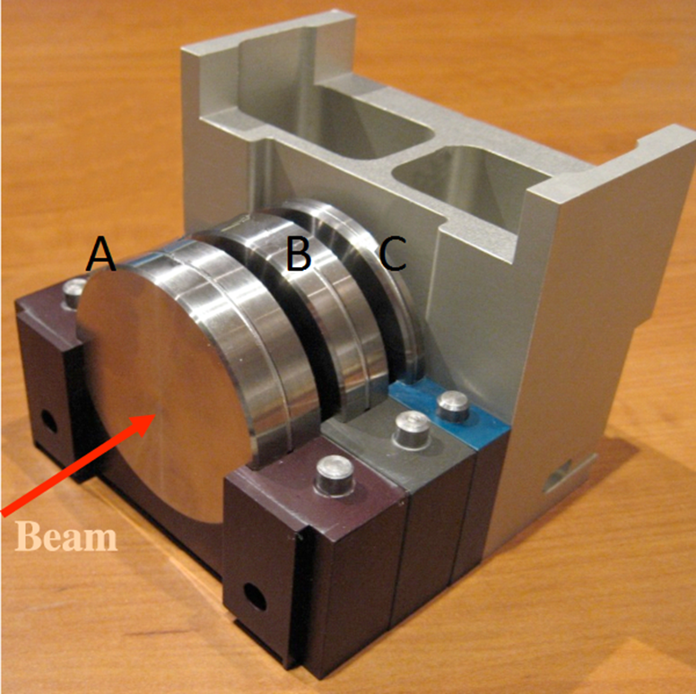
Los Alamos Isotope Production Facility

Slide 39
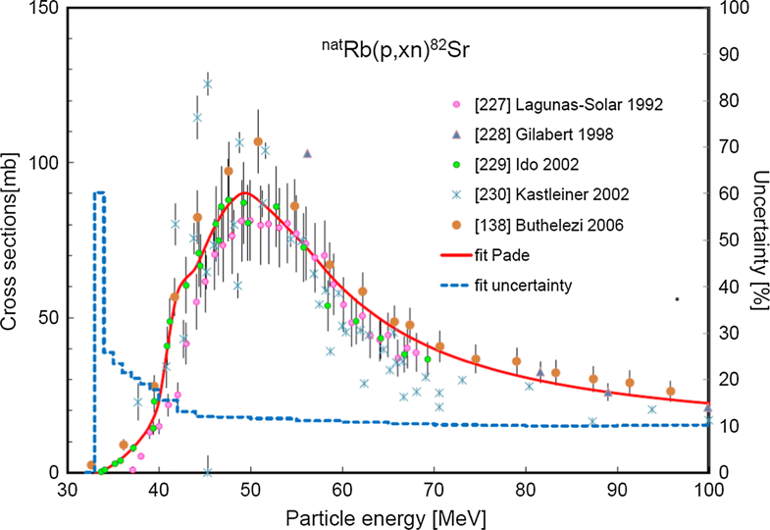
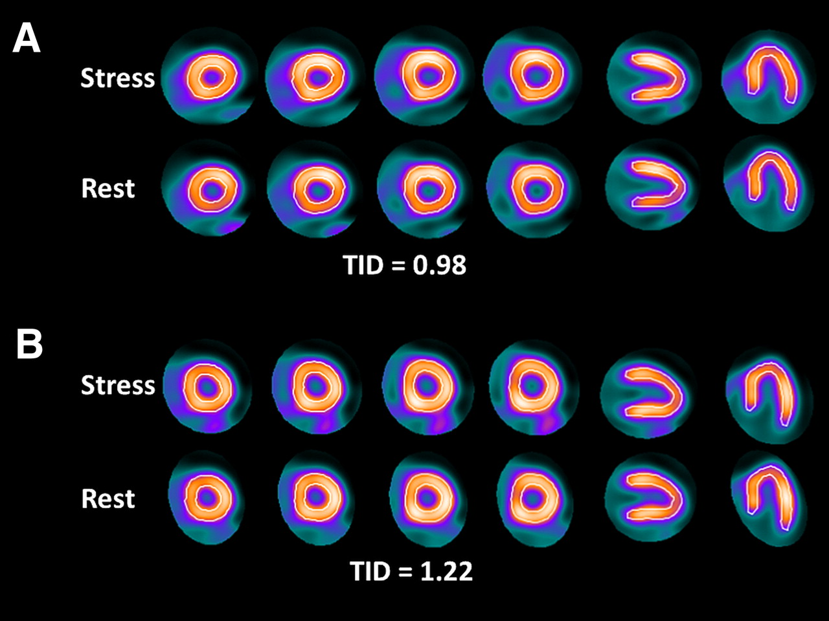
⁸²Sr Production: ⁸⁵Rb(p,4n)⁸²Sr
⁸²Sr/⁸²Rb generator for PET cardiac imaging
  ⁸²Sr (23.4d) ⁸²Rb (1.26m)
Made at LANL and BNL
Rischpler et al. JNM, 53(5), 2012
Tarkanyi et al. Journal of Radioanalytical and Nuclear Chem, 319(2), 2019

Slide 40
²²⁵Ac
Promising radionuclide for targeted alpha therapy
  Limited supply from legacy material (²³³U)
    ~1.6 Ci/annually
²²⁵Ac (10.0 d)
α
²²¹Fr (4.9 min)
α
²¹⁷At (32.3 ms)
α
²¹³Bi (45.6 min)
β⁻ (97.8%)
(2.2%)
α
²¹⁸Rn (35 ms)
²¹³Po (3.8 µs)
α
²⁰⁹Pb (3.25 h)
Kratochwil et al. JNM 2016, 57(12), 1941-44
²⁰⁹Bi (Stable)

Slide 41
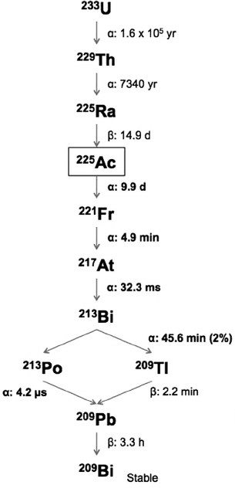
²²⁵Ac Legacy Material

Slide 42
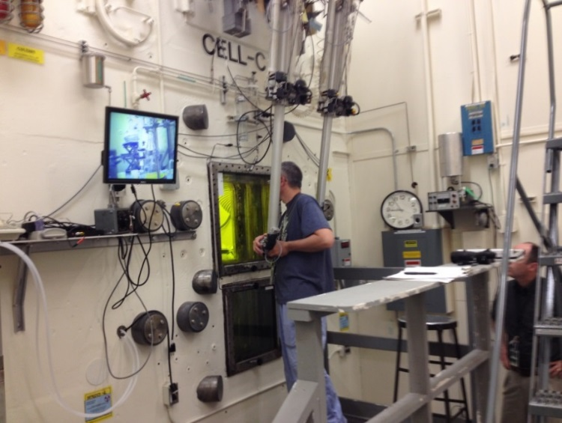
²²⁵Ac DOE Tri-Lab Project
Los Alamos National Laboratory (LANL)
Oak Ridge National Laboratory (ORNL)
Brookhaven National Laboratory (BNL)

Slide 43
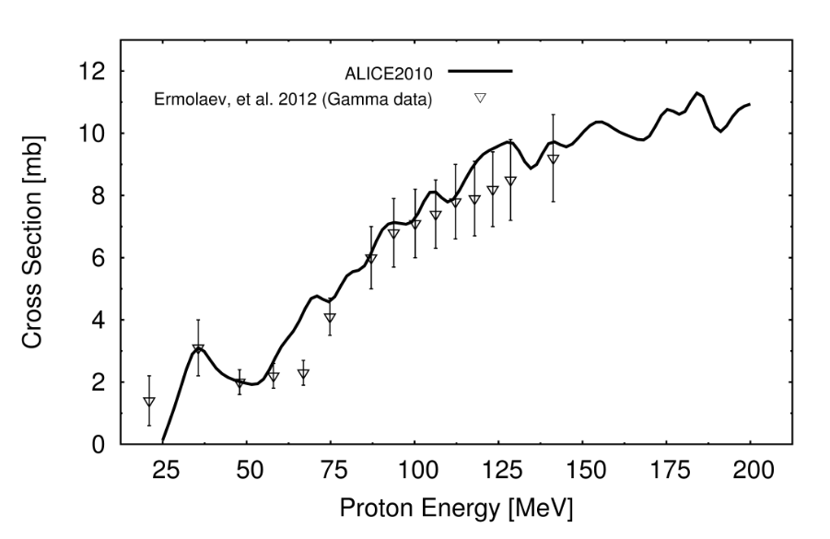
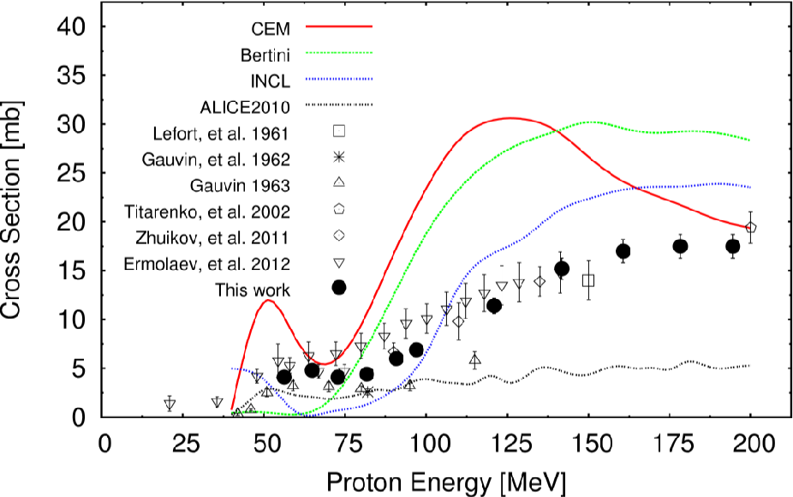
²³²Th(p,x)²²⁵Ac
Weidner et al., Applied Radiation and Isotopes, 70(11), 2012

Slide 44
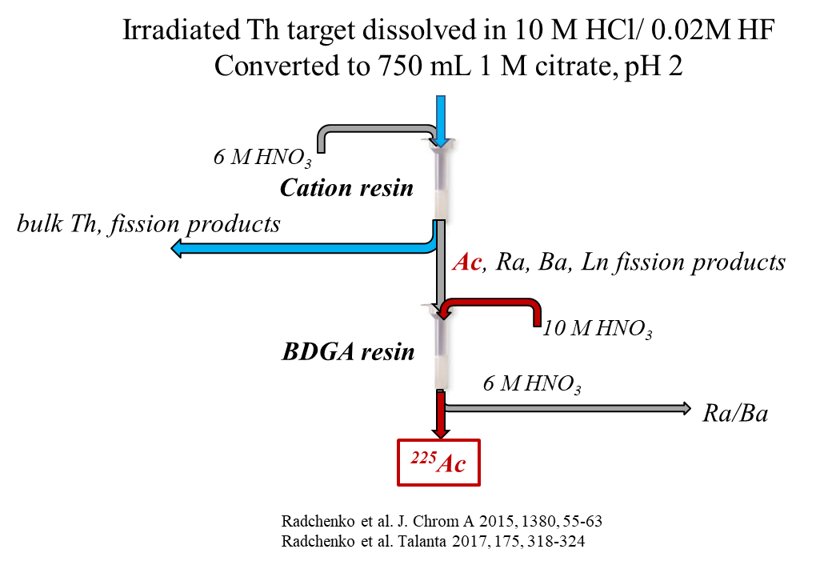
Complicated Separation Chemistry

Slide 45
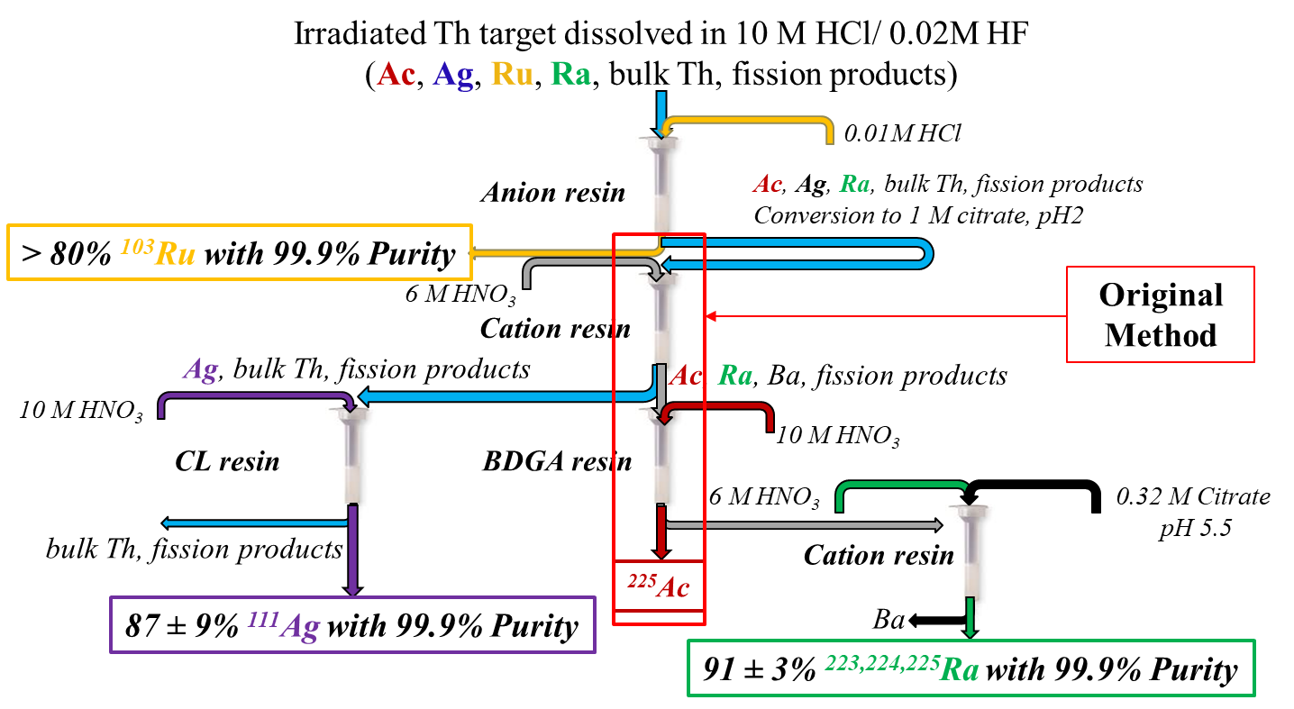
Co-production of additional radionuclides of interest
Mastren et al, Scientific Reports, 2017, 7, 8216
Mastren et al, Analytica Chimica Acta, 2018, 998, 75
Mastren et al, Plos One, 2017, 12, 12

Slide 46
Production
Facility for rare isotope beams

Slide 47
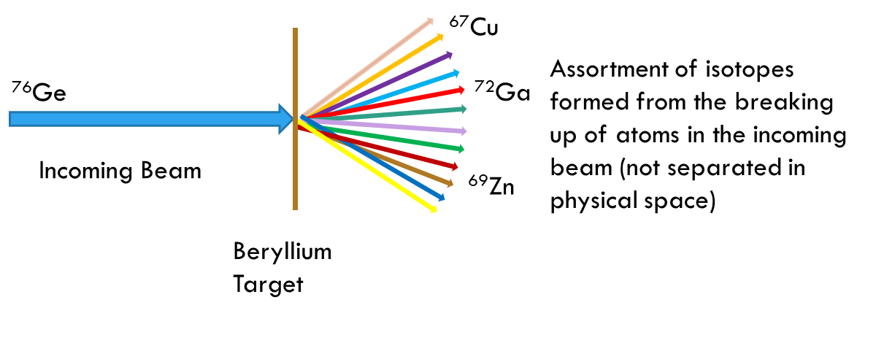
Fragmentation

Slide 48
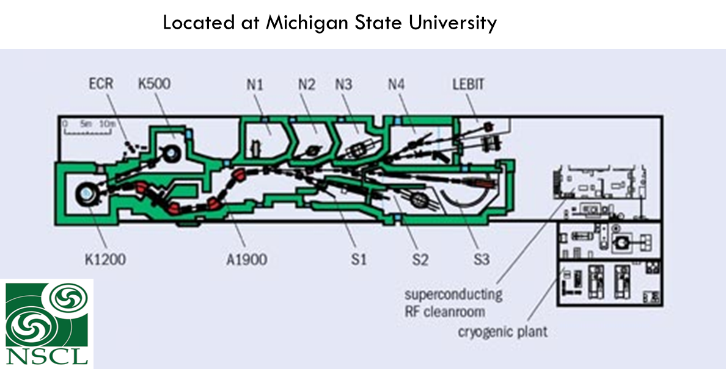
National Superconducting Cyclotron Laboratory

Slide 49
Upgrade of NSCL to FRIB
FRIB (Facility for Rare Isotope Beams)
  Broadens the energy range and types of rare isotope beams currently available.
  The beam current will increase by three orders of magnitude.
  Rare isotope beams come from primary beams of different types that are fragmented. In the process of fragmentation lots of other isotopes will be simultaneously created and available for harvest in the beam dump.
  Upgrade to FRIB will produce these isotopes in usable quantities.
  Some of these “orphan” isotopes are relevant for many scientific applications.

Slide 50
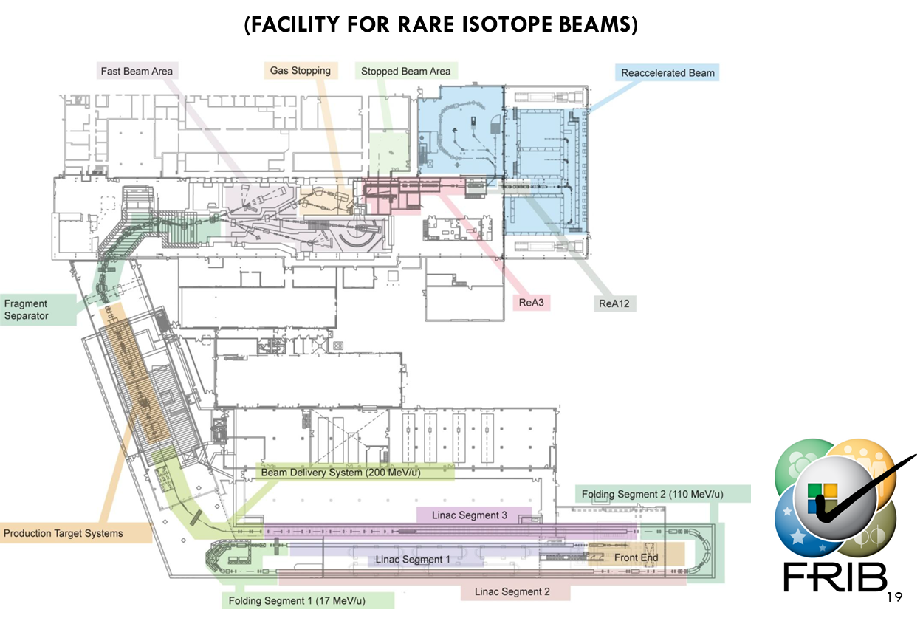
Upgrade to FRIB

Slide 51

Schematic of Proposed Secondary Beam Separator and Beam Dump at FRIB

Slide 52

Production Target and Beam Dump Area

Slide 53



End Station Build for Initial Isotope Harvesting Experiments
Multiple containers of water purged with He
System designed to serve as a mock beam dump for secondary beam collection
Water Cell w/ window
Beam
Gas exit manifold
Collection Bottles on rotating carousel
Pen, A. et al, NIM A, 2014, 747, 62-68

Slide 54
Isotopes of Interest
*A range of Eu isotopes are of interest, A~147 – 154.
Isotope | Decay Mode | Half-life | Application
³²Si | ^{β-, 221keV no γ} | 162y | Tracer; geology, botany
⁴⁴Ti | ^{ε, γ-78.3, 67.8keV} | 59.2y | Medicine, astrophysics, Nuclear Structure
⁴⁸V | ^{β+, 694keV} ^{γ-983.5, 1312.1keV} | 15.98d | Stockpile Stewardship, Medicine
⁶⁷Cu | ^{β-, 390, 480, 580keV} ^{γ-184.6keV} | 2.6d | Medicine
⁸⁵Kr | ^{β-, 687keV} ^{γ-514.0keV} | 10.76y | Astrophysics, Stockpile Stewardship
Eu* |  | 24d-37y | Stockpile Stewardship
²¹¹Rn | ^{γ-674.1, 1363.0, 678.4keV} ^{α-5.784,5.851MeV} | 14.6h | Medicine
²²⁵Ra | ^{β-, 320keV} γ-40.3keV | 14.9d | Medicine, Electric Dipole Moment
²²⁵Ac | ^{α-5.829, 5.793, 5.731MeV} | 10.0d | Medicine

Slide 55
Isotope Harvesting
Similar to high energy proton irradiation of thorium, various radionuclides will be present in beam dump
Isotope harvesting currently in developmental stages
Curie levels of activity
They are working to incorporate isotope harvesting into the future FRIB facility
FRIB completion expected in 2022

Slide 56
Questions?

Slide 57
Thank you for your attention!!!

