Slide 1
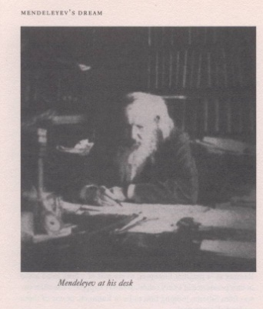
Nuclear Alchemy: The Sorcery of Making New Elements and the Quest for the Island of Stability
Exotic Beam Summer School
June 25, 2019
Mark A. Stoyer

Slide 2
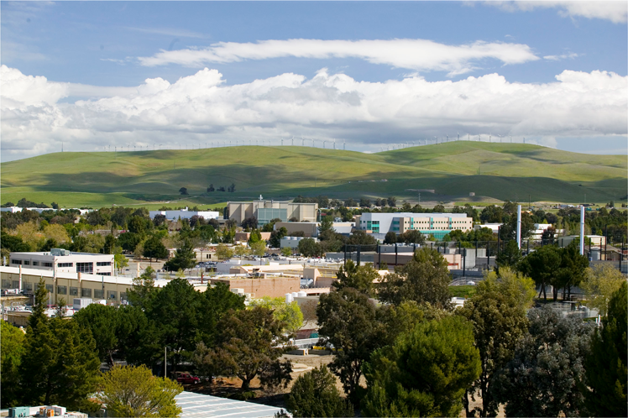

Where is Livermore?
Established 1952
One of three national security laboratories in the US – applied science lab
Managed for the US Department of Energy by a private consortium of companies
~8000 employees
~$2B annual budget
1 mile² in area (2.6 km²)
19 hour time difference currently
LLNL
8000 miles away from Canberra!
12875 km away from Canberra!

Slide 3
What is the definition of a chemical element?
A) A substance that cannot be separated by chemical processes into simpler substances
B) Atoms having the same number of electrons
C) Atoms having the same number of neutrons
D) Atoms having the same number of protons
Answer: A or D

Slide 4
How would you “discover” a new element?
A) Combine a bunch of chemicals in a test tube and chant special incantations while heating with a Bunsen burner
B) Chemically process tons of dirt/ore
C) Use a nuclear reaction
D) Look for spectral lines in the galaxy using x-ray and gamma-ray detectors
Answer: C, but all have been tried

Slide 5
What nuclear reaction would you try to make element 118?
A) ⁸⁶Kr + ²⁰⁸Pb → 1n + ²⁹³118
B) ¹⁴¹Pr + ¹⁴¹Pr → 2n + ²⁸⁰118
C) ⁴He + ²⁹³116 → 3n + ²⁹⁴118
D) ⁴⁸Ca + ²⁴⁹Cf → 3n + ²⁹⁴118
Was tried but cross-section << 1 fb!
Coulomb barrier and neutron deficiency work against
Can’t get target material
Answer: D

Slide 6

Mendeleev’s 1869 periodic table enabled a quantum leap in chemical understanding
Mendeleyev used this new tool to predict the existence of chemical elements that hadn't been discovered yet; they were found several years later

Slide 7
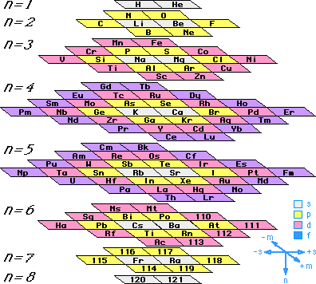
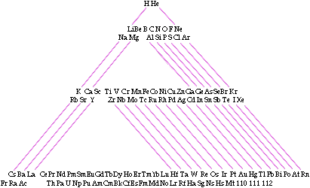
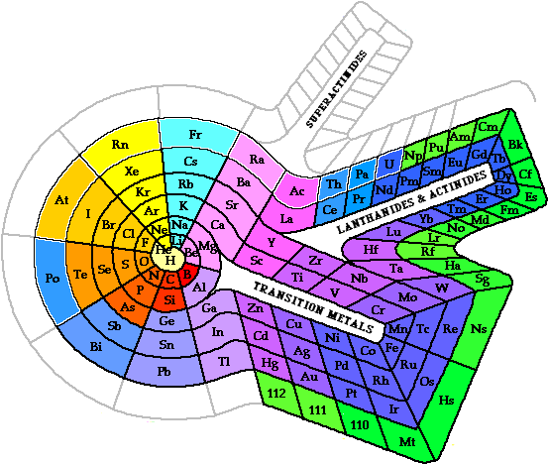
Now there are a variety of ways to visualize chemical periodicity
g-orbitals are predicted to start filling at Z=120!

Slide 8
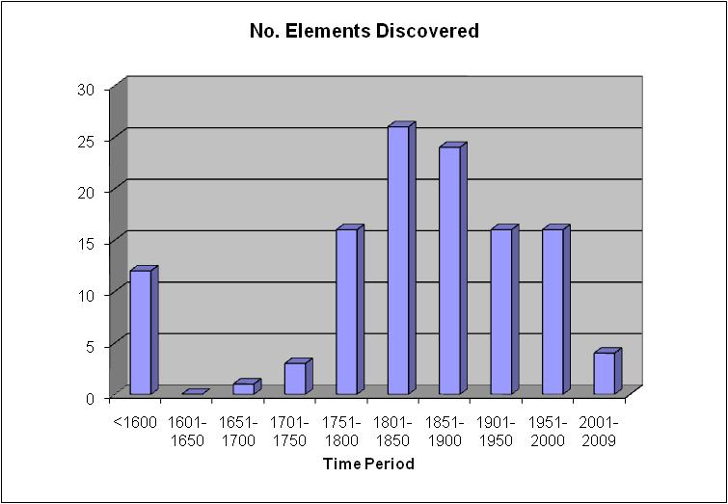
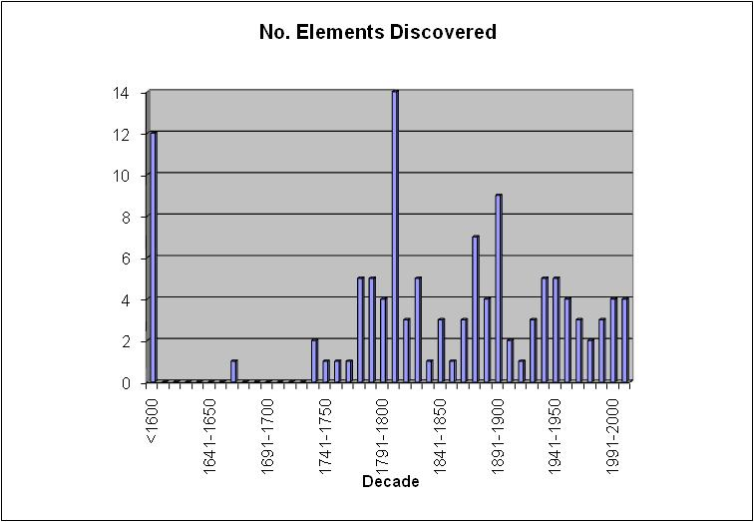
New element discovery has progressed steadily since the 1700’s
On average, just under 20 elements have been discovered every half-century
On average, about 4 elements have been discovered every decade

Slide 9
Laboratories have tended to discover a series of consecutive elements in recent history (1940 – 2010)
LBL discovered elements 93, 94, 95, 96, 97, 98, 101, 103, 104, 105, 106
Argonne/LANL discovered elements 99 and 100
GSI discovered elements 107, 108, 109, 110, 111, 112
Dubna/LLNL now finding evidence for elements 113, 114, 115, 116, 117 and 118
Names for element 114 (flerovium, Fl) and 116 (livermorium, Lv)
Discovery requires confirmation, preferably by another experimental group

Slide 10
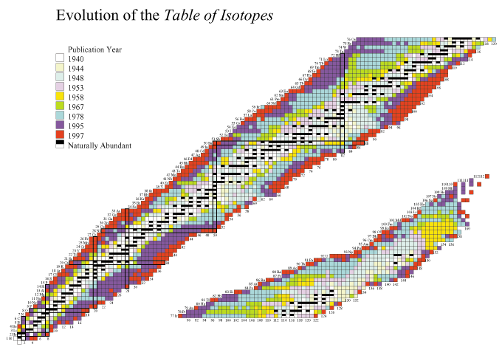
New isotope discovery has been rapid since the mid-1900’s and routinely operating particle accelerators
Z
This talk will focus here
N

Slide 11
Our current knowledge of the upper end of the chart of nuclides (2019)

Slide 12
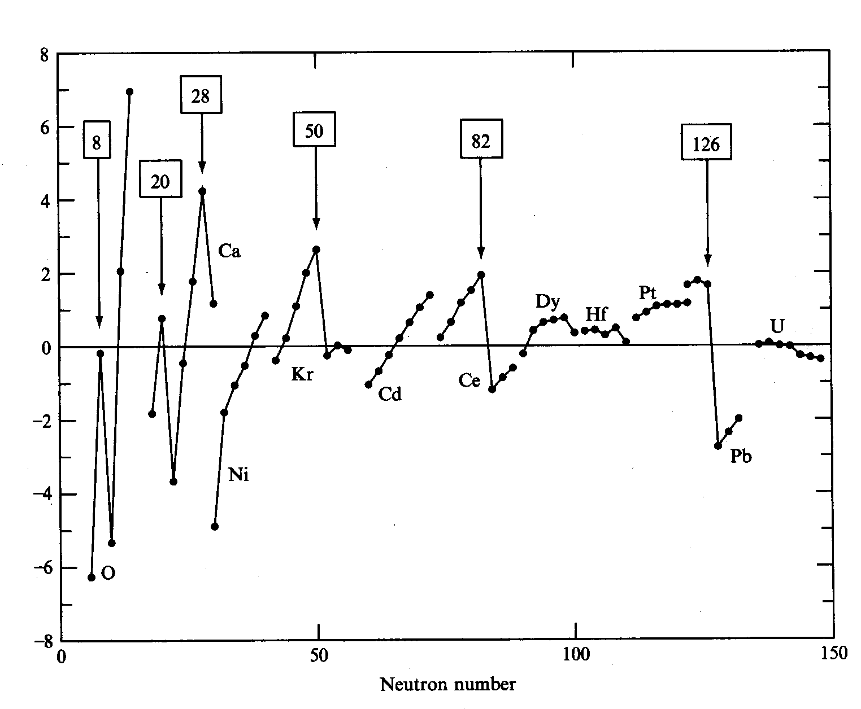
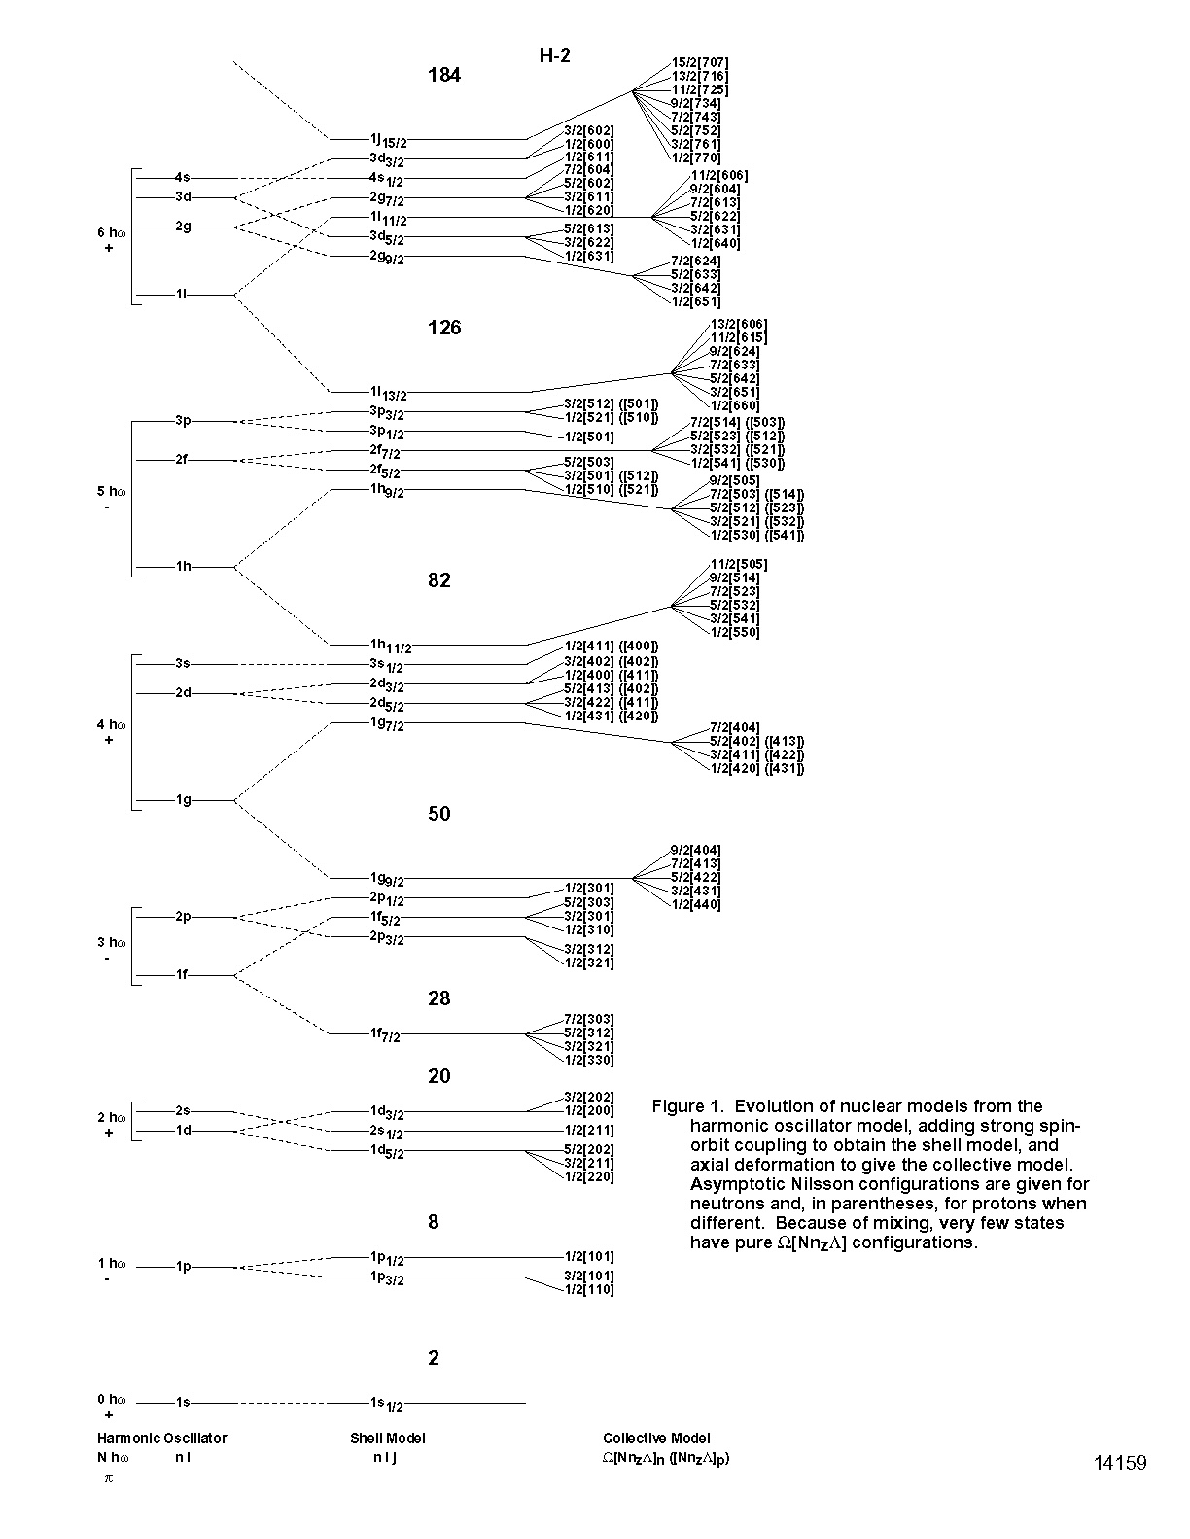
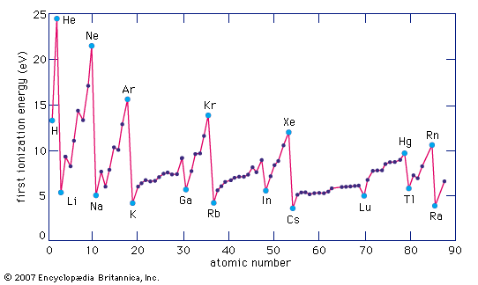
The existence of certain “magic” numbers of neutrons or protons has been known for nuclei, prompting the development of the shell model and analogies to filled electronic orbits in chemistry
2-neutron separation energies

Slide 13
Are “magic” numbers universal throughout the chart of nuclides?
A) Yes – they are 2, 8, 20, 28, 50, 82, 126, 184 …
B) No – Because of the complex interactions between nucleons in the nucleus, they change with different ratios of protons/neutron
Answer: B

Slide 14
Scientists tried unsuccessfully for 40 years to find the “Island of Stability”
peak of

Slide 15
Nuclear theory at Berkeley, circa 1969
Proton number
Neutron number

Slide 16
Nuclear theory in the Soviet Union, circa 1969

Slide 17
Modern nuclear theory has done a much better job at modeling superheavy nuclei (and suspect with this new data models will improve)
(Latest calculations are a bit more ambiguous about the location of the closed proton shell, some models indicate Z=114, Z=120 or even Z=126—all indicate N=184)

Slide 18
The results of the predictions enabled us to plan experiments in this region

Slide 19
The heaviest known nuclei (ca 1998), superimposed on the calculated shell corrections to the liquid drop model
Note the variety of production mechanisms used to make new elements!

Slide 20
Typical techniques for producing Heavy Elements or SHE
Most facilities use heavy ion accelerators to bombard targets and produce fusion/evaporation residues for further study, although transfer reactions are sometimes possible
  “Cold Fusion” reactions (e.g. ⁷⁰Zn + ²⁰⁸Pb)
  “Hot Fusion” reactions (e.g. ⁴⁸Ca + ²⁴³Am)
Separation of “Goodies” from unwanted products
  Separators like DGFS, BGS
  Separators like VASSALISSA, SHIP
  Advanced separators (MASHA …)
  Fast and/or automated chemistry
Detection and identification of “Goodies”

Slide 21
The Dubna gas-filled separator uses a combination of chemistry and physics to suppress unwanted reaction products

Slide 22
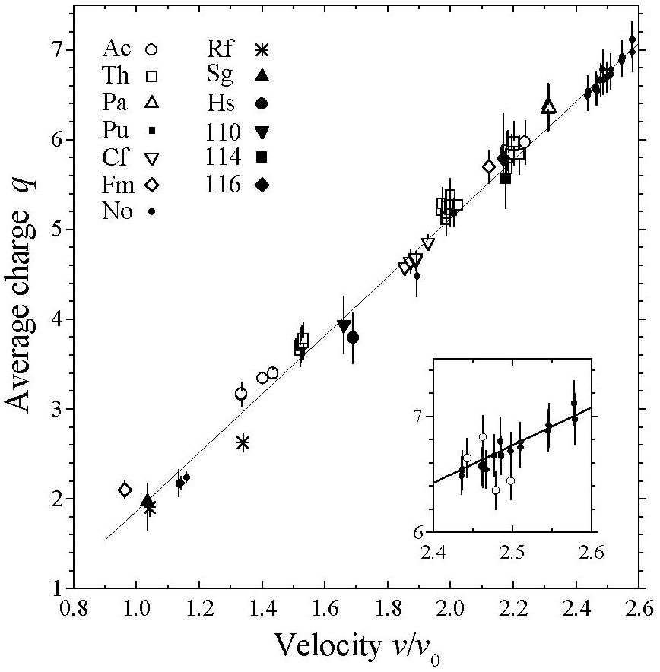
Average charge state measurements of evaporation residues in hydrogen define the separator dipole current for these experiments
114 and 116
An interesting interplay between chemistry and physics!

Slide 23
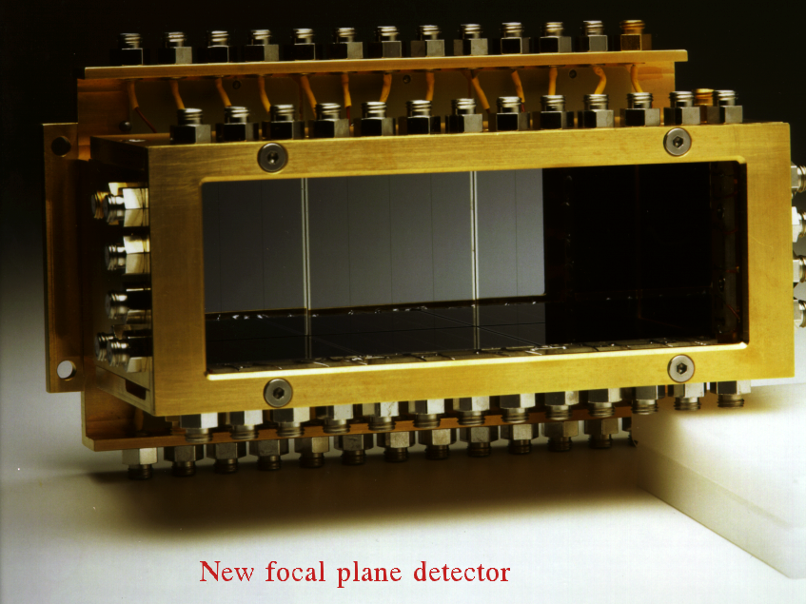
The high-efficiency detector system
The addition of the top, bottom, and side detectors increased the geometry for
counting α particles from 50% to 87%.
Veto detectors mounted behind the focal plane were used to identify and reject
light charged particles passing through the separator.

Slide 24
Experimental details of the first 116 experiment
Experiment performed at U400 cyclotron in Dubna, Russia (JINR)
Beam was ⁴⁸Ca – a rare isotope of Ca and the most neutron-rich (note that this nucleus is doubly magic—Z=20 and N=28)
Target was ²⁴⁸Cm electroplated on a wheel – total of ~20 mg
Beam time was between June-July, Nov.-Dec 2000 and Jan, Apr-May 2001
2.3 × 10¹⁹ particles delivered at beam energy of 238 MeV (note that the total number of delivered ⁴⁸Ca ions was 2.3 × 10¹⁹ or 1.8 mg) – Beam was switched off when an interesting EVR-α event was recorded
The Dubna gas-filled separator was used to reduce the unused beam, transfer reaction products, and other background—the separator had an efficiency of ~35-40%
Evaporation residues were implanted in a detector and decay events were detected—the detector system had an efficiency of ~87%
The predicted cross-section was ~ 1 pb
PRC 63 (2000) 011301(R)
EPJA 15 (2002) 201
We observed 3 events consisting of position correlated EVR implants, alpha-decays, and terminated by SF

Slide 25
The first Lv experiments yielded the following decay chains

Slide 26
The decay chains compared very well with what we knew from earlier Fl (element 114) experiments

Slide 27
Lv video

Slide 28
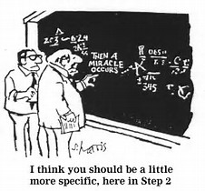
And then some time passes, with lots more experiments around the world …
13 years

Slide 29
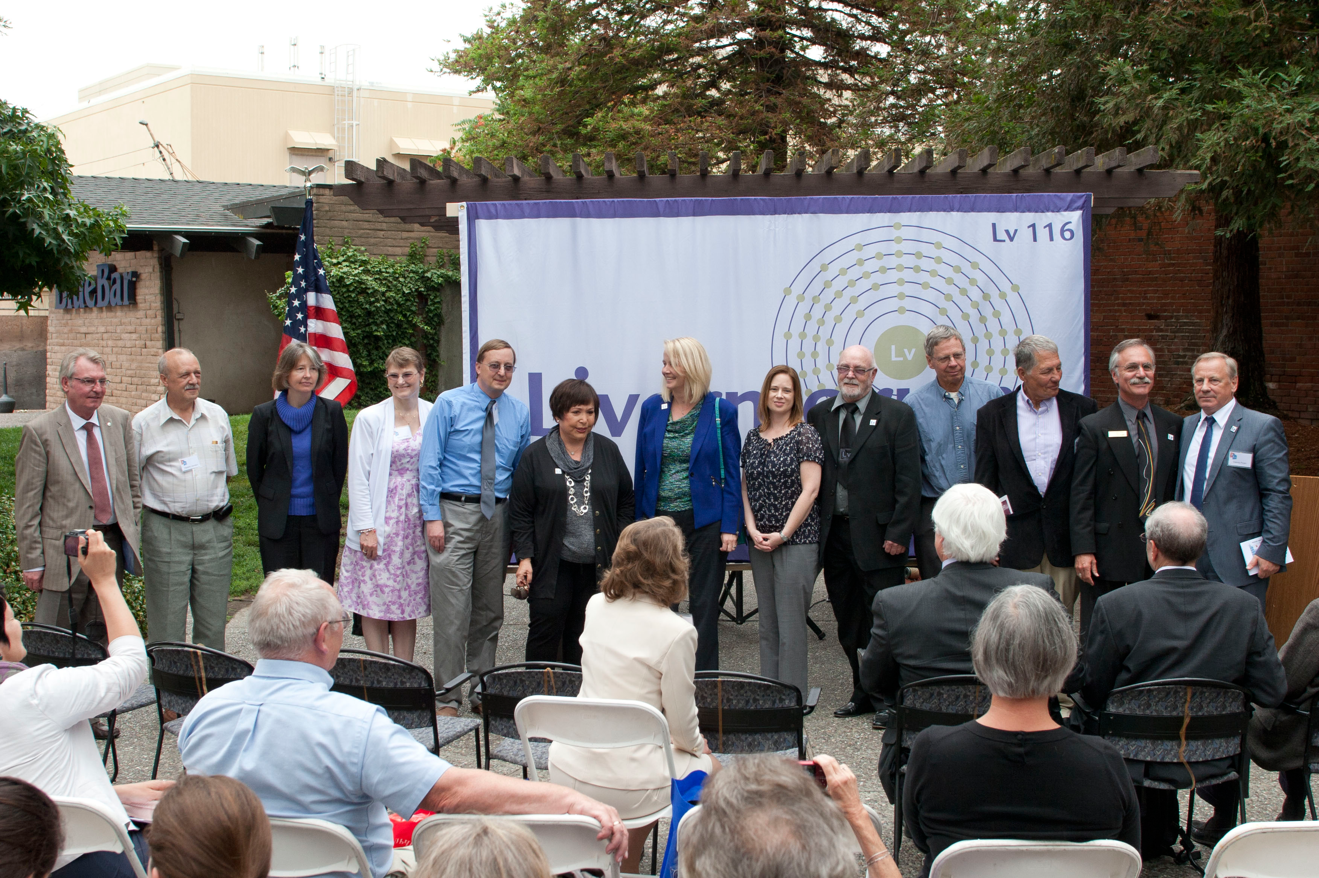
We celebrated naming a new element Livermorium with the Mayors of Dubna and Livermore
May 30 declared Livermorium day
June 24, 2013 celebration

Slide 30
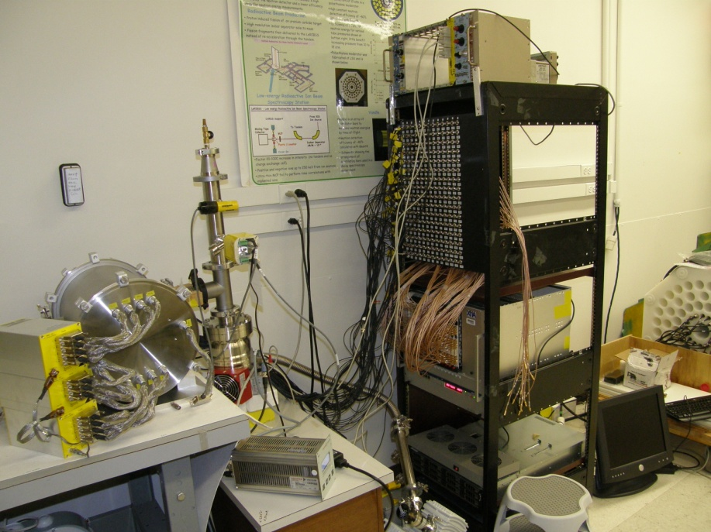
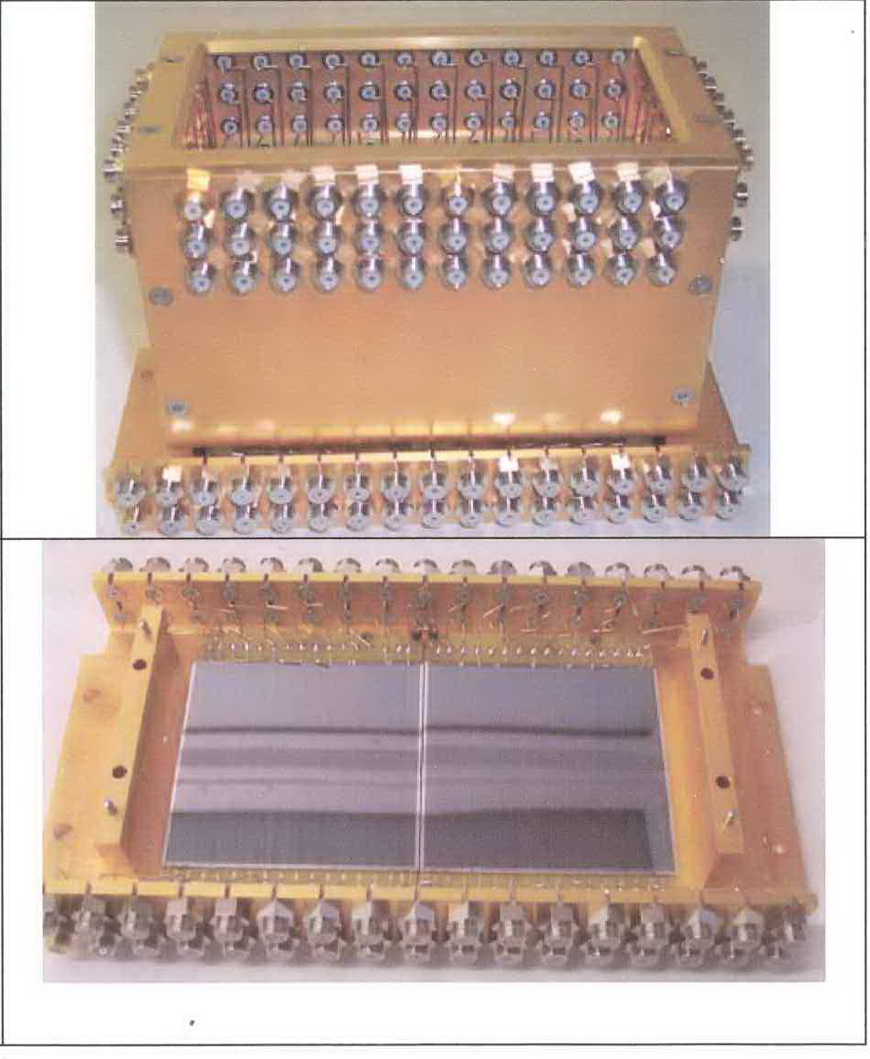
A new detector has been installed at the DGFRS focal plane
New digital electronics being tested at HRIBF and to be implemented soon in Dubna by ORNL
The new detector is comprised of 6 × 6 cm² 16–strip Si DSSD detectors. Because the focal plane detector is larger the side detectors are also larger—the net result is that the detection efficiency is the same as the prior detector ~87%

Slide 31
Experimental details of the 117 experiment
Experiment performed at U400 cyclotron in Dubna, Russia (JINR)
Beam was ⁴⁸Ca – a rare isotope of Ca and the most neutron-rich (note that this nucleus is doubly magic—Z=20 and N=28)
Target was ²⁴⁹Bk electroplated on a wheel – total of ~15 mg (note that this corresponds to 25 Ci of activity) [Note t_{1/2} = 320 d!!!!]
Beam time was between 7/27/09 and 2/25/10—a total of ~150 days
2.4 × 10¹⁹ particles delivered at beam energy of 252 MeV and 2 × 10¹⁹ particles delivered at beam energy of 247 MeV (note that the total number of delivered ⁴⁸Ca ions was 4.5 × 10¹⁹ or 3.6 mg) – Beam was switched off when an interesting EVR-α event was recorded
The Dubna gas-filled separator was used to reduce the unused beam, transfer reaction products, and other background—the separator had an efficiency of ~35-40%
Evaporation residues were implanted in a detector and decay events were detected—the detector system had an efficiency of ~87%
The predicted cross-section was ~ 1 pb
PRL 104 (2010) 142502
We observed 6 events consisting of position correlated EVR implants, alpha-decays, and terminated by SF

Slide 32
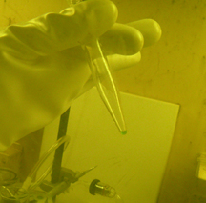
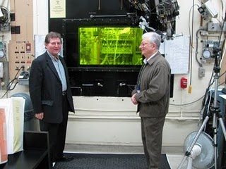
Target material was fabricated at ORNL HFIR
22.2 mg ²⁴⁹Bk (36 Ci) was produced by irradiating Cm/Am for 250 days in highest flux reactor as a by-product of ²⁵²Cf production
Neutron flux was ~ 4 × 10¹⁵ n/cm²/s
After purification, less than 1.7 nCi ²⁵²Cf remained in sample

Slide 33
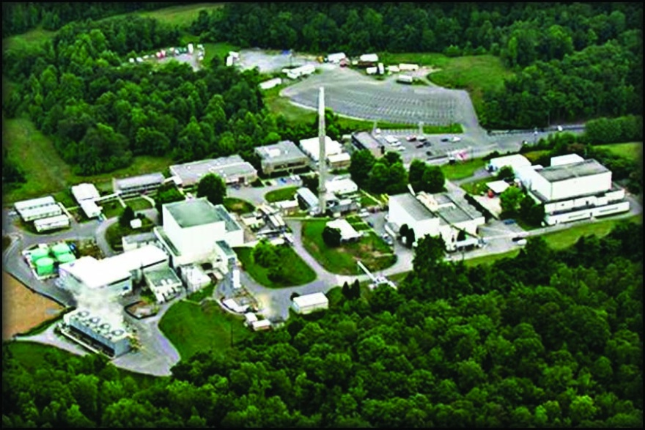
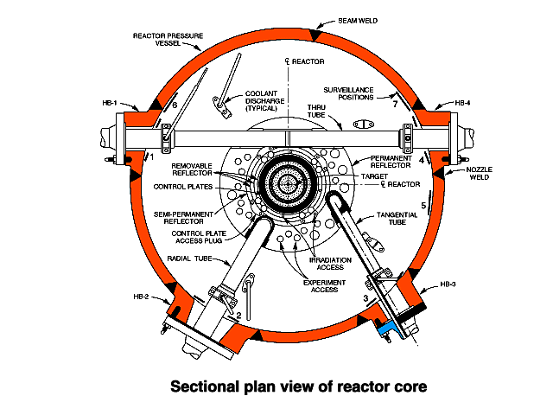
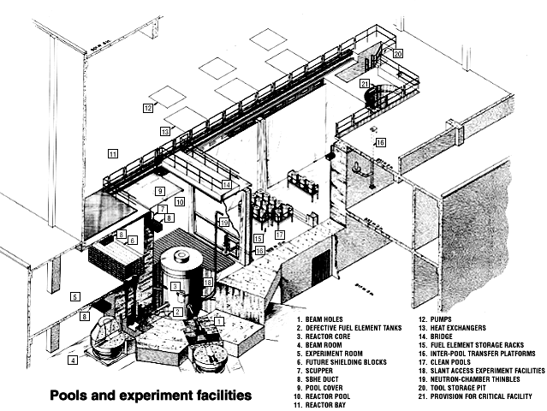
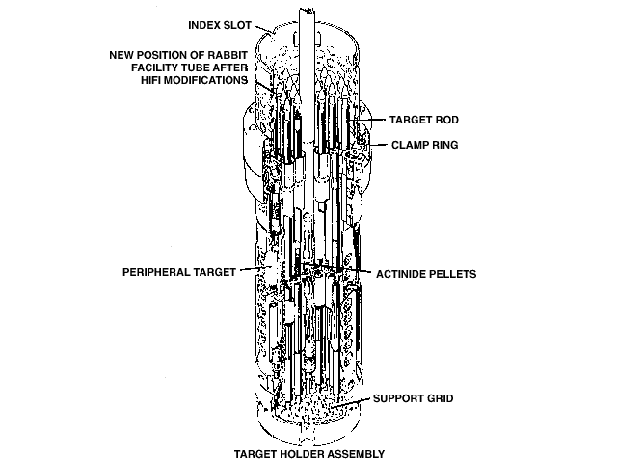
Oak Ridge High Flux Isotope Reactor

Slide 34
This experiment took an incredible amount of international coordination, extraordinary patience, and 2 years to perform!
PRL publication April 9, 2010
Third time’s the charm—shipping to Russia
150 days of accelerator bombardment
90 day cooling of irradiated material
Arrangements to obtain ²⁴⁹Bk as a side-fraction of ²⁵²Cf production for oil industry
Data analysis, random probability analysis
Target wheel fabrication in Dmitrovgrad
Jan 2008
Apr 2008
Jul 2008
Oct 2008
Jan 2009
Apr 2009
Jul 2009
Oct 2009
Jan 2010
Apr 2010
Bk/Cf separation chemistry and Bk purification
Target wheel is ~ 50:50 ²⁴⁹Bk:²⁴⁹Cf
250 day irradiation of Am/Cm targets in ORNL HFIR
Late 2004, proposed ⁴⁸Ca + ²⁴⁹Bk experiment, but target material not available

Slide 35
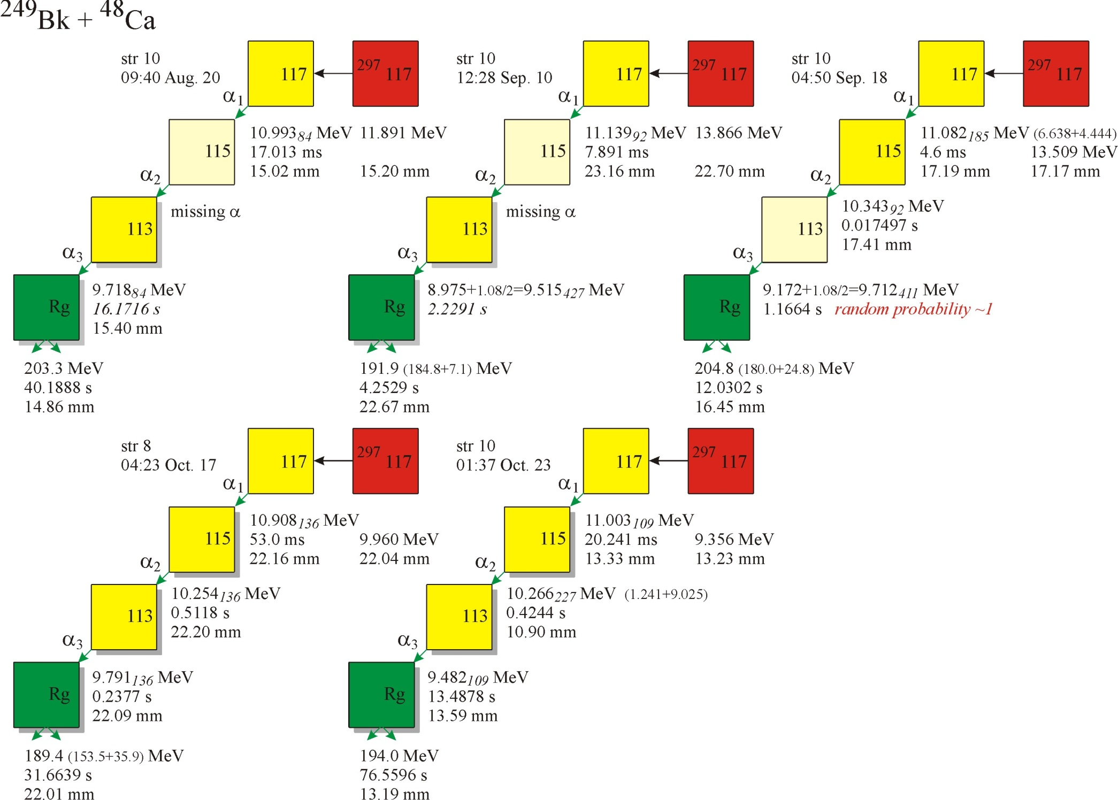
Interpreted as the 4n-evaporation channel -- ²⁹³117
Detector strip event occurred in
Time event occurred (Russian Standard Time)
Alpha decay energy
Implant energy
Vertical position in strip
Side detector only alpha decay energy
Time since preceding event
Fission energy
Alpha decay energy deposited in two detectors (focal plane and side det)
Fission energy deposited in two detectors (focal plane and side det)
252 MeV beam energy

Slide 36
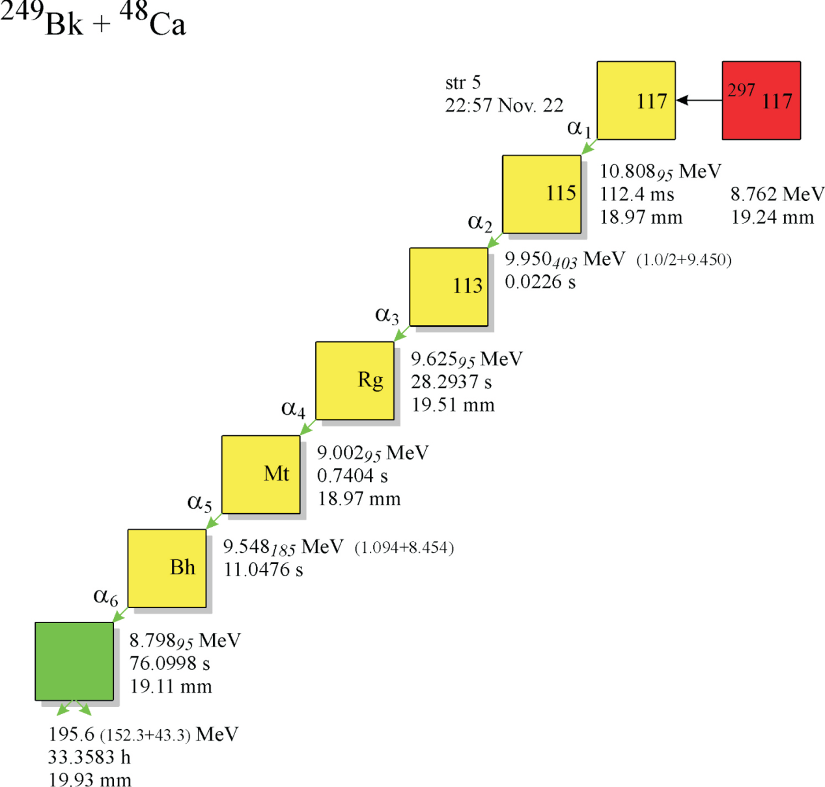
Interpreted as the 3n-evaporation channel -- ²⁹⁴117
May be missing α decays because beam came on
247 MeV beam energy

Slide 37
Decay properties of nuclides observed in element 117 experiments

Slide 38
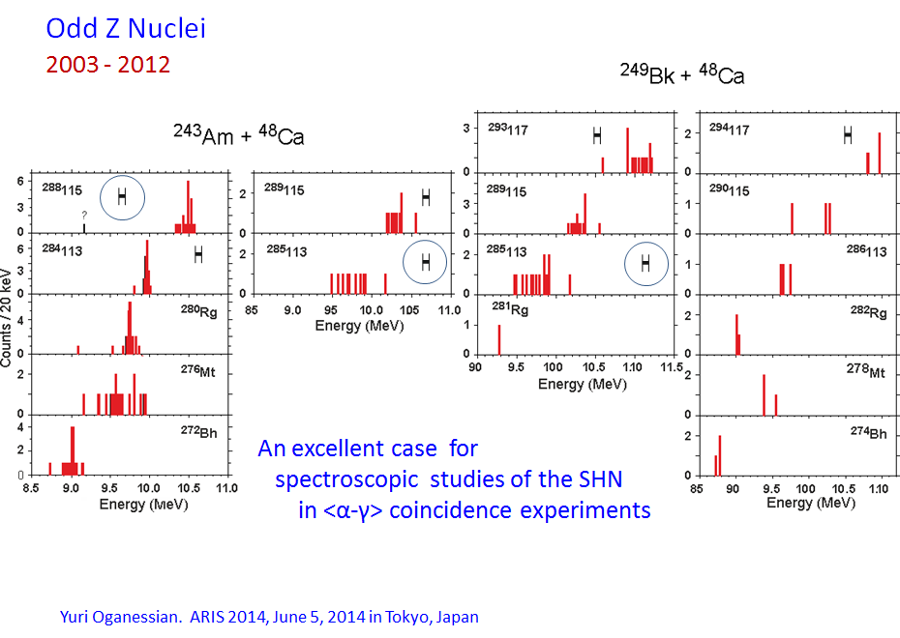
Odd-Z nuclei exhibit broader alpha energy spectra indicative of decay to excited states

Slide 39
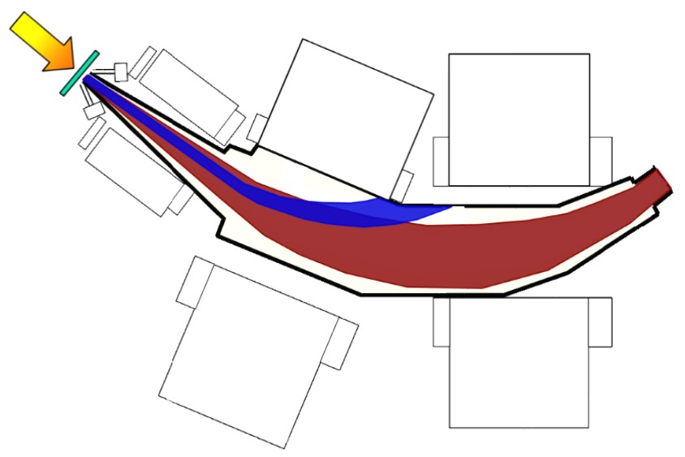







Decay Spectroscopy of Element 115 - Setup
Beam
Courtesy J. Gates
Target
Beam + Everything Else
+ γ-ray
detectors
Transfermium Elements
Berkeley Gas-filled Separator

Slide 40
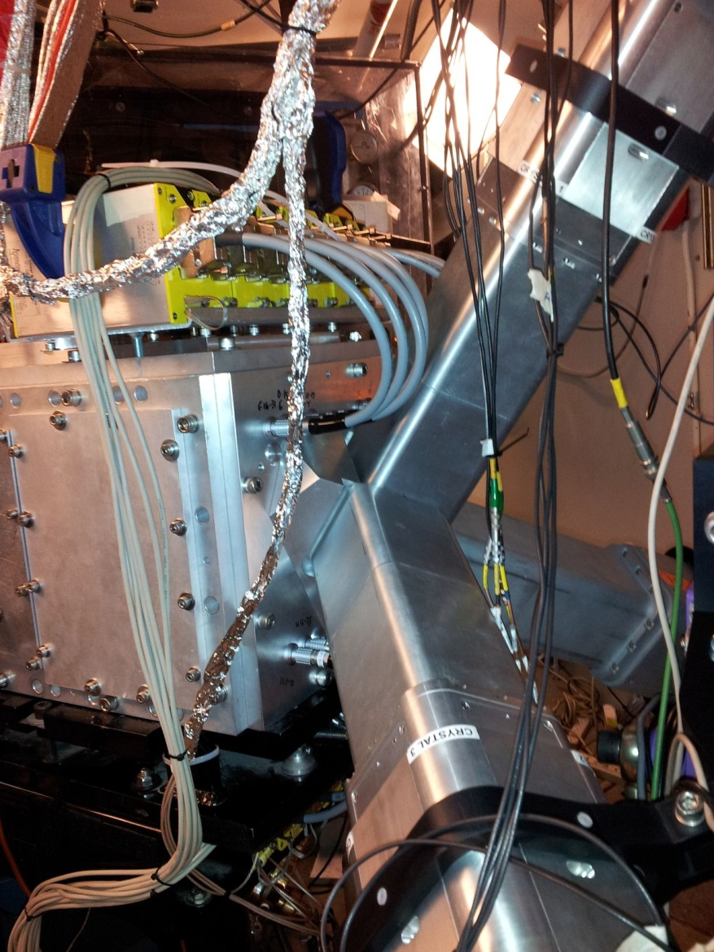
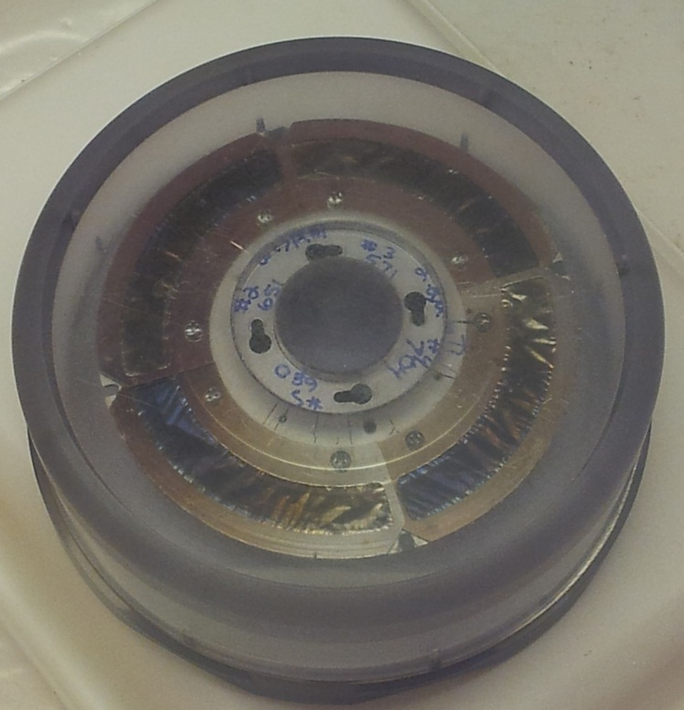
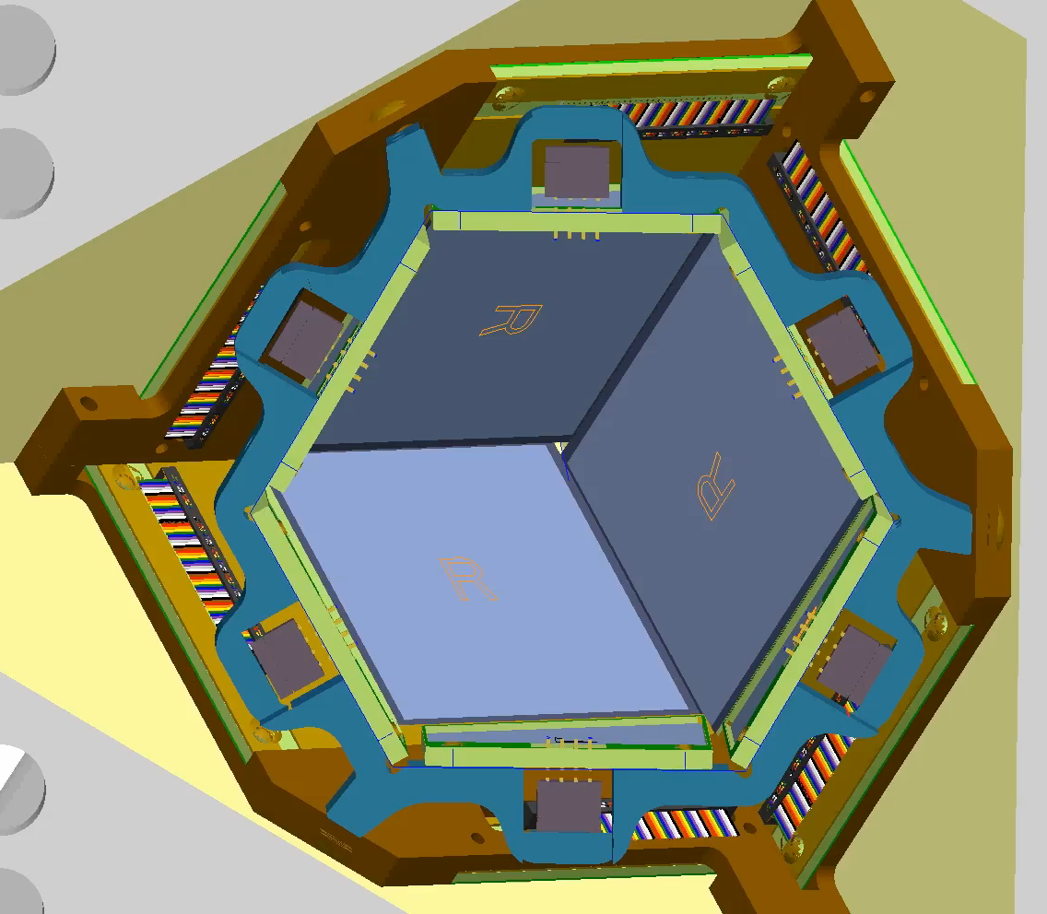
Decay Spectroscopy of Element 115 - Setup
BGS upgrades:
²⁴³Am targets
C³ detector with HPGe stand
Differential pumping system to replace carbon window
Courtesy J. Gates
²⁴³Am₂O₃ targets
C³ detector
Germanium detectors

Slide 41
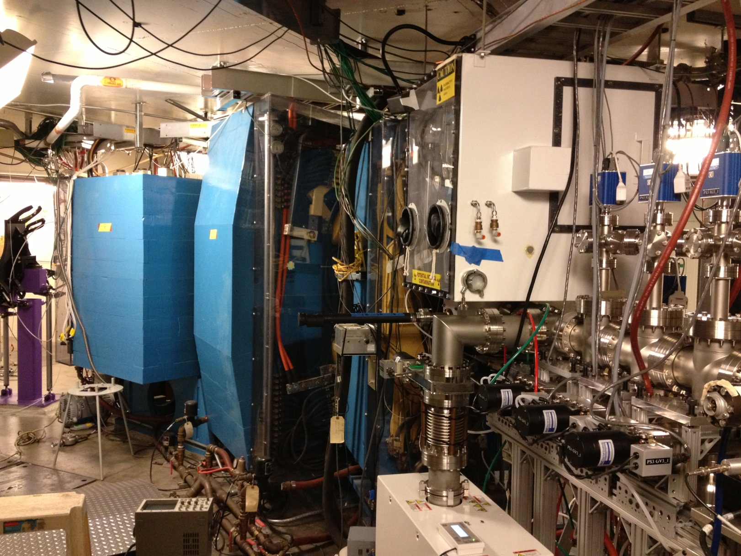
Decay Spectroscopy of Element 115 - Setup
Courtesy J. Gates

Slide 42
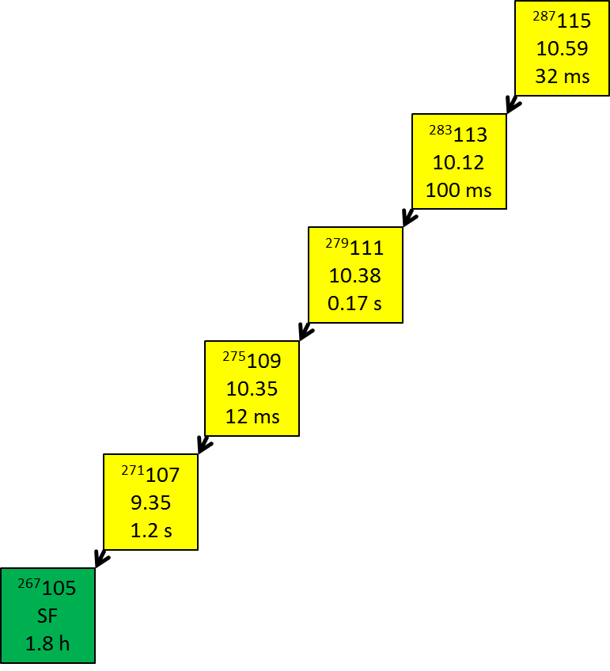
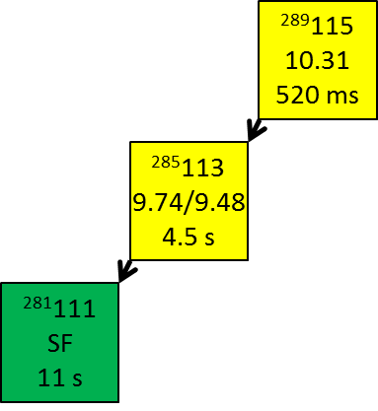

Decay Spectroscopy of Element 115 - Concept
observing γ- and x-rays in coincidence with α-particle decays would provide nuclear structure information about superheavy elements
⁴⁸Ca + ²⁴³Am experiment ran from April-June 2013
Average beam intensity on target was 1 pμA
  x3 increase over maximum beam intensities in 2012
Element 115 decays were observed at the rate of one event per day
43 decay chains observed matching Dubna decay properties
  3n chains = 40; 2n chains = 3
Several α-photon coincidences were observed
Courtesy J. Gates
4n 3n 2n
Published decay properties from
Oganessian et al.
PRC 87 (2013) 014302

Slide 43
Alpha particle spectra compared between experiments and simulations
²⁸⁰Rg
²⁷⁶Mt

Slide 44
Alpha-particle-gamma-ray coincidences reveal low lying structure of ²⁷⁶Mt

Slide 45
Alpha-particle-gamma-ray coincidences reveal low lying structure of ²⁷²Bh

Slide 46
Simple level schemes of ²⁷⁶Mt and ²⁷²Bh

Slide 47
The observed photon spectrum is not convincingly consistent with x-rays

Slide 48
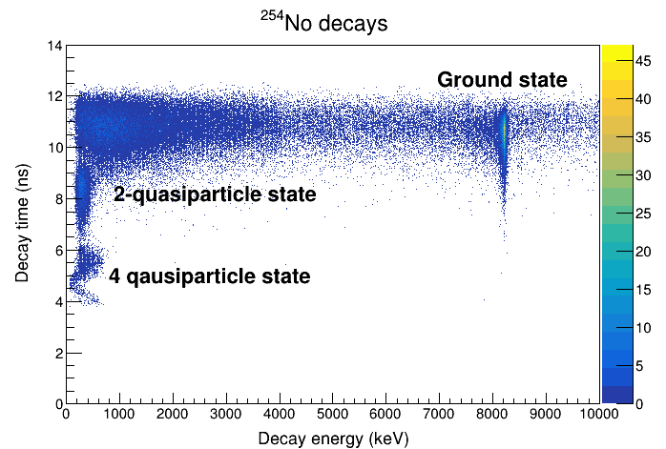
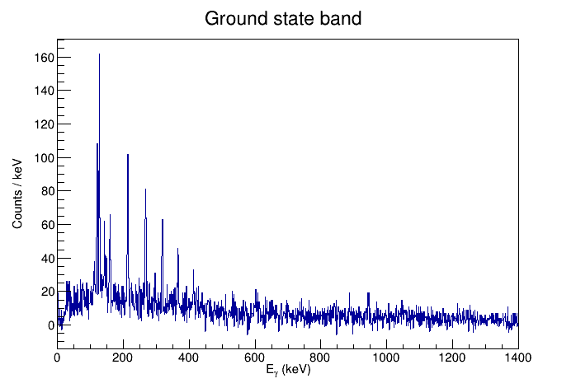
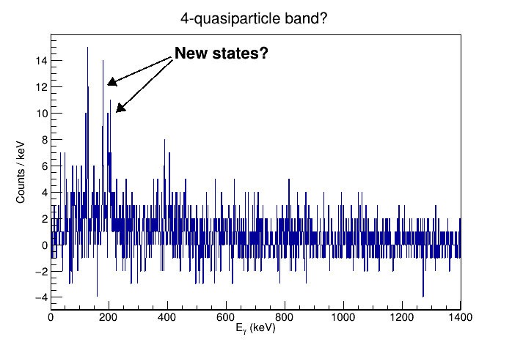
New gas-filled separator (AGFA) coupled with Gammasphere at ANL investigated the nuclear structure of ²⁵⁴No in great detail

Slide 49
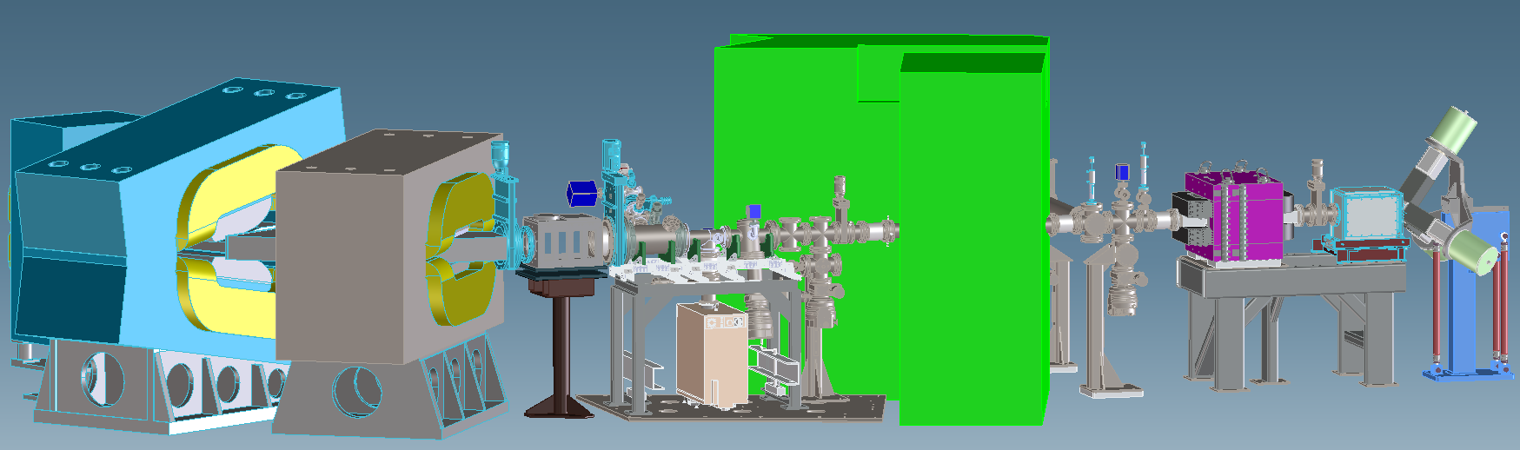
Courtesy of Ken and Jackie
Experimental Measurement of Superheavy Element Mass Numbers
Ken Gregorich (LBNL, retired) Jenn Pore (LBNL)
Jacklyn Gates (LBNL) Jeff Kwarsick (UCB, LBNL)
Gregory Pang (LBNL, former) Mejdi Mogannam (UCB)
Guy Savard (ANL) Mark Stoyer (LLNL)
New FIONA capability:
Low energy (5kV)
mass-separated isotopes
delivered to a low background region
on a 10-ms time scale
Mass Analyzer
disperse products
by A/q
We’ve been working on the new apparatus since February 2015.
Our headline SHE experiment was carried out in May-June 2018.
6 ft
Accelerator
accelerate to 10 kV
Shielding Wall
allow detection in low-background environment
Berkeley Gas-filled
Separator
Produce heavy element isotopes,
separate from beam and
other nuclear reaction products
RF Gas Catcher
stop ions He gas,
RF and DC E-fields direct ions to an exit orifice
RF Quadrupole Trap
bunch and cool ions,
re-accelerate and transfer to mass analyzer
Detector Station
^{A}Z from α-decay
mass from x-position
lifetime from y-position

Slide 50
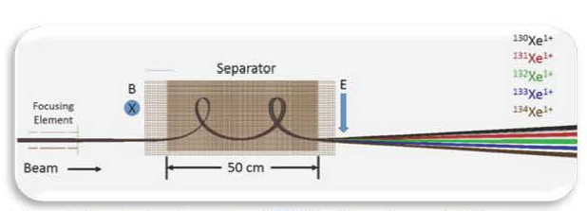
Courtesy of Ken and Jackie
FIONA, a Trochoid M/q Separator
Ion trajectories in crossed magnetic and electric fields are trochoids
The period (temporal and precession) of the trochoid is defined by M/q: independent of velocity
Separation is based on the phase of the of the trochoid upon exiting the device
Many modes of operation with different M/q dispersion
Two-loop mode has M/q resolution > 250 efficiency >70% dispersion = 20mm/(%M/q)
Calibration method accurate to 0.5 mm

Slide 51
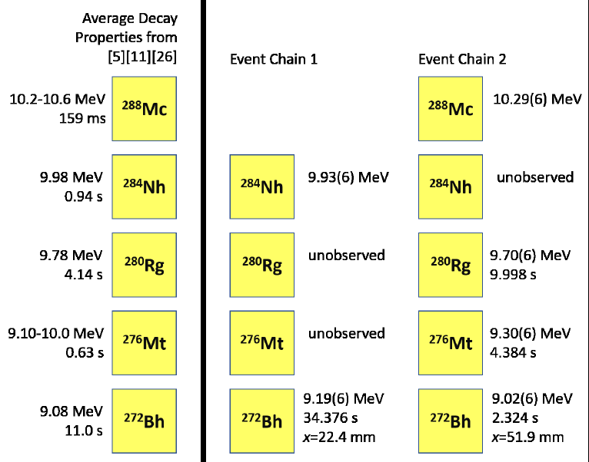
Courtesy of Ken and Jackie
Two decay chains originating from ²⁸⁸Mc were observed
For the first decay chain, ²⁸⁸Mc decayed inside the Gas-Catcher
Observed decay energies and lifetimes unambiguously show that these decay chains originate from what had previously been assigned to ²⁸⁸Mc
Background rates were extremely low
(we are NOT at the BGS focal plane!),
So the probability that these are random correlations of unrelated events is extremely low (<0.03 random two-member chains expected
<10⁻⁵ random 3-member chains expected)
²⁸⁸Mc
decayed in
gas catcher

Slide 52
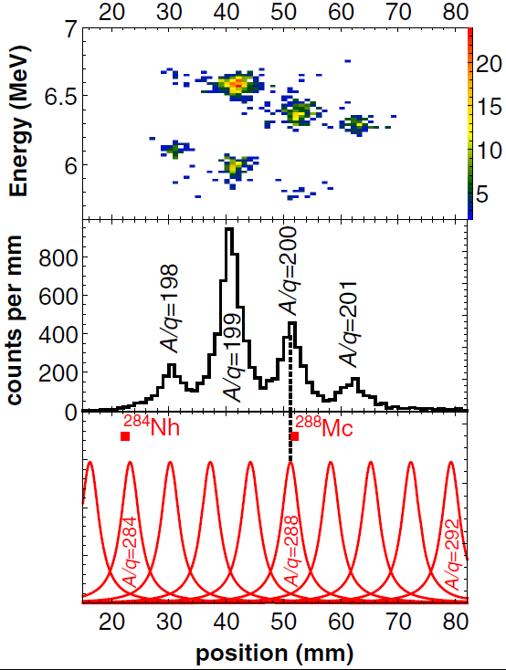
Courtesy of Ken and Jackie
How good is the A/q measurement?
¹⁹⁸At
¹⁹⁹At
²⁰⁰At
¹⁹⁸⁻²⁰¹At measured before and immediately after ²⁸⁴Nh and ²⁸⁸Mc
Fits to At used to determine
M/q peak centroids (positions)
Lorentzian M/q peak width
M/q dispersion
These are used to determine expected SHE M/q peak positions & shapes
Single-event M/q assignment probabilities can be read directly:
M/q chain1 M/q chain2
283 13% 287 7%
284 81% 288 83%
7% 289 10%
Applying the constraint that these two M/q values differ by 4 units (both originating from the same isotope with the first member of the first chain decaying in the Gas Catcher)
we arrive at a
M/q=284,288 confidence level of 97.6%.
²⁰¹At
¹⁹⁸Po
¹⁹⁹Po
²⁰⁰Po

Slide 53
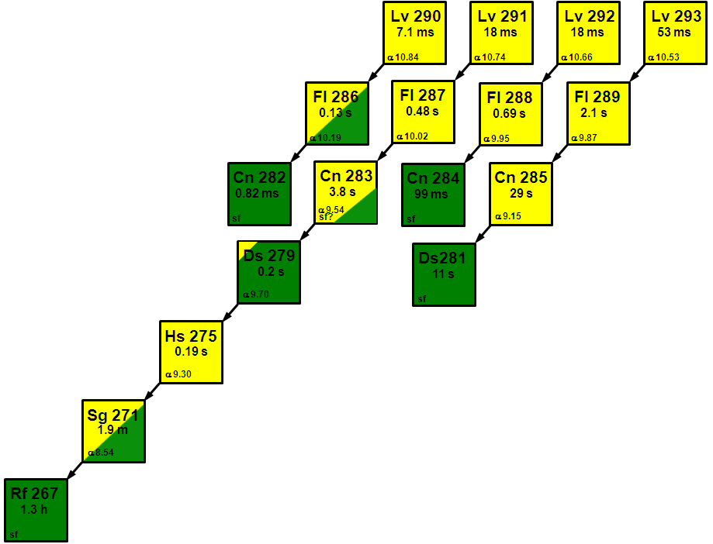
Lv currently has 4 isotopes with 10 – 50 ms half-lives – the odd-A chains are longer (due to hindrance)
Note the presence of long-lived Fl, Cn, Ds, Sg and Rf isotopes!

Slide 54
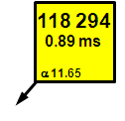
One isotope of element 118 is currently known

Slide 55
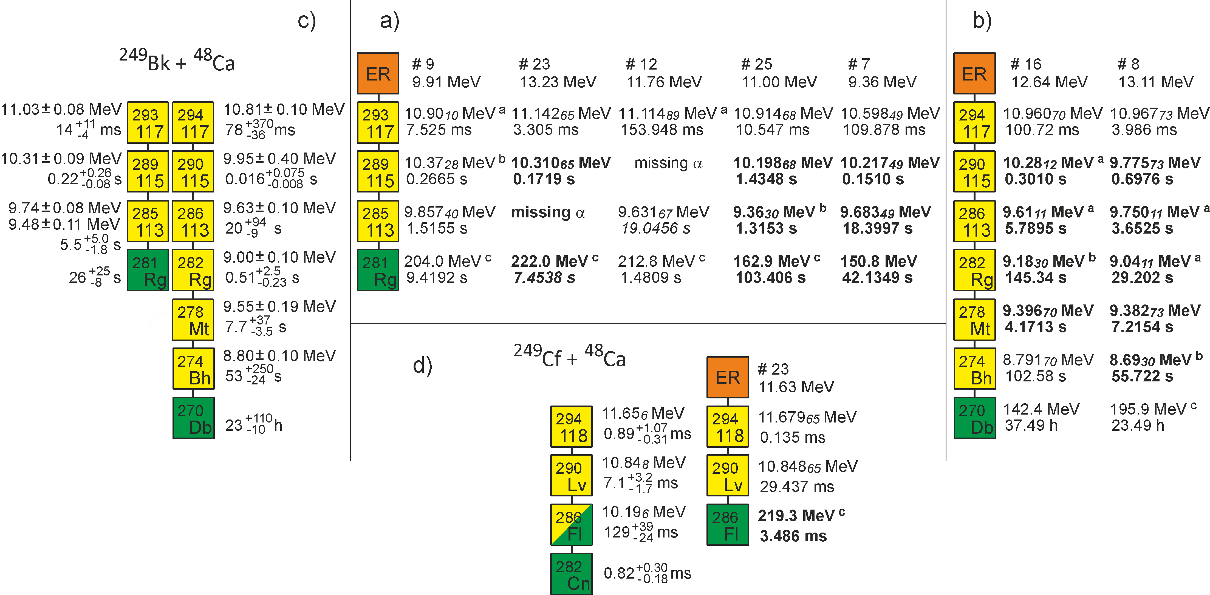
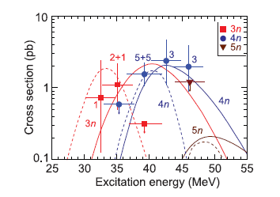
New data from the ⁴⁸Ca + ²⁴⁹Bk reaction
PRL 109 (2012) 162501
Bold events detected when beam was off
PRL 104 (2010) 142502
Note production of ²⁹⁴118 from ²⁴⁹Cf in-growth in target!
At the time of production, the target was 28% ²⁴⁹Cf
Excitation functions for these reactions have been measured

Slide 56
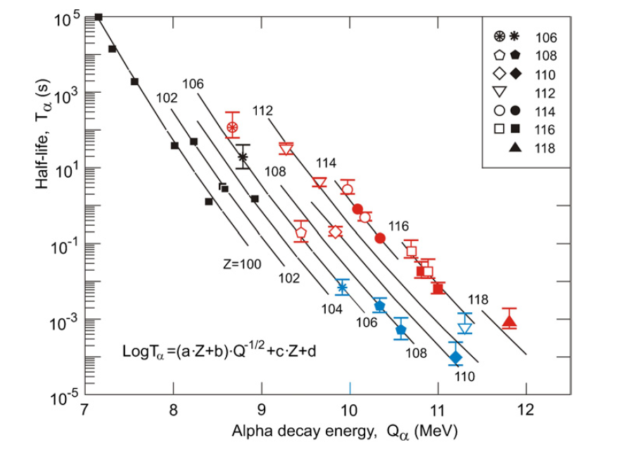
The average decay properties of the even-mass decay chains match the Geiger-Nuttall relationship
e-o e-e

Slide 57

Comparison of 4n-evaporation cross-section with fission barrier
E_{x}=35-40 MeV
hot fusion
E_{x}=35-40 MeV
hot fusion
SHE
σ_{EVR}=Σσ_{xn}

Slide 58
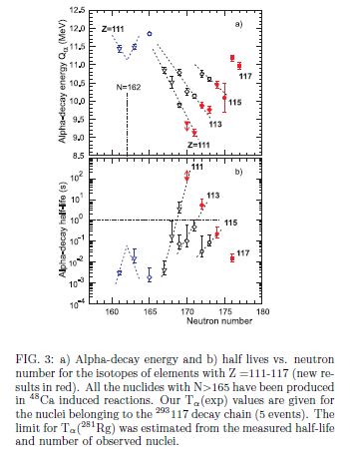
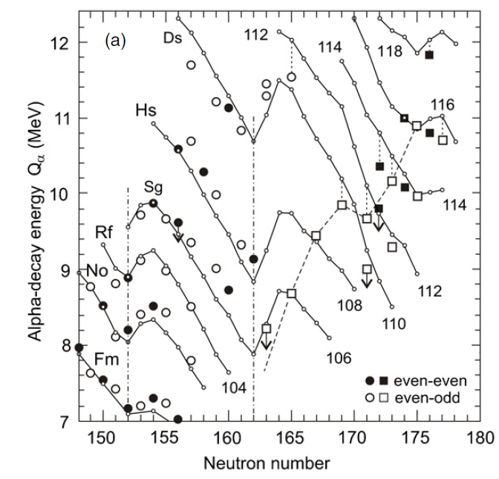
Systematics indicate clearly we are approaching the “Island of Stability”

Slide 59
Spontaneous fission half-lives also indicate shell closure

Slide 60
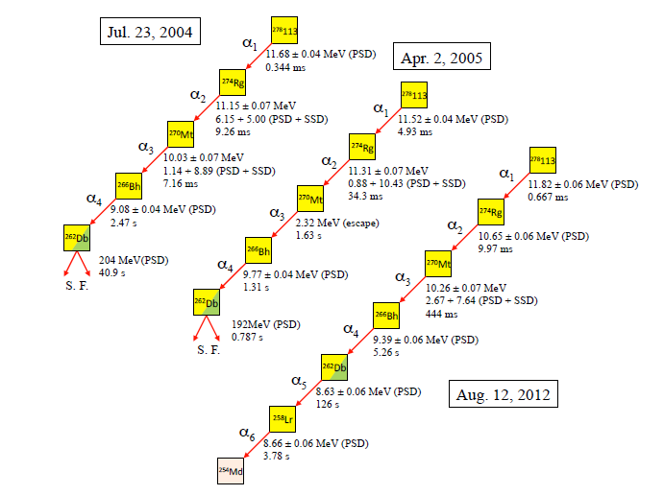
Cold fusion reactions produced some isotopes of element 113 at RIKEN
²⁰⁹Bi + ⁷⁰Zn → ²⁷⁸113 + n
GARIS
σ_{1n} = 22 ⁺²⁰ ₋₁₃ fb

Slide 61
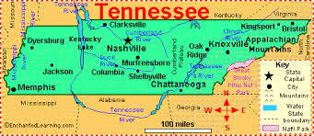

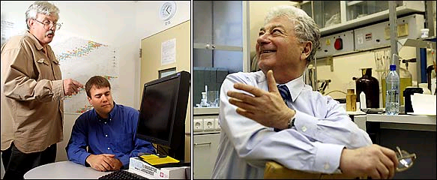
New element names illustrate traditions of selecting chemical element names
IUPAC recently granted naming rights for four new elements (113, 115, 117 and 118)
Japanese group named element 113 Nihonium (Nh)
JINR/LLNL/ORNL/Vanderbilt Univ. group named elements 115 Moscovium (Mc) and 117 Tennessine (Ts)
JINR/LLNL group named element 118 Oganesson (Og)

Slide 62


SHE Factory
New cyclotron DC 280
Ion | Expected beam intensity of (4-8) MeV/A ions (pps)
¹⁸O | 1×10¹⁴
²⁰Ne | 1×10¹⁴
⁴⁰Ar | 1×10¹⁴
⁴⁸Ca | 0.6-1.2×10¹⁴
⁵⁰Ti | 3×10¹³
⁵⁴Cr | 4×10¹³
⁵⁸Fe | 4×10¹³
⁶⁴Ni | 4×10¹³
⁷⁰Zn | 2×10¹³
¹³⁶Xe | 2×10¹³
²³⁸U | 5×10¹⁰
FLNR, JINR

Slide 63






First experiments at SHE Factory
New Dubna gas-filled recoil separator DGFRS-II
DGFRS-2
factor of 3
DGFRS-1
Simulated yields of Fl isotopes (A.G. Popeko)
DQ_{h}Q_{v} set-up
Q_{v}DQ_{h}Q_{v}D set-up
Reaction | Transmission
²⁴⁴Pu(⁴⁸Ca,3n)²⁸⁹Fl | 60 %
²⁴⁴Pu(⁵⁸Fe,4n)²⁹⁸120 | 75 %

Slide 64





Super-Heavy Element (SHE) Factory
SHE Factory Building
High-current cyclotron DC-280
Gas-filled separator
Preseparator
Notes:
The project of the SHE factory includes three principal components: i) high current accelerator, ii) new experimental hall and iii) a number of the next generation facilities.

Slide 65





Test reactions:
^{nat}Yb+⁴⁰Ar→Ra, ^{nat}Yb+⁴⁸Ca →Th, ¹⁷⁰Er+⁵⁰Ti →Th, and ^{206,208}Pb+⁴⁸Ca →No
Cross section ~10⁸⁻⁹ pb
Adjustment of optical elements Q_{v}, D, Q_{h}, Q_{v}, D
Transmission
Image size on detector
Dispersion
Background
Optimal gas pressure
Yield vs. target thickness
Target stability vs. beam intensity and dose
Systematics of charge states
Test of digital and analog data acquisition systems
By the end of CY2019, test new separator with ⁴⁸Ca + ²⁴³Am reaction
48×128 DSSD & 6×8 SSSD
Digital and analog electronics, in parallel

Slide 66



We have been collaborating with Dubna on SHE research since 1989

Slide 67

The chemistry of an element, and its adherence or lack thereof to periodicity, is a fundamental scientific question
Elements don’t have to fit into the periodic table in this way!
Elements for which no chemical info known
P. Pyykkö, Phys. Chem. Chem. Phys. 13, 161 (2011)

Slide 68

An episode of The Big Bang Theory had Sheldon theoretically discovering a stable SHE
Season 7 (2013) – “The Romance Resonance”

Slide 69
Which of Sheldon’s four reactions would you use to make element 120?
A) ²⁵⁸Md + ⁴⁰K → ²⁹⁸120*
B) ²⁴⁴Pu + ⁵⁸Fe → ³⁰²120*
C) ²⁴⁸Cm + ⁵⁴Cr → ³⁰²120*
D) ²³⁸U + ⁶⁴Ni → ³⁰²120*
Answer: All but A have been tried, Md target not possible – t_{1/2} = 51d

Slide 70

Another episode had element 117 decay chains in background
The Big Bang Theory, Season 9 Episode 15: The Valentino Submergence

Slide 71
Conclusions
Production of SHE has proceeded with hot fusion reactions over the last 10-15 years – now producing more than just 1 or 2 atoms
Nuclear chemistry and physics techniques are used to explore nuclear and chemical properties of the heaviest elements
Five elements have been confirmed by other laboratories and six have been named (Nh, Fl, Mc, Lv, Ts, and Og)
Exploration of the limits of nuclear and chemical stability continue
  Experiment with ²⁵¹Cf target
  Attempted experiments to make elements 119 and 120
  First mass number measurement of a SHE (²⁸⁸Mc and ²⁸⁴Nh)
Experiments to explore the nuclear structure of the heaviest elements and try to identify elements by detecting x-rays have been performed

Slide 72
I am of course discussing the work of many
LLNL (Heavy Elements Group) – Ken Moody, John Wild, Ron Lougheed, Mark Stoyer, Nancy Stoyer, Carola Laue, Dawn Shaughnessy, Jerry Landrum, Joshua Patin, Philip Wilk, Roger Henderson, Sarah Nelson
JINR, Dubna, Russia – Yu. Ts. Oganessian, V.K. Utyonkov, Yu. V. Lobanov, F.Sh. Abdullin, A.N. Polykov, I.V. Shirokovsky, Yu.S. Tsyganov, G.G. Gulbekian, S.L. Bogomolov, B.N. Gikal, A.N. Mezentsev, S. Iliev, V.G. Subbotin, A.M. Sukhov, G.V. Buklanov, K. Subotic, M.G. Itkis, R.N. Sagaidak, S. Shishkin, A.A. Voinov, V.I. Zagrebaev, and S.N. Dmitriev
ORNL – C. Alexander, J. Binder, R. A. Boll, J. Ezold, K. Felker, R. K. Grzywacz, K. Miernik, J. B. Roberto, K. P. Rykaczewski
Vanderbilt University – J.H. Hamilton, A.V. Ramayya
RIAR, Dimitrovgrad, Russia – M. A. Ryabinin
UNLV, ANL, TAMU more recent additions to the collaboration

Slide 73
Acknowledgements
Russian Foundation for Basic Research under grant No. 96-02-17377
INTAS under grant No. 96-662
U.S. DOE under contract No. DE-AC52-07NA27344
Some actinides provided by the U.S. DOE through ORNL
Performed in the framework of Russian Federation/U.S. Joint Coordinating Committee for Research on Fundamental Properties of Matter

