Slide 1
Exotic Beam Summer School 2019
Nuclear Structure – Experiment
THE SEQUEL!
Christopher J. Chiara
CCDC-ARL/ORAU

Slide 2
Organization of these lectures
We will explore the six W’s of experimental nuclear structure:
Who?
What?
When?
✓
Where?
Why?
hoW?
✓
✓
☞
(but not necessarily in that order…)
Selection of topics
Shell structure recap
Ground-state properties (briefly)
Excited-state properties
Pulling it all together: Case study 1
Something different: Case study 2
✓
✓
☞

Slide 3
Nuclear structure (the how?)
In Wed’s lecture, we left off with HOW to study nuclear structure using γ-spectroscopy techniques.
Ways to identify the origin of a γ ray if nothing known
Auxiliary devices coupled to γ-ray detectors providing nuclide/reaction information (Z, A/q, reaction products, decay products, Coulomb excitation of projectile)
Correlation with γ rays from known reaction partner
Placing γ rays in a level scheme
CJC perspective: It’s like putting together a jigsaw puzzle when you don’t know what the picture looks like and you don’t have all of the pieces.
Logic, guidance from systematics and/or theory (use with caution!), γ^{n} coincidences

Slide 4
Building a level scheme
Level and γ properties
Measured E_{γ}’s → level energies
Efficiency-corrected γ peak areas → intensities, branching ratios, level populations
γ ADs/ACs, γ polarizations, internal conversion → multipolarity → level spin, parity
z
Intensity of EM field (emitted photon) given by Poynting vector, which depends on spherical harmonics Y_{lm}(θ,φ), where θ is relative to quantization axis
θ
Notes:
Intensities: depends on population mechanism, but BRs are independent.

Slide 5
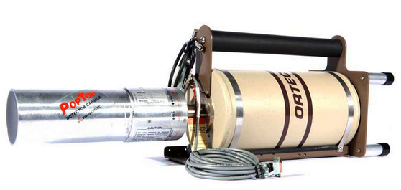
Building a level scheme
Angular distributions
Quantization axis = spin direction
May be known event by event
Reaction plane defines spin vector
z = Î
y
x
b
θ
y
x

Slide 6
Building a level scheme
Angular distributions
Quantization axis = spin direction
May be known event by event
Reaction plane defines spin vector
z = Î
y
x
b
Detect outgoing particle trajectory to determine reaction plane, measure angle φ relative to that
φ
y
x
(φ is the difference between lab angles φ_{γ} and φ_{p})

Slide 7
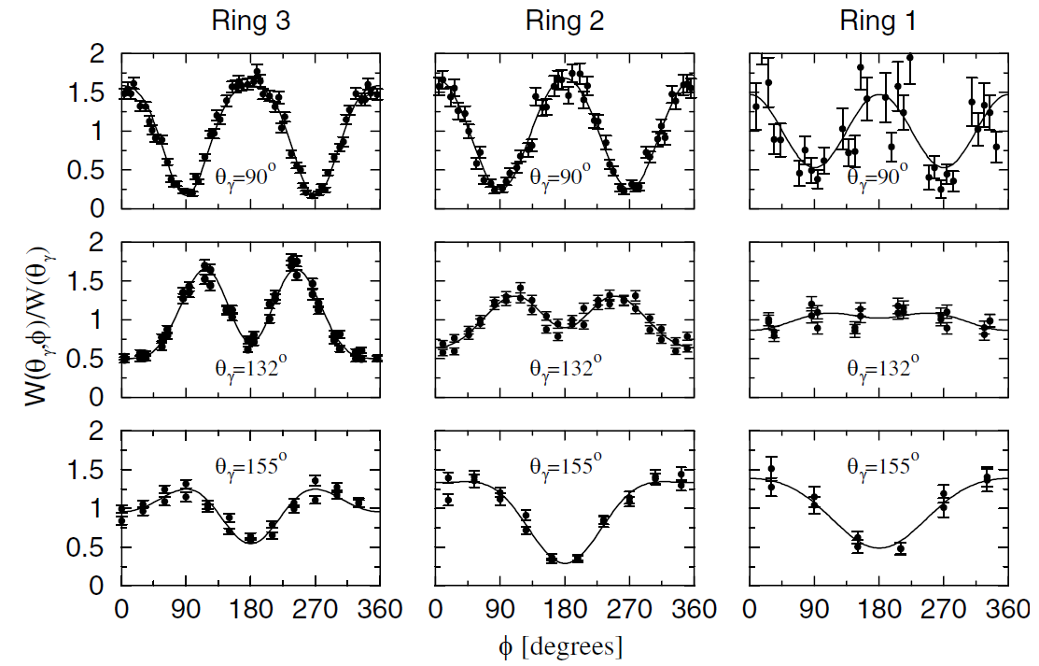
Building a level scheme
Angular distributions
Quantization axis = spin direction
May be known event by event
Reaction plane defines spin vector
z = Î
Stone et al., PRL94, 192501 (2005)
y
x
b
Detect outgoing particle trajectory to determine reaction plane, measure angle φ relative to that
φ
y
x
Measure intensity as a function of angle
(φ is the difference between lab angles φ_{γ} and φ_{p})
Notes:
132Te on C.

Slide 8
Building a level scheme
Angular distributions
Quantization axis = spin direction
May be known event by event
…or it may not! What to do then?
$$W\left(θ\right)=\sum_{k=0}^{L}{A_{2k}P_{2k}\left(\cos{θ}\right)}$$
Reaction plane still defines spin vector, even if not determined experimentally
z = Î
y
x
θ
Ensemble of spins perpendicular to beam direction, symmetrically distributed ➔ use beam axis for quantization
y
x
Measure intensity as a function of angle
Notes:
A_2k varies with degree of alignment (should have attenuation coefficient).

Slide 9
Building a level scheme
Angular distributions
Quantization axis = spin direction
May be known event by event
…or it may not! What to do then?
$$W\left(θ\right)=\sum_{k=0}^{L}{A_{2k}P_{2k}\left(\cos{θ}\right)}$$
Pure dipole only has P₂ term, quad adds P₄, oct has P₆, etc.
With M1/E2 mixing, A₄ ≠ 0; mixing ratio δ* can be deduced, providing insight into underlying structure
Strictly speaking, AD in singles; “gated AD”: γγ coincidence with no angle condition on gating γ (clean-up only) → if 4π coverage, same AD as in singles
* δ² = (E2 intensity)/(M1 intensity)
Notes:
Delta tells us ratio of transition amplitudes for the two multipolarities.

Slide 10
Building a level scheme
Angular distributions
Quantization axis = spin direction
May be known event by event
…or it may not! What to do then?
Spins not aligned indefinitely → AD attenuated through hyperfine interactions
If there is no spin orientation, all substates contribute equally and W(θ) = constant
What to do if alignment is lost (or was never there), e.g. for γ’s below isomers?

Slide 11
Building a level scheme
$$W\left(ψ\right)=\sum_{k=0}^{L}{A_{2k}P_{2k}\left(\cos{ψ}\right)}$$
Angular correlations
Coincidence technique
Detect first γ → defines quantization axis
Detect second γ → determine relative angle
Same form as for AD, different coefficients.
L limit determined by lowest multipole.
E2-E2
E2-E1
E1-E1
ψ
0⁺→2⁺→0⁺

Slide 12
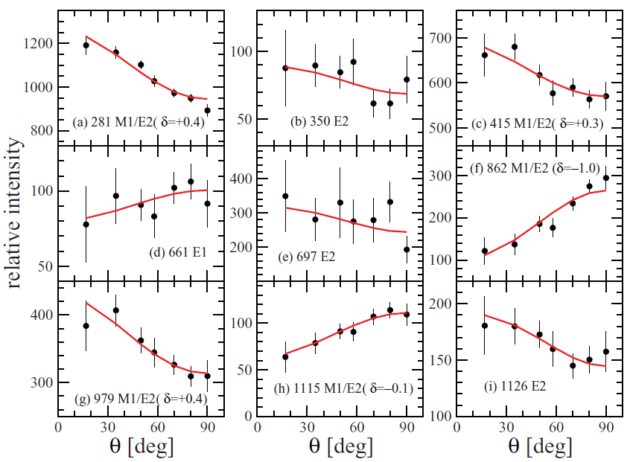
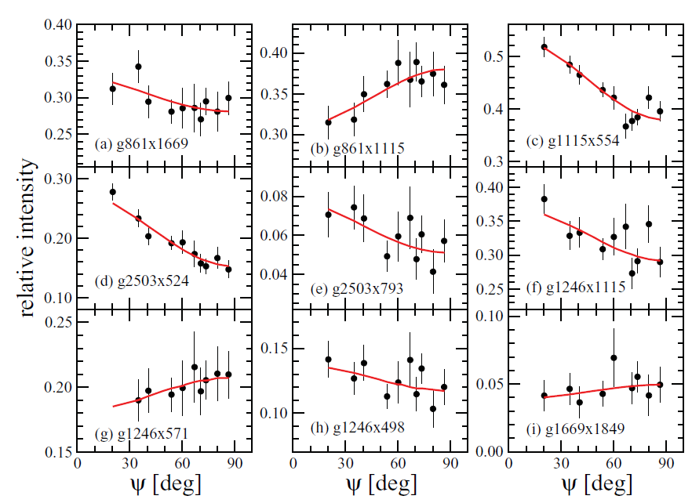
Building a level scheme
E2 – E2
E2 – M1/E2(δ=-0.11)
M1/E2(δ=-0.11) – M1/E2(δ=-0.15)
⁶⁵Cu ADs – ⁴⁸Ca+²⁶Mg
E3 – M1/E2(δ=1.0)
Chiara et al., PRC85, 024309 (2012)
⁶⁷Cu ACs – ⁶⁴Ni+²³⁸U

Slide 13
Building a level scheme
ADs/ACs → multipole order L, but do not directly distinguish E vs M
Pure ΔI=1 E1, e.g., looks the same as pure ΔI=1 M1
Nonzero mixing ratio may change that, as M1/E2 far more likely than E1/M2
For more direct determination of E or M: measure polarization (e.g. Clover detectors)
…or internal-conversion electrons
Nuclear level decay via internal conversion (IC)
first observed over 100 y ago [van Baeyer and Hahn, Physik. Z. 11, 488 (1910)] *
ubiquitous process
usable as analysis tool (cf. BrIcc, http://bricc.anu.edu.au/)
Continuum
Initial state
L shell
K shell
Atomic System
Nuclear System
Instead of γ emission, energy transferred to atomic electron, which is ejected
* nucleus discovered in 1911!

Slide 14
Building a level scheme
Internal conversion
$α_{T}$ = $\frac{Ie}{Iγ}=α_{K}+α_{L}+α_{M}+…$
$$I_{γ+e}=I_{γ}+I_{e}=I_{γ}+α_{T}I_{γ}=I_{γ}(1+α_{T})$$
$$λ=λ_{γ}(1+α_{T})$$
$$T_{1/2}=T_{1/2,γ}{\left(1+α_{T}\right)}^{−1}$$
$α_{T}$ $∝{\left(\frac{Z}{n}\right)}^{3}E^{−L−3/2}$
ICCs larger for:
higher-Z elements
innermost shells
lower-E transitions
M than for E
for ML transitions
$α_{T}$ $∝{\left(\frac{Z}{n}\right)}^{3}E^{−L−5/2}$
for EL transitions

Slide 15
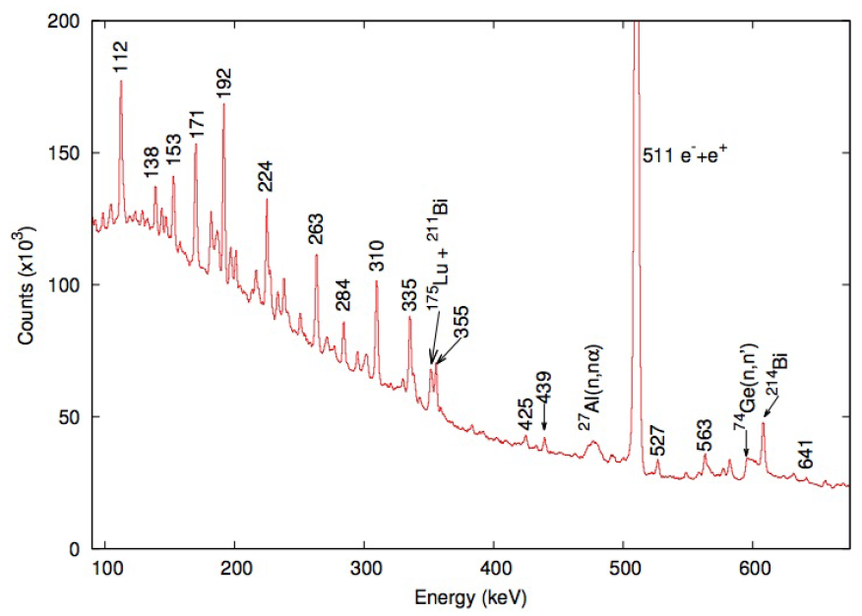
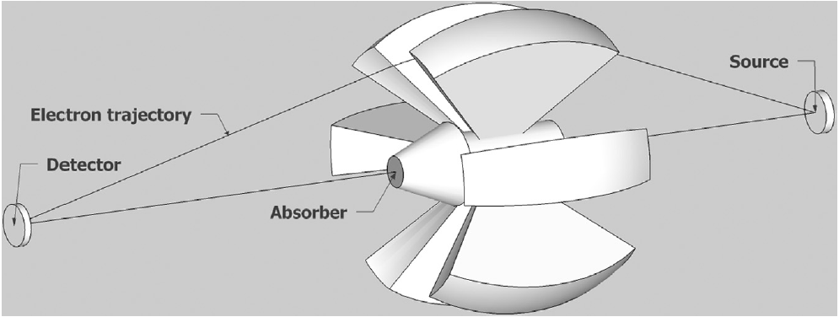
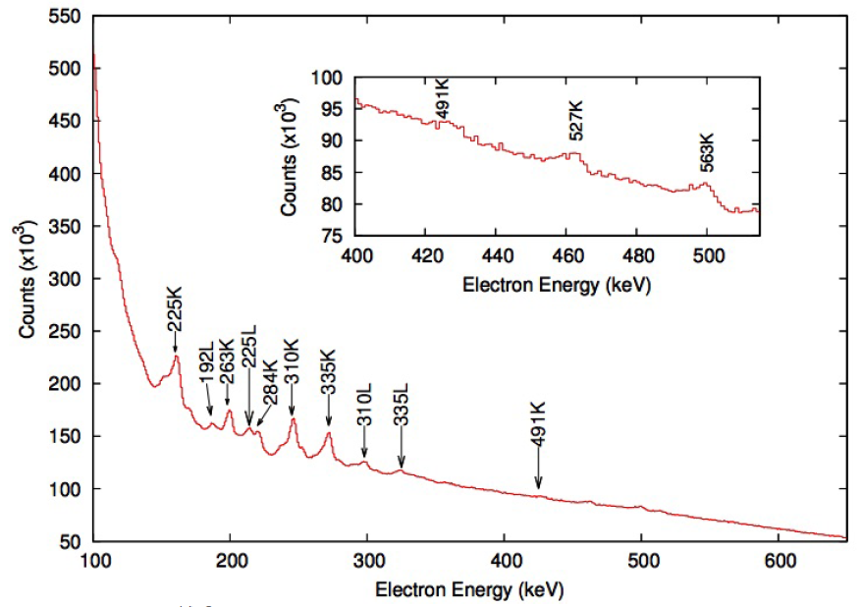
Building a level scheme
Conversion-electron spectroscopy
Electron ejected with energy E = ΔE_{x} – |E_{B}| → measurable spectrum
Multiple electron peaks for each γ, from K, L, …
Mini-orange conversion-electron spectrometer (in-beam)
Guerro et al., NIMA739, 32 (2014)
Battaglia et al., EPJA52, 126 (2016)
Notes:
Also: SAGE at JYFL, solenoid transports e-’s to Si for e-g coincs.

Slide 16
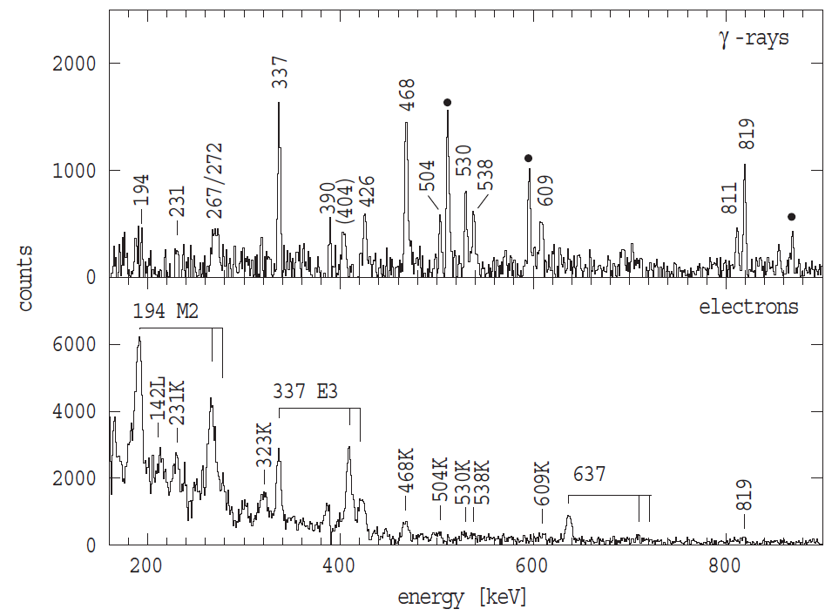
Building a level scheme
Conversion-electron spectroscopy
Electron ejected with energy E = ΔE_{x} – |E_{B}| → measurable spectrum
Multiple electron peaks for each γ, from K, L, …
Mini-orange conversion-electron spectrometer (in-beam)
…or delayed spectroscopy
Dracoulis et al., PRC79, 031302 (2009)
(K energies aligned to γ peaks)
Measure γ and e- intensities, compare with calculated ICCs (e.g. BrIcc) → multipolarity
[http://bricc.anu.edu.au/]

Slide 17
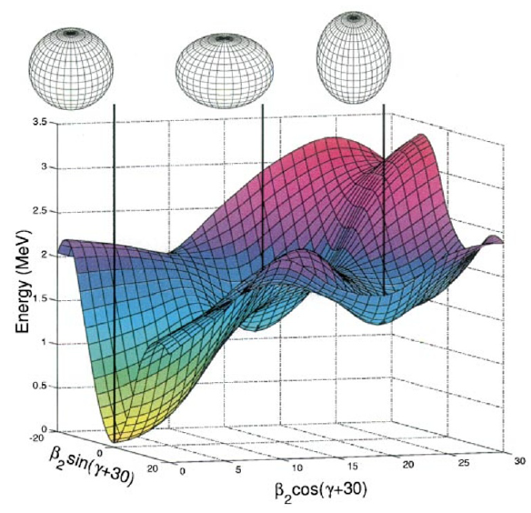
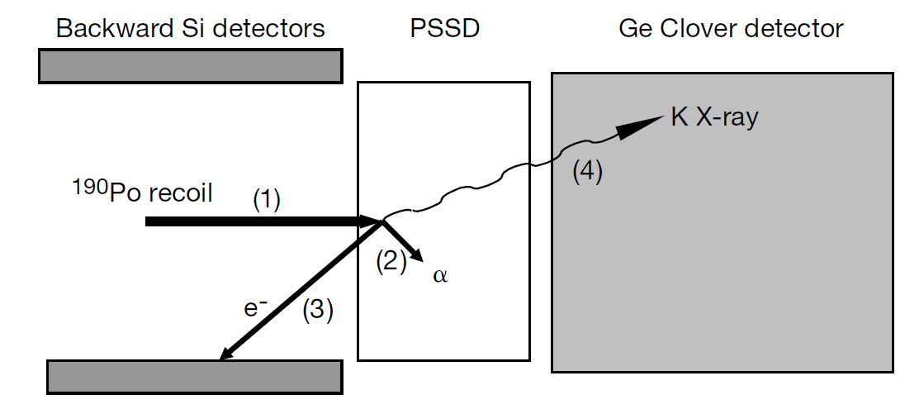
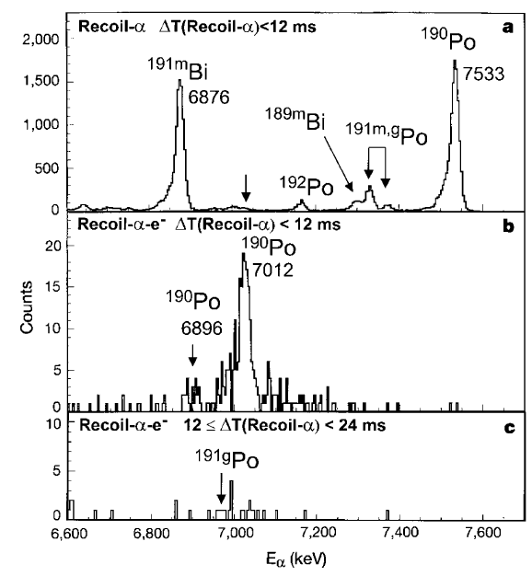
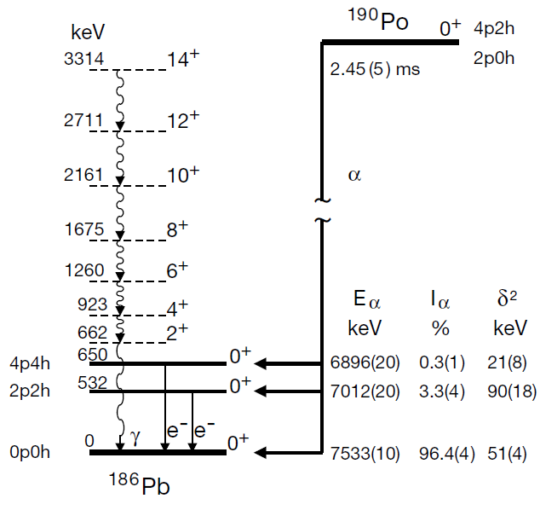
Building a level scheme
E0 decays
Most transitions have γ vs e- competition, but one case that “never” has a γ: 0⁺ → 0⁺
Transition would be E0 (monopole moment = charge), which cannot radiate to points external to nucleus
Andreyev et al., Nature 405, 430 (2000)
reduced α width: $δ^{2}=\frac{h(ln{2)b_{α}}}{T_{1/2}P}$
Notes:
P = penetration probability (includes effect of Q-value)
d^2 allows one to “obtain information on the internal structure of the configurations involved in the connected states”. --AA et al.
Not the same d^2 as the mixing ratio!

Slide 18
Building a level scheme
E0 decays
Most transitions have γ vs e- competition, but one case that “never” has a γ: 0⁺ → 0⁺
Transition would be E0 (monopole moment = charge), which cannot radiate to points external to nucleus
Why “never” and not never?
If E > 2m_{e}c² = 1.022 MeV, internal pair (e⁺e⁻) production is possible.
e⁺ subsequently annihilates with another e⁻, yielding 511-keV γ’s.

Slide 19
Building a level scheme
Level and γ properties
Measured E_{γ}’s → level energies
Efficiency-corrected γ peak areas → intensities, branching ratios, level populations
γ ADs/ACs, γ polarizations, internal conversion → multipolarity → level spin, parity
Relative γ times → level half-lives, B(XL)’s
$$B\left(XL\right)∝{E_{γ}^{−(2L+1)}T}_{1/2,γ}^{−1}$$
Reduced transition rates
can be a sensitive probe of matrix elements connecting initial and final states:
$$B\left(XL;I_{i}→I_{f}\right)=\frac{1}{2I_{i}+1}{\left\langle ψ_{f}\left\|XL\right.{\left\|ψ\right.}_{i}\right\rangle }^{2}$$

Slide 20
Measuring half-lives
Excited-state half-lives range from ~10⁻²³ s (>10-MeV resonances) to >4.5x10¹⁶ y (^{180m}Ta). That’s over 47 orders of magnitude!
Most excited states have sub-ns half-lives; why are some exceptionally long?
Low transition energy
Large spin difference
Large difference in underlying configurations
K-forbiddenness (change in spin projection on symmetry axis ΔK > L)
No single approach to measuring half-lives will apply to all cases.
Notes:
In contrast with collective structures where decays are rather fast.

Slide 21
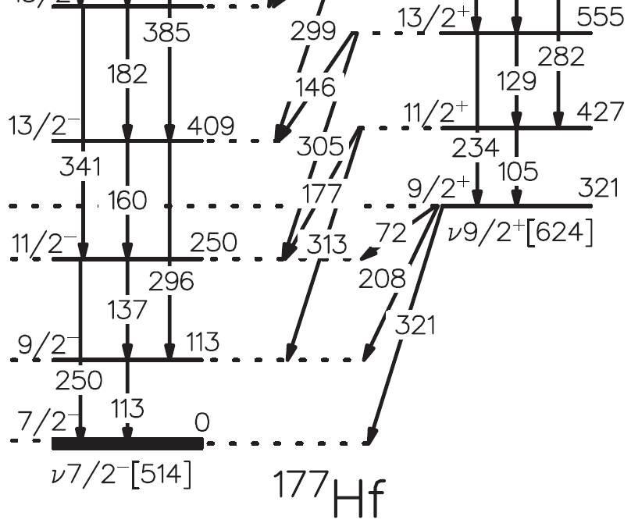
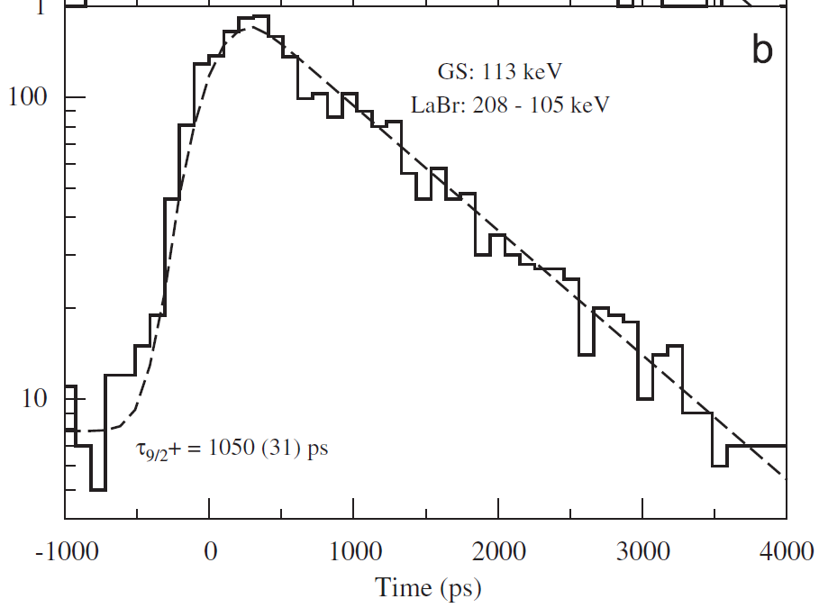
Measuring half-lives
Observe exponential decay for half-lives of ~tens of ps or longer
Measure γ-ray time relative to a fast START signal
START with preceding β decay in e.g. fast plastic
…or START with RF (clock tick marking reaction)
…or START with preceding γ in e.g. Ge (T_{1/2} > ns) or LaBr₃ (sub-ns)
Get half-life from slope of exponential
T_{1/2} = 728(21) ps
Kondev et al., PRC85, 027304 (2012)
Zhu et al., NIMA652, 231 (2011)

Slide 22
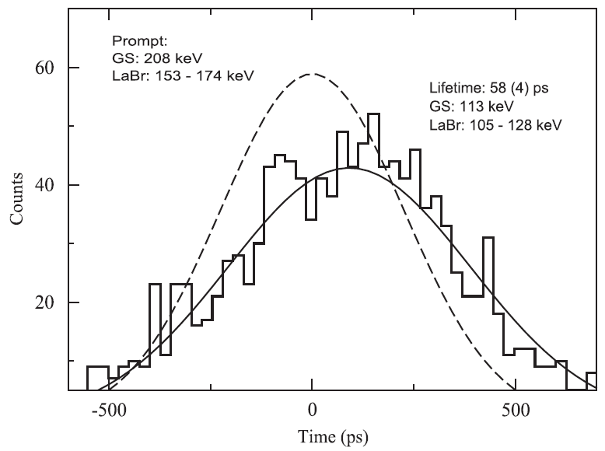
Measuring half-lives
Observe exponential decay for half-lives of ~tens of ps or longer
Measure γ-ray time relative to a fast START signal
START with preceding β decay in e.g. fast plastic
…or START with RF (clock tick marking reaction)
…or START with preceding γ in e.g. Ge (T_{1/2} > ns) or LaBr₃ (sub-ns)
Get half-life from slope of exponential…or from centroid shift
T_{1/2} = 40(3) ps
Kondev et al., PRC85, 027304 (2012)
Zhu et al., NIMA652, 231 (2011)
Notes:
Can be used for in-beam or stopped (following b/a/IT decay).

Slide 23
Measuring half-lives
For ~ps half-lives, instrumentation not fast enough
Exploit physics of in-beam measurement: Doppler shifts
Brief Doppler diversion…

Slide 24
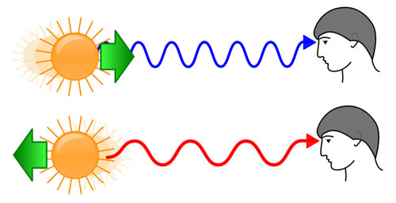
Doppler effect – friend or foe??
Doppler broadening:
Ge
Doppler shift:
Δθ
v
$$E=E_{0}\frac{\sqrt{1−{(v/c)}^{2}}}{1−(v/c)\cos{θ}}$$
$$∆E∝E_{0}(v/c)\sin{θ}∆θ$$
Ions lose energy while traversing a medium ➔ v/c decreases with time.
By modelling the energy loss, time-dependent Doppler shift determined ➔ Doppler-shift attenuation and (differential) plunger techniques
Notes:
Broadening needs to be relativistic too! Multiply by sqrt(1-beta^2)/(1-beta*cos(Q))^2.

Slide 25
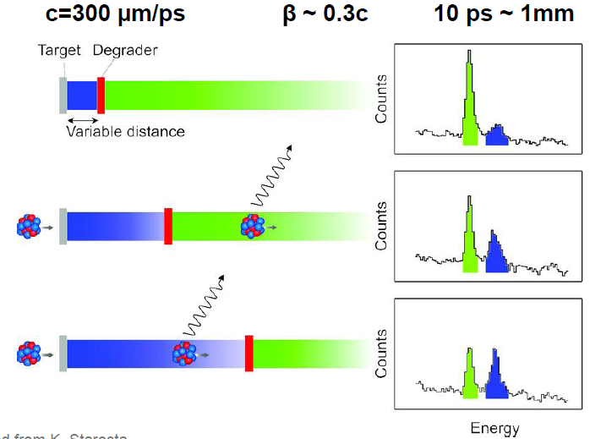
Measuring half-lives
For ~ps half-lives, instrumentation not fast enough
Exploit physics of in-beam measurement: Doppler shifts
Recoil-distance method (plunger)
v ~ 0.3c
Produce nucleus of interest with initial velocity v₀ via Coulex or KO reactions
Observe Doppler-shifted γ’s emitted between target and degrader
Ion slows in the degrader to velocity v_{d} < v₀
Observe Doppler-shifted γ’s emitted after degrader
Increase distance between target and degrader; change in relative peak intensities depends on T_{1/2}
T_{1/2} ~ 10-100s of ps can be measured
Figure: adapted from K. Starosta

Slide 26
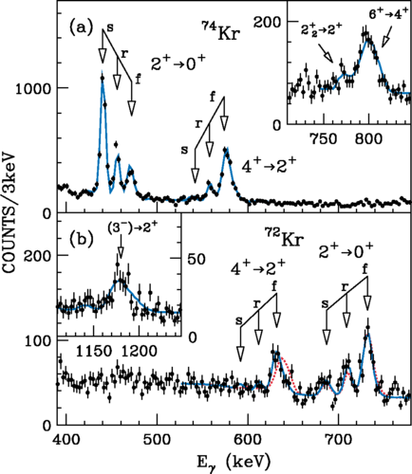
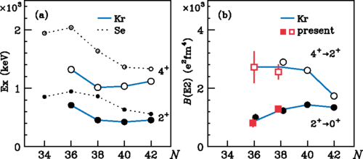
Measuring half-lives
Double-degrader plunger
T_{1/2} → B(E2) → indicator for collectivity
Behavior of the 4⁺ and 2⁺ states in ⁷²Kr suggest rapid shape evolution occurring
Iwasaki et al., PRL112, 142502 (2014).
Notes:
TRIPLEX@NSCL; advantage over usual plunging—can apply differential recoil distance method and the double recoil distance method.

Slide 27
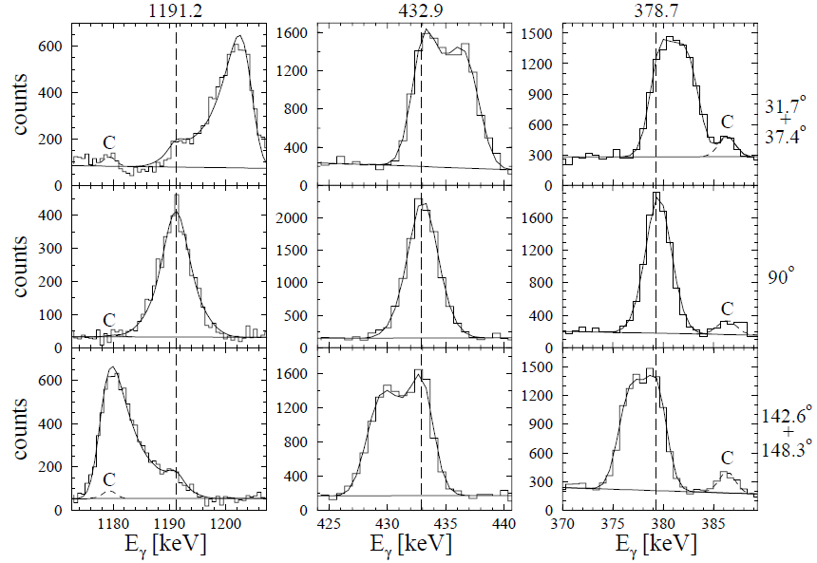
Measuring half-lives
For ~ps half-lives, instrumentation not fast enough
Exploit physics of in-beam measurement: Doppler shifts
Recoil-distance method (plunger)
Doppler-broadened line shapes
T_{1/2} = 0.13 ps 0.19 ps 0.17 ps
If ion slows substantially in foil, variation in Doppler shift → line shape
Sensitive to sub-ps T_{1/2}’s
Chiara et al., PRC61, 034318 (2000)

Slide 28
With all of that in mind, let’s now consider a case study….

Slide 29
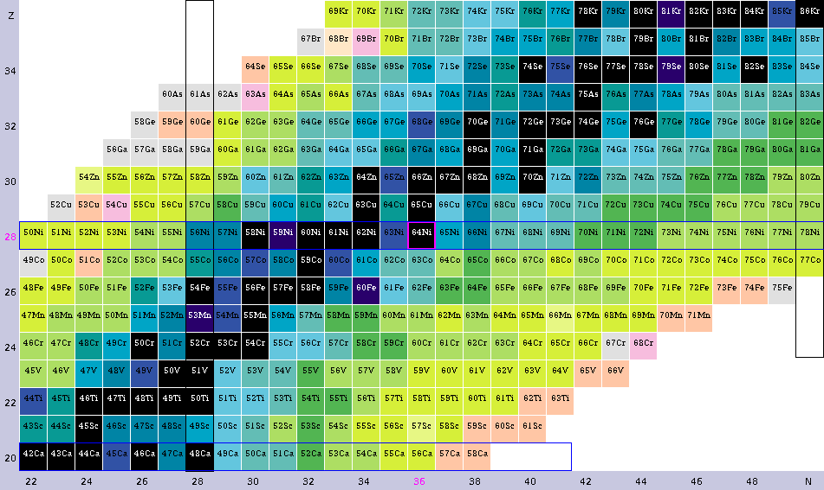
Case study: ⁶⁸Ni
Let’s say you’re interested in the neutron-rich Ni (Z = 28) region…

Slide 30
deformation →
Protons have filled up to Z = 28 gap.
Starting on n-deficient side of stability, ⁵⁶Ni (N = 28) is doubly magic.
40
N = 28
Z = 28
Nilsson diagram of region

Slide 31
deformation →
Protons have filled up to Z = 28 gap.
Starting on n-deficient side of stability, ⁵⁶Ni (N = 28) is doubly magic.
N = 40
40
Filling of upper ν(fp) shell drives shape away from sphericity.
At ⁶⁸Ni, ν(fp) is filled, νg_{9/2} subshell lies above N = 40 gap.
Z = 28
Is ⁶⁸Ni doubly magic?
Nilsson diagram of region

Slide 32
deformation →
Protons have filled up to Z = 28 gap.
Starting on n-deficient side of stability, ⁵⁶Ni (N = 28) is doubly magic.
N = 40
40
Filling of upper ν(fp) shell drives shape away from sphericity.
At ⁶⁸Ni, ν(fp) is filled, νg_{9/2} subshell lies above N = 40 gap.
Z = 28
Is ⁶⁸Ni doubly magic?
Do excitations to shape-driving orbitals result in different coexisting shapes?
Nilsson diagram of region
Notes:
Also: How does increased occupation of νg_{9/2} influence structure of nucleus?

Slide 33
Case study: ⁶⁸Ni
Robustness of shell gaps called into question:
N=40 not magic in neighbors, e.g. ⁶⁶Fe, ⁶⁴Cr, ⁶⁷Ni
Proposed proton intruder states important in the low-lying structure of ^{64,66}Mn, ⁶⁵⁻⁶⁸Co, ^{67,69,71}Cu
πp_{3/2} from above Z=28
πf_{7/2} from below Z=28
⁶⁶Fe: Hannawald et al., PRL82, 1391 (1999)
⁶⁴Cr: Gade et al., PRC81, 051304(R) (2010)
⁶⁷Ni: Zhu et al., PRC85, 034336 (2012)
^{64,66}Mn: Liddick et al., PRC84, 061305 (2011)
⁶⁵Co: Pauwels et al., PRC79, 044309 (2009)
⁶⁷Co: Pauwels et al., PRC78, 041307(R) (2008)
^{66,68}Co: Liddick et al., PRC85, 014328 (2012)
⁶⁷Cu: Chiara et al., PRC85, 024309 (2012)
⁶⁹Cu: Ishii et al., PRL84, 39 (2000)
⁷¹Cu: Oros-Peusquens and Mantica, NPA669, 81 (2000)

Slide 34
Case study: ⁶⁸Ni
Q: How might one populate excited states in ⁶⁸Ni?
Implantation/decay
Transfer reaction (SIB)
Transfer reaction (RIB)
Deep-inelastic scattering
Fusion-evaporation
Knockout reaction
Coulomb excitation

Slide 35
Case study: ⁶⁸Ni
Q: How might one populate excited states in ⁶⁸Ni?
Implantation/decay
Transfer reaction (SIB)
Transfer reaction (RIB)
Deep-inelastic scattering
Fusion-evaporation*
Knockout reaction
Coulomb excitation
A: Any of the above! All have been (*or soon will be) performed.
Complementary production methods, and complementary measurements.

Slide 36
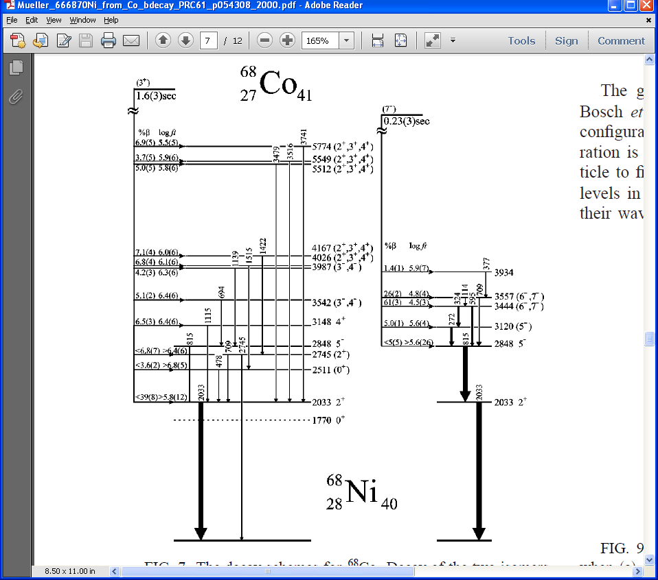
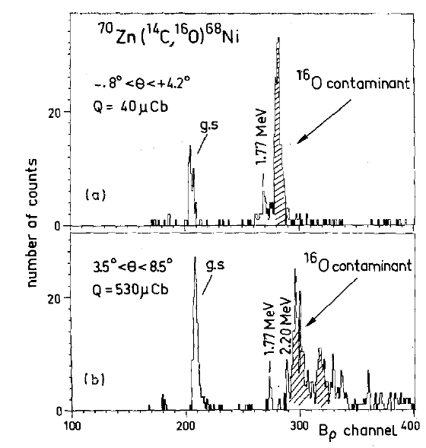
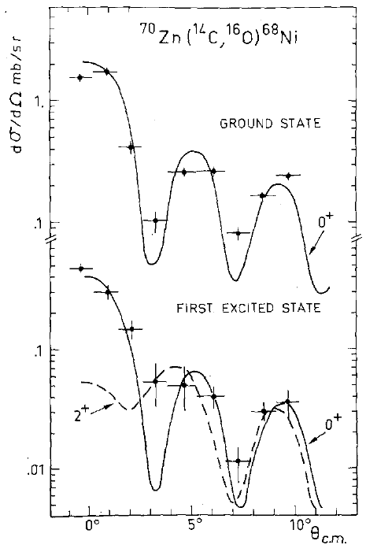
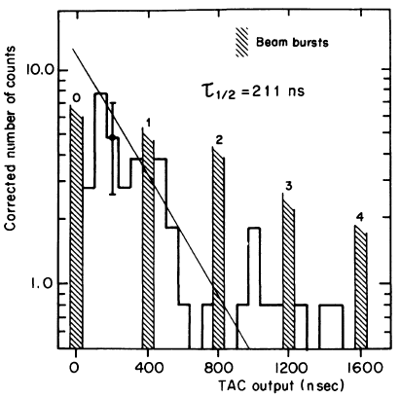
Case study: ⁶⁸Ni
211 ns
2p transfer reaction with long-lived (5700 y) beam
Magnetic spectrograph → energy and I^{π} = 0⁺
Conversion-electron detector → T_{1/2}
Bernas et al., PLB113, 279 (1982) and JPhLett45, 851 (1984), from ⁷⁰Zn(¹⁴C,¹⁶O)

Slide 37
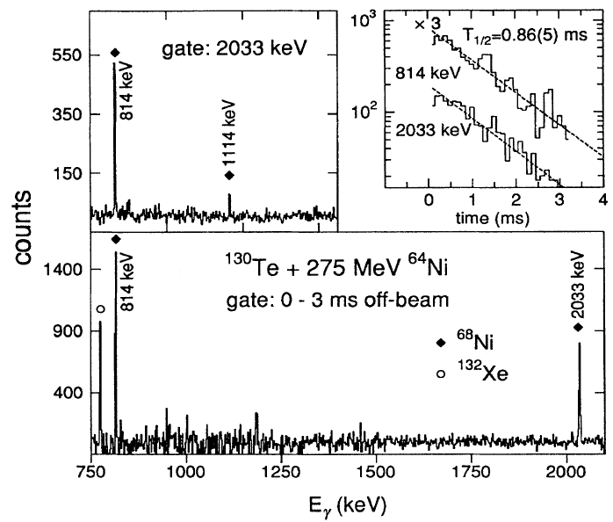
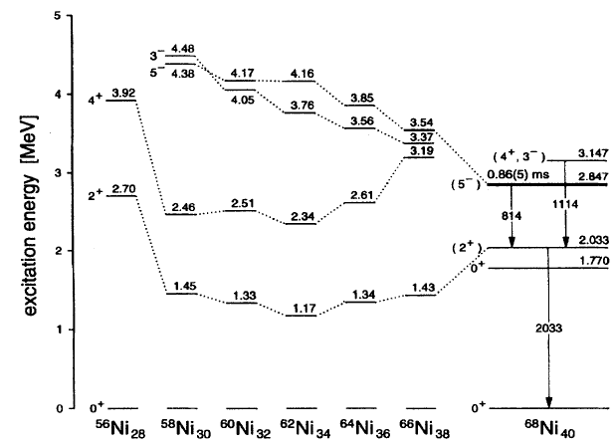
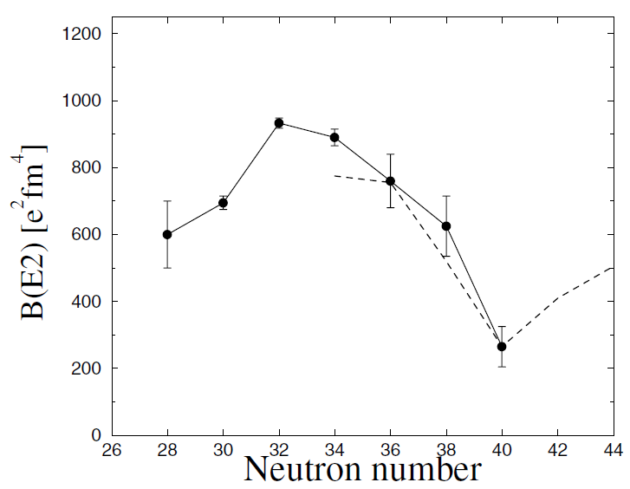
Broda et al., PRL74, 868 (1995), from ⁶⁴Ni+¹³⁰Te DI reactions
0.86 ms
211 ns
Bernas et al., PLB113, 279 (1982) and JPhLett45, 851 (1984), from ⁷⁰Zn(¹⁴C,¹⁶O)
Sorlin et al., PRL88, 092501 (2002), from ⁶⁸Ni Coulex

Slide 38
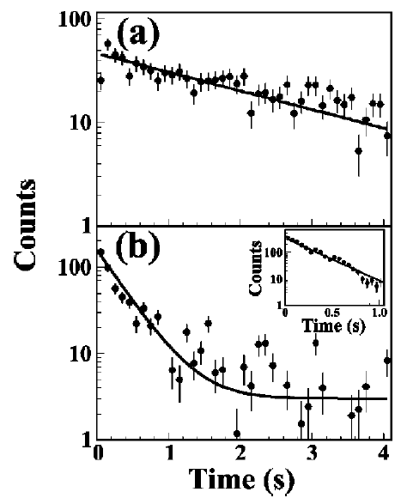
Mueller et al., PRC61, 054308 (2000), from β decay
(2⁻)?! x
(1⁺) x
Flavigny et al., PRC91, 034310 (2015), from Mn β decay chain
Liddick et al., PRC85, 014328 (2012), from Fe β decay chain
Broda et al., PRL74, 868 (1995), from ⁶⁴Ni+¹³⁰Te DI reactions
0.86 ms
211 ns
Bernas et al., PLB113, 279 (1982) and JPhLett45, 851 (1984), from ⁷⁰Zn(¹⁴C,¹⁶O)
Notes:
FF’s (2-) in part from Fe→Co decay

Slide 39
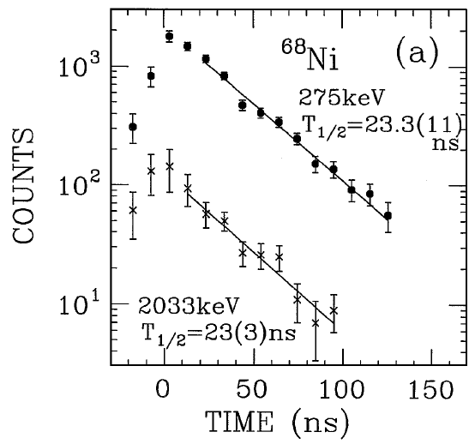
Mueller et al., PRC61, 054308 (2000), from β decay
(2⁻)?! x
(1⁺) x
Flavigny et al., PRC91, 034310 (2015), from Mn β decay chain
Ishii et al., PRL84, 39 (2000), “isomer-scope” following ⁷⁰Zn+¹⁹⁸Pt DI reactions
Liddick et al., PRC85, 014328 (2012), from Fe β decay chain
t_{1/2}=23ns
4208 8⁺
3999 6⁺
Broda et al., PRL74, 868 (1995), from ⁶⁴Ni+¹³⁰Te DI reactions
0.86 ms
3148 4⁺
211 ns
Bernas et al., PLB113, 279 (1982) and JPhLett45, 851 (1984), from ⁷⁰Zn(¹⁴C,¹⁶O)
Notes:
Isomer-scope: PLF’s detected in Si DE-E detectors, four Ge’s arranged around Si to detect delayed gammas, shielded with W from prompt gammas.
Similar in concept to implant/beta decay, except here it is with an isomer.

Slide 40
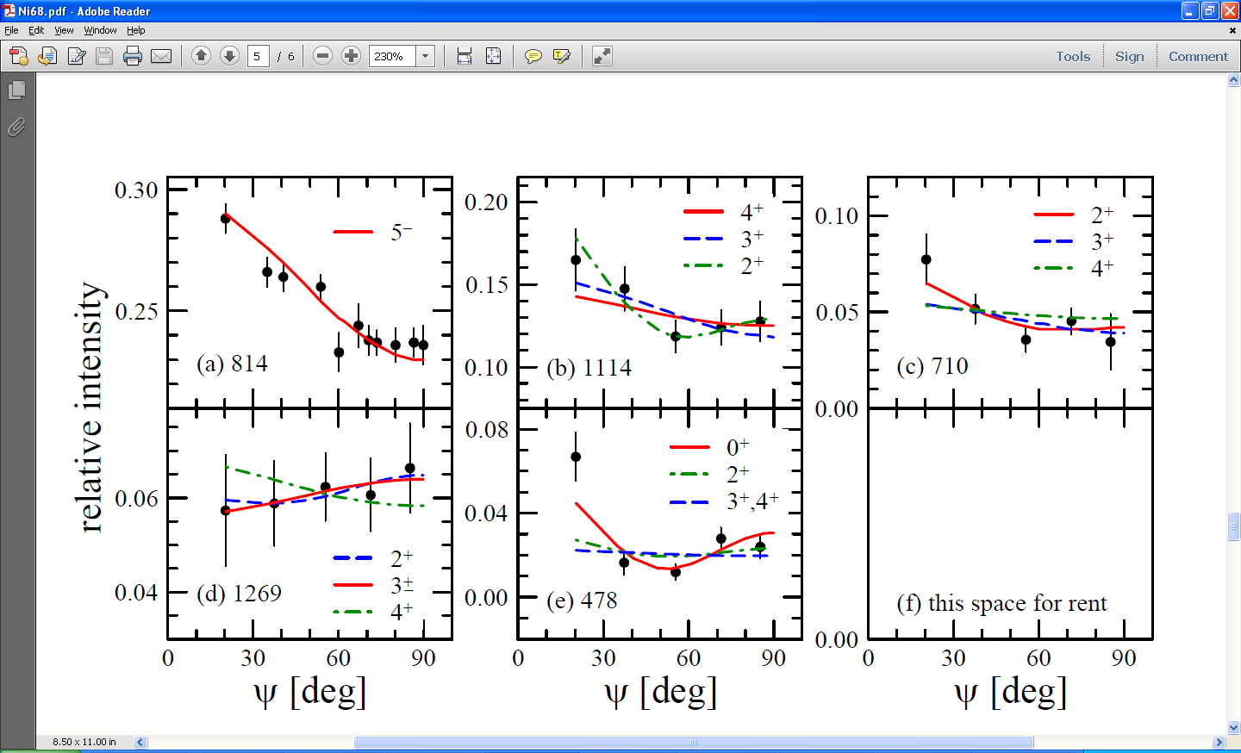
Case study: ⁶⁸Ni
Angular correlations in ⁶⁸Ni, relative to the 2033-keV 2⁺ → 0+ gating transition
delayed γγ
prompt γγ, with additional gate on delayed Po γ
Chiara et al., PRC86, 041304(R) (2012); ⁷⁰Zn + ²⁰⁸Pb DI reaction

Slide 41
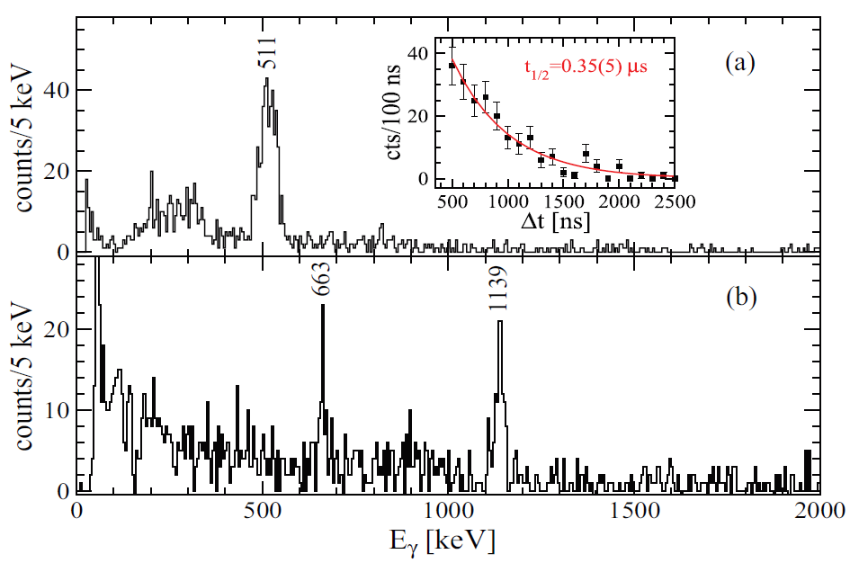
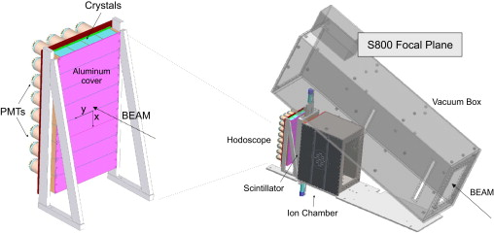
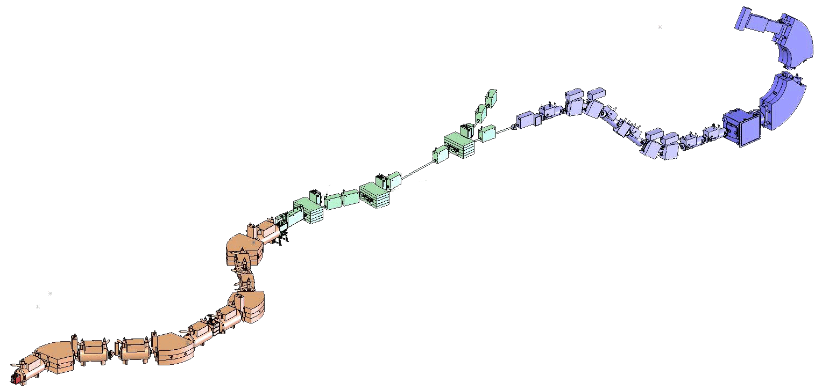
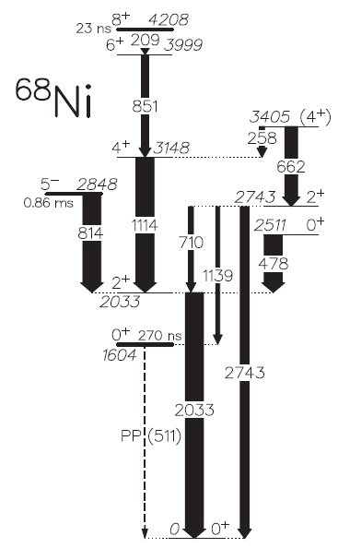
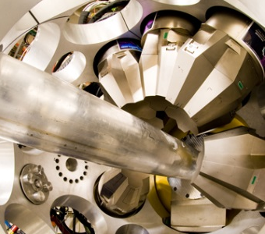
After ~30y unchallenged, concurrent analyses of three experiments revealed E_{x}(0⁺₂) = 1604 keV, not 1770 keV!
Recchia et al., PRC88, 041302(R) (2013)
4x8 CsI(Na) array behind Al plate → delayed γ’s
S800 spectrograph
A1900 fragment separator
Production target
423 mg/cm² ⁹Be
GRETINA
Notes:
Didn’t measure T1/2’s of other states, but obtained B(E2) ratios that provided info about config mixing, demo’d that wider SM space needed.

Slide 42
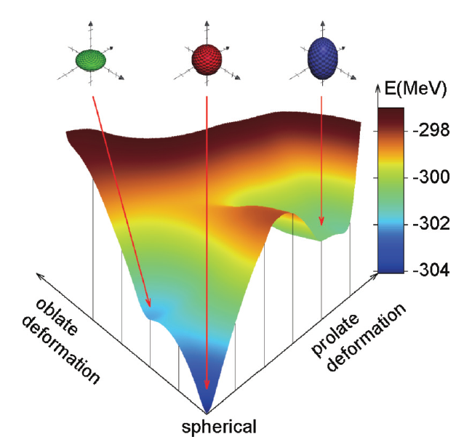
<10 states below 3.5 MeV
3 of the lowest 4 are 0⁺ states! ➔ hallmark of shape coexistence
Suchyta et al., PRC89, 021301(R) (2014)

Slide 43
deformation →
40
What lies on top… SD band??
superdeformed? →
Subject of upcoming fusion-evap experiment
Nilsson diagram of region

Slide 44
Nuclear physics with not-so-exotic beams
It may seem strange to say this at an Exotic Beam Summer School, but:
Don’t be misled into believing that the only remaining pursuits worth taking lie out at the very extremes, requiring RIBs to access.
Sometimes “run-of-the-mill” stable beam + target combos reveal surprises. (Such experiments can still be challenging!)
Case study: Nuclear Excitation by Electron Capture in ⁹³Mo

Slide 45
case study: Neec
Despite ~separable scales of atom and nucleus, they do affect each other…
#protons determines # and E’s of electrons
shape and charge distribution change with #neutrons
interaction between nuclear moments and atomic EM fields
A. Pálffy, Contemp. Phys. 51:6, 471 (2010)
nuclear transition affects atom…or vice versa

Slide 46
case study: Neec
Coupled atomic-nuclear processes
Nuclear level decay via internal conversion (IC)
first observed over 100 y ago
ubiquitous process
usable as analysis tool
Continuum
Initial state
L shell
K shell
Atomic System
Nuclear System
Nuclear Excitation by Electron Capture (NEEC)
inverse of IC
requires ΔE matching
predicted [Goldanskii and Namiot, PLB62, 393 (1976)] but never observed experimentally
Continuum
Intermediate state
L shell
Initial state
K shell
Atomic System
Nuclear System
E_{B} + E_{e} = ΔE_{n}
Notes:
How closely must they match? Atomic and nuclear levels have line widths.

Slide 47
case study: Neec
Coupled atomic-nuclear processes
Nucleus may start in isomeric state rather than g.s. [Zadernovsky & Carroll, Hyp. Int. 143, 153 (2002)]
could induce isomer depletion through alternate path to g.s.
γ- and x-ray energies distinct
Nuclear Excitation by Electron Capture (NEEC)
inverse of IC
requires ΔE matching
predicted [Goldanskii and Namiot, PLB62, 393 (1976)] but never observed experimentally
Continuum
Intermediate state
L shell
Isomer
K shell
Ground state
Atomic System
Nuclear System
E_{B} + E_{e} = ΔE_{n}

Slide 48
case study: Neec
What makes NEEC observation such a challenge?
Nucleus must be in “NEEC-able” state (long-lived, with nearby intermediate state)
Ion stripped to high charge state
Source of electrons of appropriate kinetic energy
Need clear signature of effect
Experimental approach*
Populate ^{93m}Mo through fusion-evaporation reaction in inverse kinematics (heavy beam + light target) ⇒ high recoil velocity of ions
Fast ions initially stripped to high q_{mean} in target
Fast ions run into “stationary” electrons of target; in moving frame, equivalent to incident electron beam
Surrounding detectors to ID signature 268γ’s
*Adapted from Karamian & Carroll, Phys. At. Nucl. 75, 1362 (2012)
Notes:
Might seem obvious that you’d want beam of e-’s, but you can flip it around so ion is moving and e-’s are “stationary”.

Slide 49
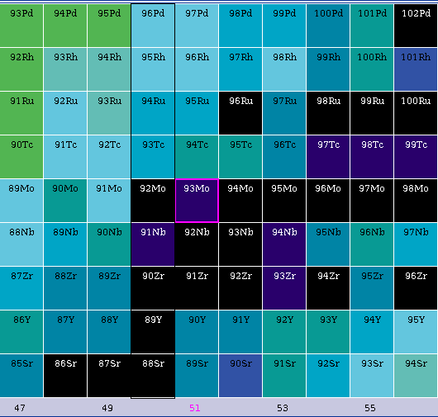
case study: Neec
⁹³Mo nestled among stable neighbors.
Variety of fusion-evaporation reactions using stable beam + target combos can get you there.
We opted for
⁹⁰Zr + ⁷Li → ^{93m}Mo + p3n.

Slide 50
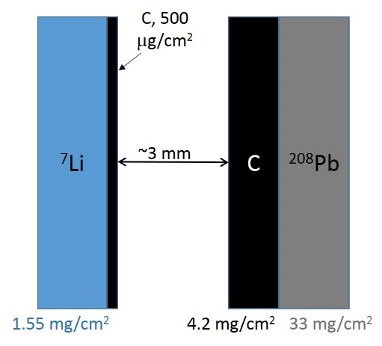
case study: Neec
$$E=E_{0}\frac{\sqrt{1−{(v/c)}^{2}}}{1−(v/c)\cos{θ}}$$
Doppler shift:
v/c > 10%
v/c rapidly diminishes
v/c = 0

Slide 51
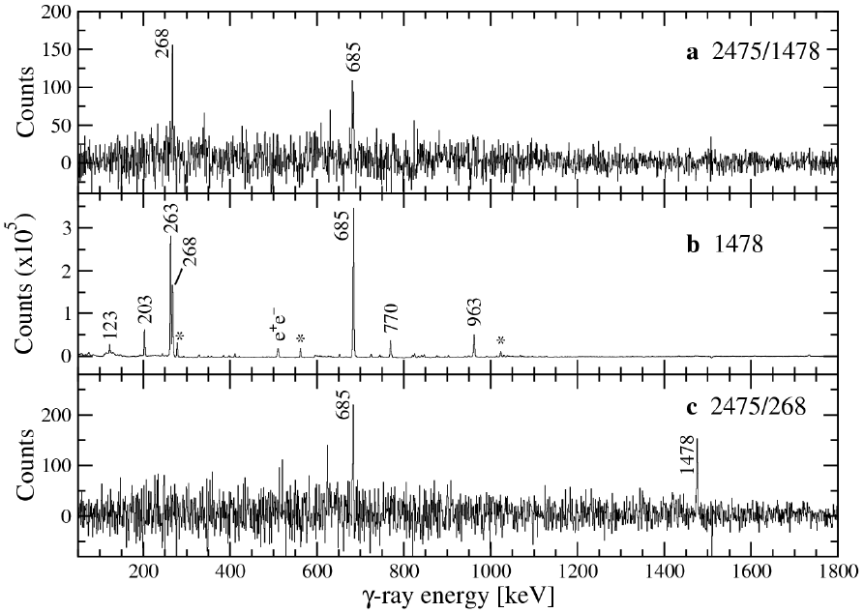
case study: Neec
Signature
2475 – 268 – 685 – 1478 coincidence ⇒ NEEC

Slide 52
Organization of these lectures
We will explore the six W’s of experimental nuclear structure:
Who?
What?
When?
✓
Where?
Why?
hoW?
✓
✓
✓

Slide 53
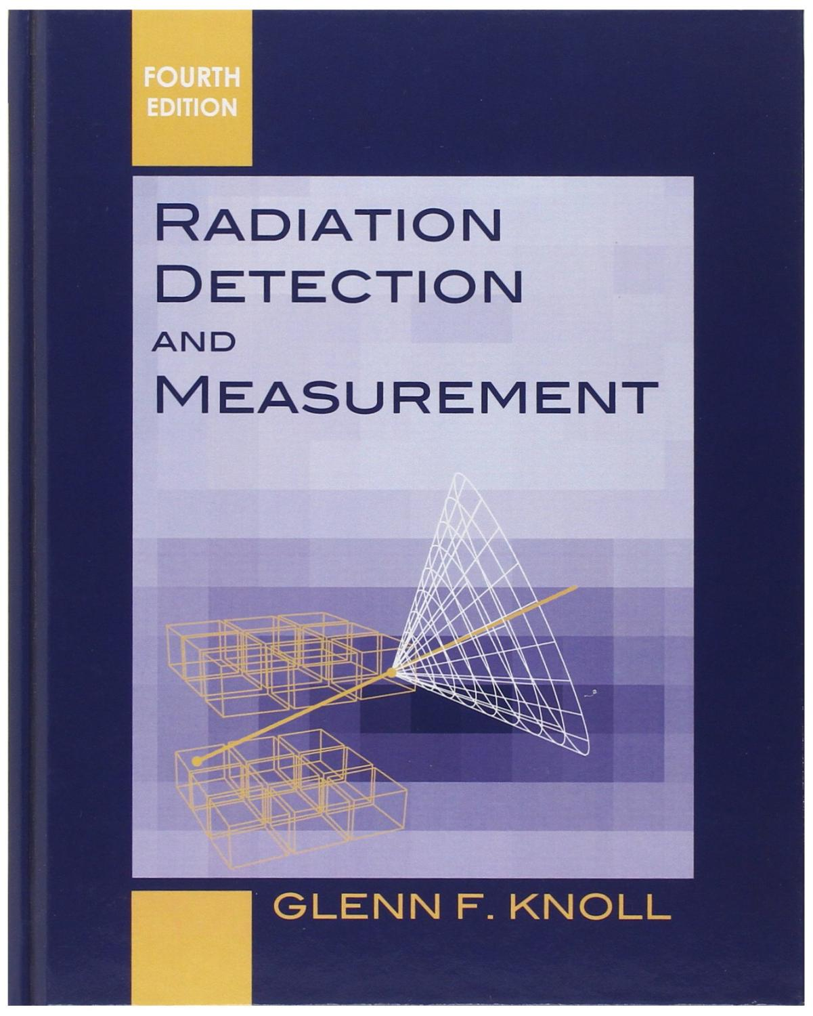
References
Electroweak Interactions Group
Department of Physics
Colorado School of Mines
http://electroweak.mines.edu
+ full treatment of ADs/ACs/polarizations in “In-Beam Gamma-Ray Spectroscopy” by Morinaga & Yamazaki

Slide 54
Backups

Slide 55
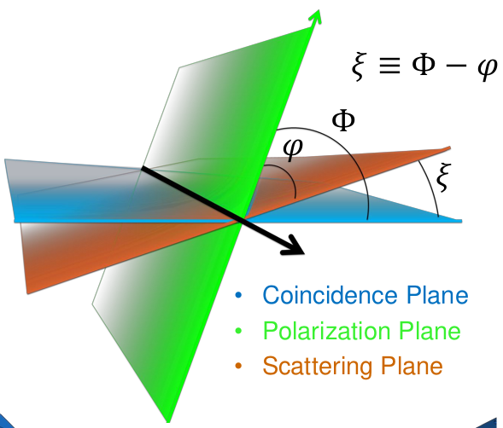
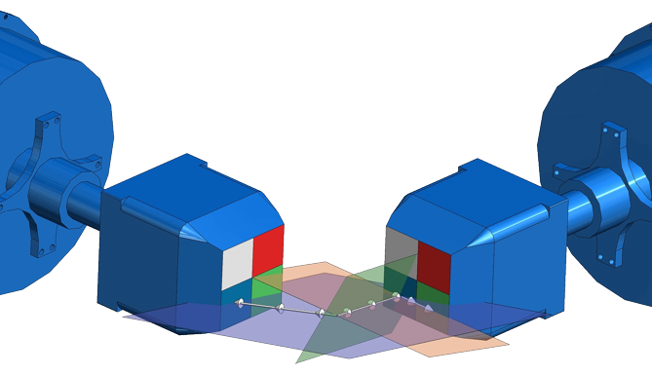
Building a level scheme
ADs/ACs → multipole order L, but do not directly distinguish E vs M
Pure ΔI=1 E1 looks the same as pure ΔI=1 M1, e.g.
Nonzero mixing ratio may change that, as M1/E2 far more likely than E1/M2
For more direct determination of E or M: measure polarization
Measure Compton scattering within and perpendicular to reaction plane
$$P∝\frac{{aN}_{⊥}−N_{∥}}{{aN}_{⊥}+N_{∥}}$$
(a corrects for different intrinsic count rates)
Notes:
E field ➔ E || E1 axis but _|_ M1 axis

Slide 56
Measuring g-factors
Angular correlations
Half-lives
g-factors
Stuchbery et al., PRC88, 051304 (2013)
Recoil-in-vacuum (RIV) technique
Nucleus produced in reaction in oriented state
Recoil exits target into vacuum → spin is deoriented by hyperfine interactions
Deorientation dependent on g-factor
$$W\left(θ_{p},θ_{γ},∆φ\right)=1+\sum_{kq}{B_{kq}(θ_{p})Q_{k}G_{k}F_{k}D_{q0}^{k∗}(∆φ,θ_{γ},0)}$$
rotation matrix giving angle dependence of correlation → P(cosθ_{γ})
angles of p(articles) and γ’s
statistical tensor defining initial spin alignment
attenuation factor for finite γ detector size
“usual F coefficients” for ACs/ADs
Notes:
Fk’s in terms of Racah W-coeffs and C-G coeffs

Slide 57
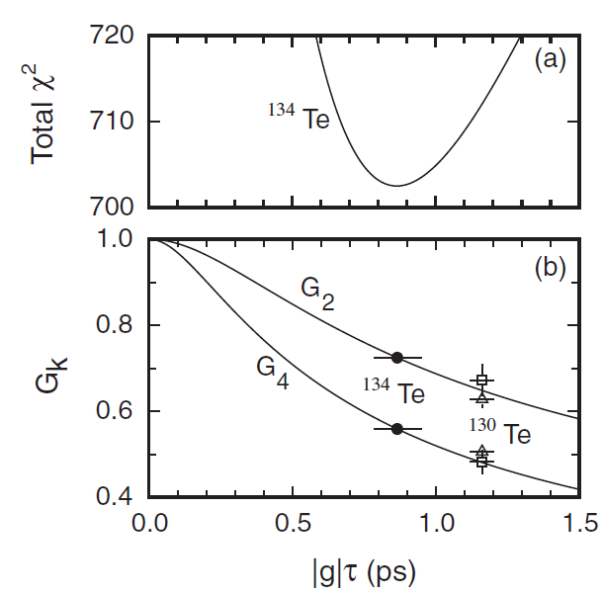
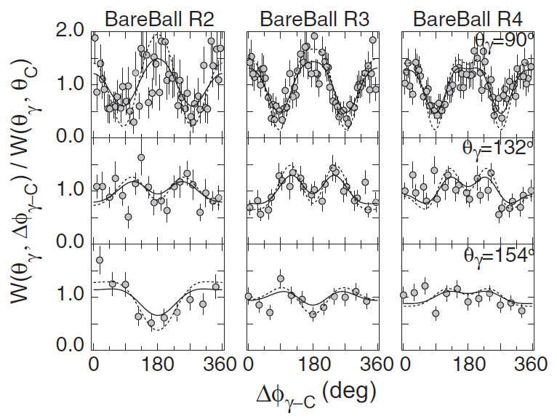
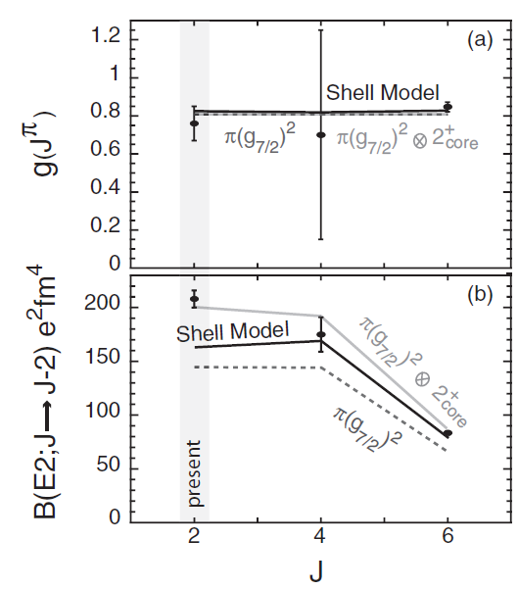
Measuring g-factors
RIV in ¹³⁴Te
Coulex of ¹³⁴Te RIB (and also ¹³⁰Te SIB)
Simultaneously measure B(E2) and g-factor for 2⁺
Observe attenuated ACs → relate to G_{k} → g-factor
Stuchbery et al., PRC88, 051304 (2013)
Notes:
g-fac well reproduced; BE2 suggests some collectivity arising from core excitations.

Slide 58
Evidence in favor of N = 40 gap:
large 2⁺ energy in ⁶⁸Ni
low-collectivity B(E2) in ⁶⁸Ni
Evidence against N = 40 gap:
different behavior in neighboring isotope chains
masses do not reveal “magic” behavior
Guénaut et al., PRC75, 044303 (2007)
Neidherr et al., PRC80, 044323 (2009)

Slide 59
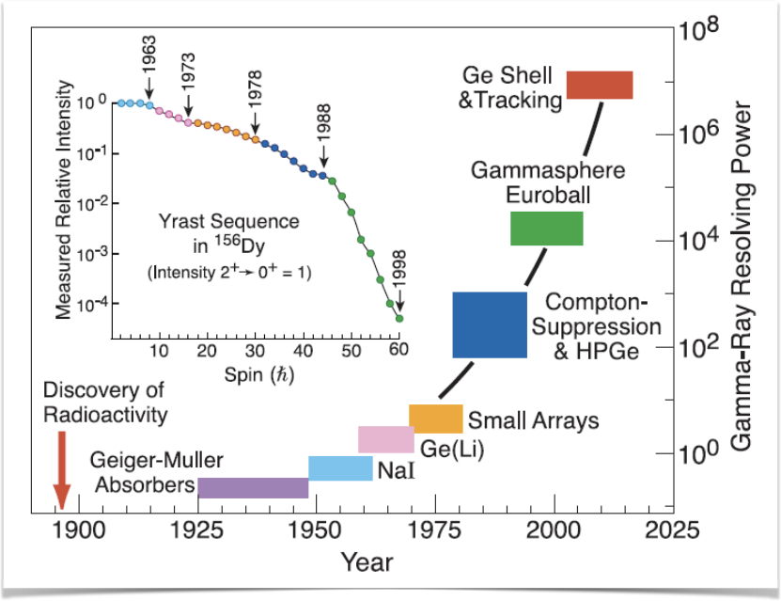
The Progression of Gamma-Ray Detection
K.G. Leach
EBSS 2018: Nuclear Structure Experiment - II
Wednesday, June 27, 2018
Electroweak Interactions Group
Department of Physics
Colorado School of Mines
http://electroweak.mines.edu
KGL

Slide 60
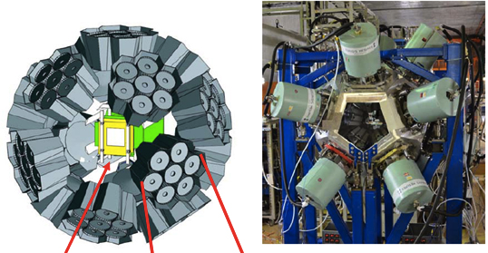
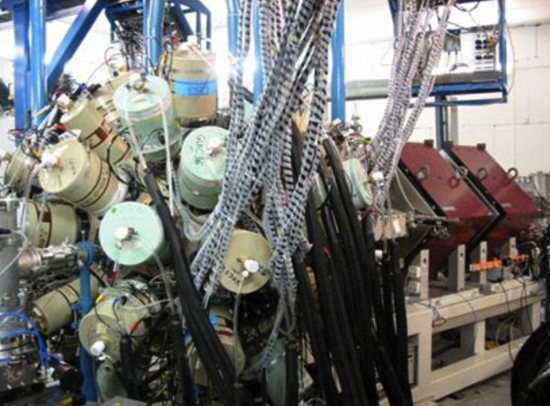
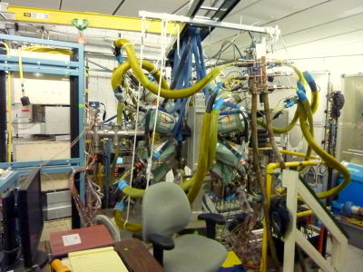
Nuclear Excited State Decay
EURICA Decay Spectroscopy at RIBF (RIKEN)
Heavy Element Studies at RITU
Nucleon knockout at the S800
β Decay at NSCL
Heavy-ion reactions with the FMA
HLC

Slide 61
Introducing….Large-Scale Clover and Cluster HPGe Arrays
K.G. Leach
EBSS 2018: Nuclear Structure Experiment - II
Wednesday, June 27, 2018
Electroweak Interactions Group
Department of Physics
Colorado School of Mines
http://electroweak.mines.edu
KGL

Slide 62
Gamma-Ray Tracking Arrays – AGATA and GRETA
KGL

Slide 63
Selection Rules
J_{i}^{π}
E_{i}
E_{γ} (L)
J_{f}^{π}
E_{f}
The transition probability for at state decaying by transition of multipole order L is:
Weisskopf estimates
…
…
HLC/KGL

Slide 64
Gamma-Ray Angular Distributions
If we produce unequal populations p(m_{i}) angular distributions W(θ) will be non-constant
Nuclear Orientation
HLC

Slide 65
Case study: ⁶⁸Ni
Suchyta et al., PRC89, 021301(R) (2014); implantation/decay
Recchia et al., PRC88, 041302(R) (2013); fragmentation reaction
After ~30y unchallenged, analyses of three experiments within the same year revealed E_{x}(0⁺₂) = 1604 keV, not 1770 keV!
Notes:
(Third not shown…also in Recchia et al.)

Slide 66
Case study: ⁶⁸Ni
Levels observed at similar energies, but no transition between them ➔ ???
Highly collective transition, possibly superdeformed
B(E2) transition strengths
(measure of collectivity)
SM calc
exp't

