Slide 1
Exotic Beam Summer School 2019
Nuclear Structure – Experiment
Christopher J. Chiara
CCDC-ARL/ORAU

Slide 2
Before we get started…
My location: SEDD at ALC, CCDC-ARL
The Army loves acronyms! (Even bad ones….)
The Army loves dense, complicated slides!
Completely unrelated observation: “active radio” at ORNL

Slide 3
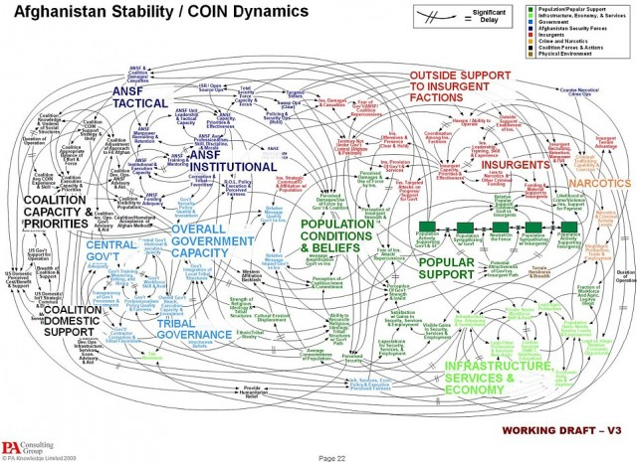
Keeping it “Army simple”…
Organization of these lectures:
DECAY MODES
ABQ
Left turn
energies
I^{π}’s
excited states
ground state
shapes
masses
EXPER-IMENT
NUCLEAR STRUCTURE
collective
T_{1/2}’s
single-particle
SM
42
Where am I?
THEORY

Slide 4
Organization of these lectures (for real):
We will explore the six W’s of experimental nuclear structure:
Who?
What?
When?
Where?
Why?
hoW?
(but not necessarily in that order…)
Selection of topics
Shell structure recap
Ground-state properties (briefly)
Excited-state properties
Pulling it all together: Case study 1
Something different: Case study 2
HLC/KGL = swiped or adapted from H.L.Crawford/K.G.Leach

Slide 5
Nuclear structure (the why?)
WHY would one study nuclear structure?
To understand the structure of the nucleus, of course!
By studying properties of the nucleus, we can
test theoretical predictions
provide data for development of new models
feedback loop
This impacts
our understanding of nucleon-nucleon interactions
other areas of physics, such as atomic, astro, and HEP
applications such as energy and power, medicine, and national security

Slide 6
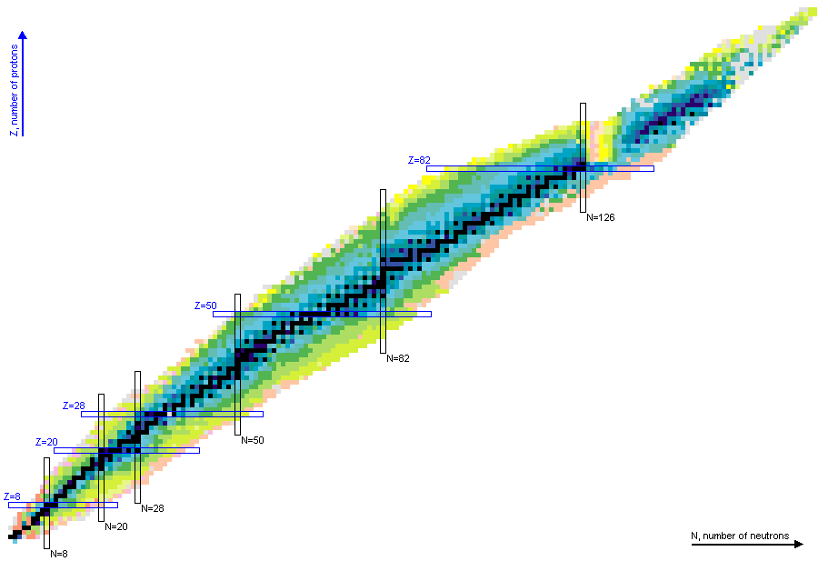
Nuclear structure
What are the limits of the nucleus?
Proton/neutron driplines
Super-heavy nuclei
High angular momentum
High excitation energy
~7k nuclides predicted to exist, of which ~3k have been studied and ~0.3k are stable.
Exotic nuclei offer a vastly expanded body of data, potentially revealing new phenomena.

Slide 7
Nuclear structure (the what?)
WHAT should we study? Theory can make predictions for various nuclear properties, but ultimately they must be experimentally measured to test models.
Masses
Shapes
Energies of excited states
Band structures/decay schemes
Spins and parities
Half-lives
Transition intensities/branching ratios
Decay modes/probabilities/energies
Moments/g-factors
Cross sections
…
“The List” (incomplete!)
We will cover many of these topics here.
Notes:
These observables provide insight into the nuclear wave function.

Slide 8
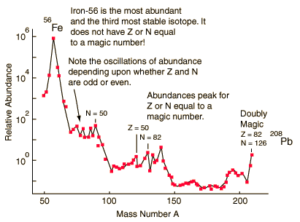
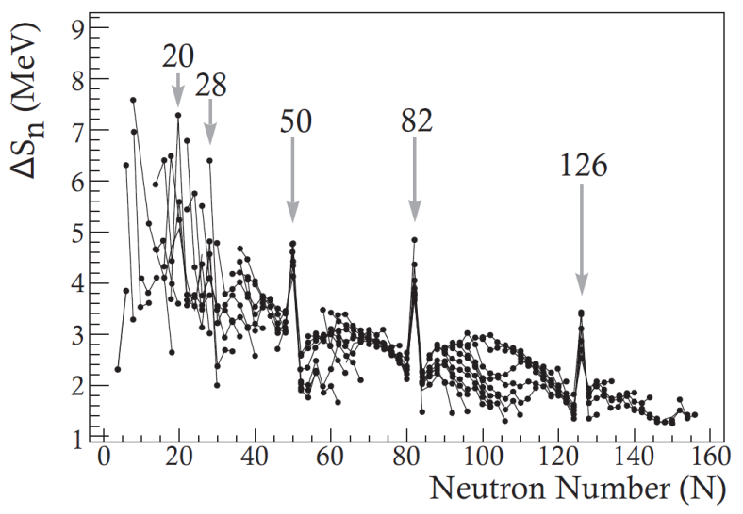
A quick SM recap (this is the experiment lecture, after all…)
Natural abundance of the isotopes shows peaks at particularly stable nuclei.
Similar indicators are found across the nuclear landscape, suggesting a nuclear shell structure.
Heaviest stable nucleus – ²⁰⁸Pb
₅₀Sn has 10 stable isotopes, 2 more than any other element
Proton Number, Z
Firestone, Table of Isotopes. Wiley, New York, 1996.
Neutron Number, N
HLC

Slide 9
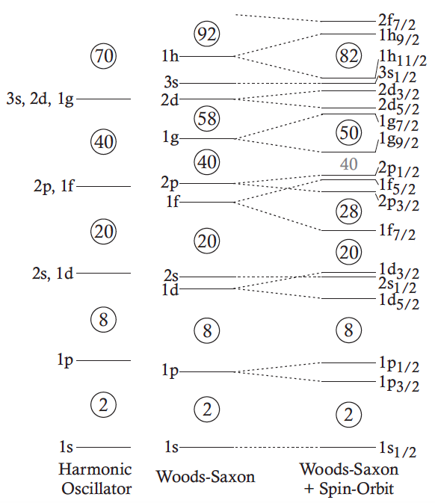
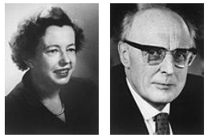
A quick SM recap
Analogous to atomic SM…
Maria Goeppert-Mayer & Hans D. Jensen
1963
Maria Goeppert-Mayer, Phys. Rev. 75, 1969 (1949).
O. Haxel, Phys. Rev. 75, 1766 (1949).
Single particles grouped into shells with gaps between → magic #s
HLC
…but with different potential

Slide 10
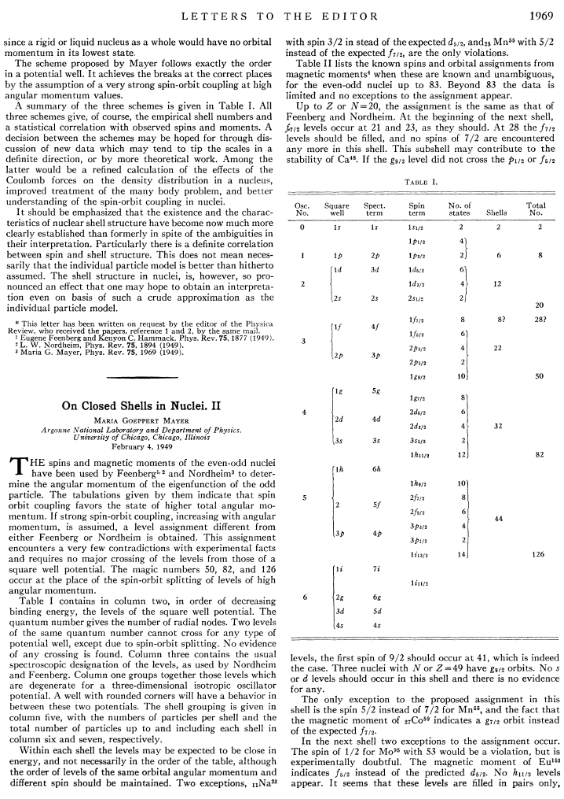
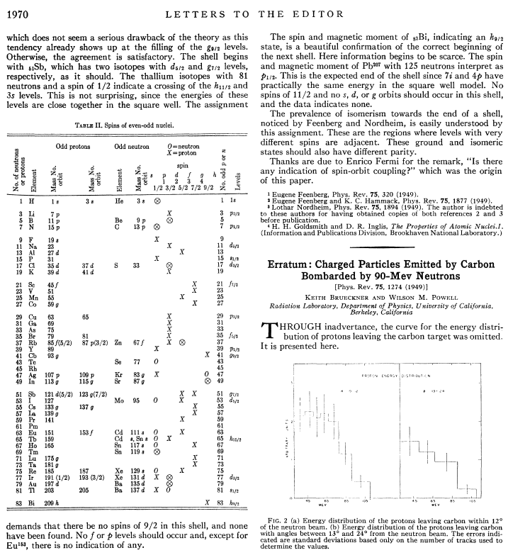
Maria Goeppert Mayer, PR75, 1969 (1949)
2
8
20
28
50
82
126
Big things come in small packages:
<1.5 page paper → Nobel Prize (1963)!
Notes:
MGM’s model could reproduce the known magic numbers, but only with inclusion of strong s-o interaction; Nobel shared with J. Hans D. Jensen “for their discoveries concerning nuclear shell structure” (half of prize--other half was Wigner)

Slide 11
A quick SM recap
SM born from (and well established in) nuclei near β stability.
As neutrons are added, evidence that familiar shell gaps vanish and new ones appear.
Diffuseness of density, reduced spin-orbit strength, tensor interaction would alter the well-known single-particle levels for very exotic (N >> Z) nuclei.
Toward neutron drip-line
⇒
Protons
Neutrons
Protons
Neutrons
Near stability
N >> Z
Geesaman et al., Annu. Rev. Nucl. Part. Sci. 56, 53 (2006)
Notes:
N/Z → ~3

Slide 12
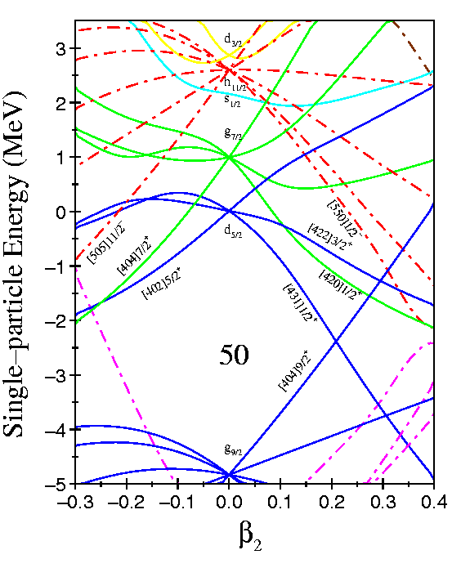
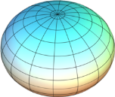
A quick SM recap
Stretch the spherical SM to deformed shapes → Nilsson model
Deformation splits the orbital substates, modifies shell gaps
Oblate
“pancake”
Prolate
“football”
Sphere
“rugby ball”?
“football”??

Slide 13
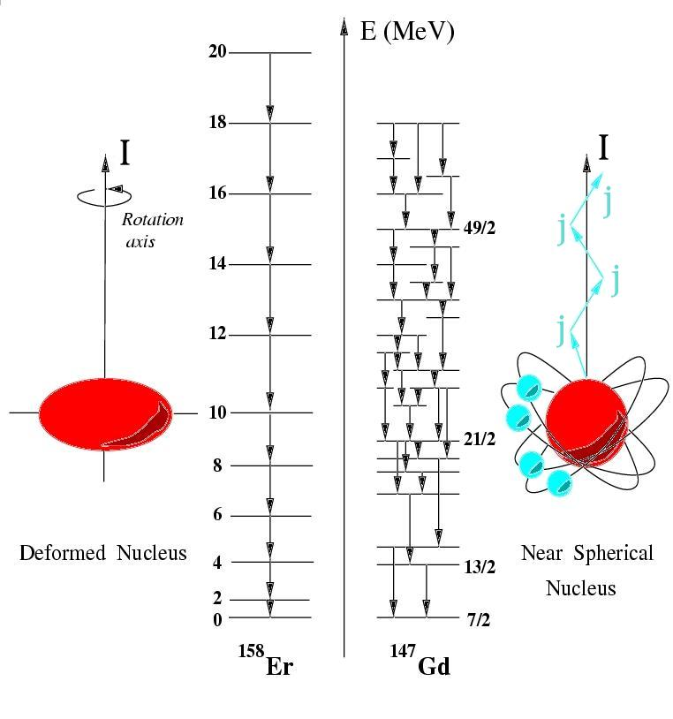
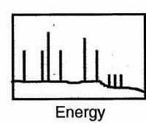
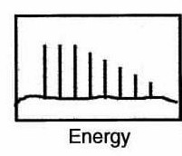
What might we expect to observe?
Level schemes…two extremes:
Many nucleons moving in concert
One/few nucleons involved
Collective Rotation
Single-Particle Alignment
$$E_{x}\left(I\right)=\frac{ℏ^{2}}{2𝒥}I(I+1)$$
Recoupling of ang.mom. generates irregular sequence
HLC
Notes:
Analogous to molecular rotors….

Slide 14
4811
Single-particle excitations
Levels can be associated with particular orbitals or couplings (configurations) of multiple nucleons
408 keV
4403
404 keV
3999
437 keV
3562
862 keV
2875
p_{3/2}
1/2+
2599
3/2+
2578
28
564 keV
585 keV
f_{7/2}
3/2-
2014
20
20
d_{3/2}
d_{3/2}
3562 keV
s_{1/2}
s_{1/2}
3999 keV
2578/2599 keV
2014 keV
⁴⁷Ca
d_{5/2}
d_{5/2}
8
8
Protons
Neutrons
7/2-
0
KGL/HLC

Slide 15
4811
Single-particle excitations
Levels can be associated with particular orbitals or couplings (configurations) of multiple nucleons
408 keV
4403
404 keV
3999
437 keV
3562
862 keV
2875
p_{3/2}
1/2+
2599
3/2+
2578
28
564 keV
585 keV
f_{7/2}
3/2-
2014
20
20
d_{3/2}
d_{3/2}
3562 keV
s_{1/2}
s_{1/2}
3999 keV
2578/2599 keV
2014 keV
⁴⁷Ca
d_{5/2}
d_{5/2}
8
8
Protons
Neutrons
7/2-
0
KGL/HLC

Slide 16
4811
Single-particle excitations
Levels can be associated with particular orbitals or couplings (configurations) of multiple nucleons
408 keV
4403
404 keV
3999
437 keV
3562
862 keV
2875
p_{3/2}
1/2+
2599
3/2+
2578
28
564 keV
585 keV
f_{7/2}
3/2-
2014
20
20
d_{3/2}
d_{3/2}
3562 keV
s_{1/2}
s_{1/2}
3999 keV
2578/2599 keV
2014 keV
⁴⁷Ca
d_{5/2}
d_{5/2}
8
8
Protons
Neutrons
7/2-
0
KGL/HLC

Slide 17
4811
Single-particle excitations
Levels can be associated with particular orbitals or couplings (configurations) of multiple nucleons
408 keV
4403
404 keV
3999
437 keV
3562
862 keV
2875
p_{3/2}
1/2+
2599
3/2+
2578
28
564 keV
585 keV
f_{7/2}
3/2-
2014
20
20
d_{3/2}
d_{3/2}
3562 keV
s_{1/2}
s_{1/2}
3999 keV
2578/2599 keV
2014 keV
⁴⁷Ca
d_{5/2}
d_{5/2}
8
8
Protons
Neutrons
7/2-
0
KGL/HLC

Slide 18
Nuclear structure (the what?)
WHAT would we study? Theory can make predictions for various nuclear properties, but ultimately they must be experimentally measured to test models.
Masses
Shapes
Energies of excited states
Band structures/decay schemes
Spins and parities
Half-lives
Transition intensities/branching ratios
Decay modes/probabilities/energies
Moments/g-factors
Cross sections
…
Some measurements are direct; others indirect and may require model interpretation.
Many complementary techniques available—only a small sampling will be presented here….
“The List” (incomplete!)
We will cover many of these topics here.

Slide 19
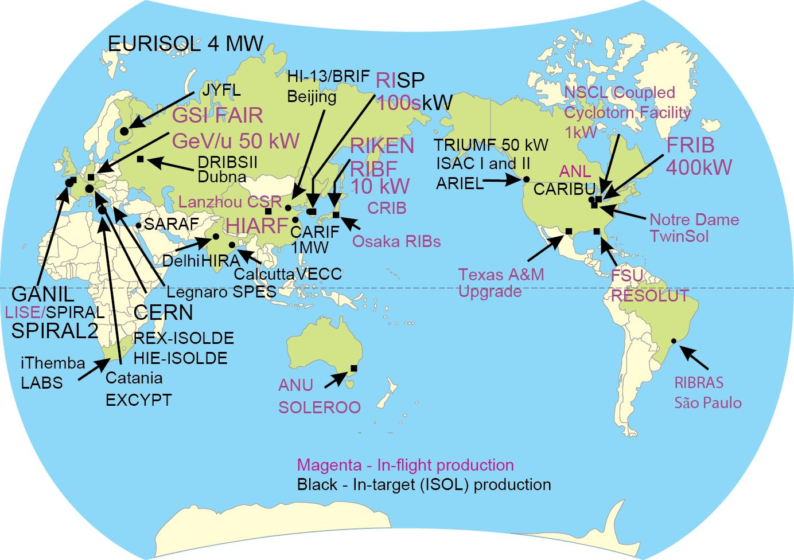
Nuclear structure (the where?)
The Production of Rare Isotope Beams Worldwide
Courtesy: Brad Sherrill
KGL

Slide 20
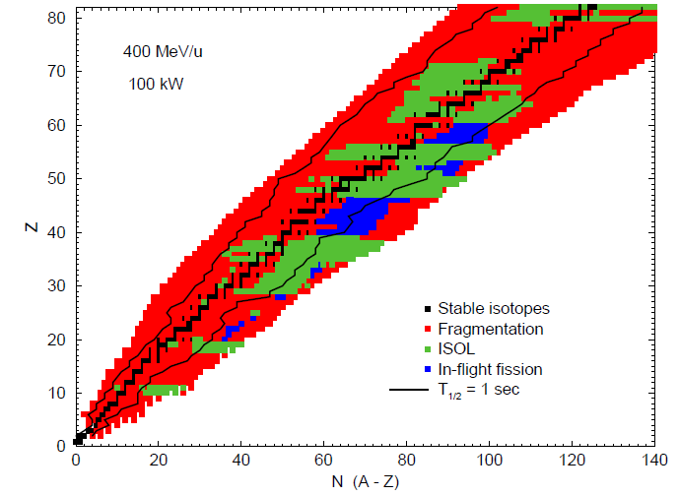
KGL

Slide 21
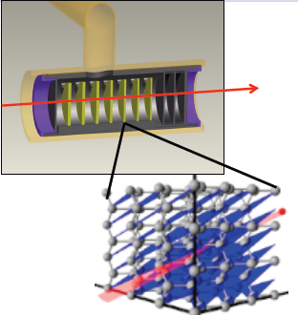
Isotope Separation On-Line (ISOL)
Examples of ISOL facilities:
TRIUMF (Canada)
SPIRAL/SPIRAL2 (France)
REX-ISOLDE/HIE-ISOLDE (CERN)
iTHEMBA - future radioactive-beam facility (South Africa)
JYFL (Finland) - IGISOL
Accelerator
Thick, Hot Target
Ion Source
Fragment Separator
Post-Accelerator/ Experiment
HLC/KGL

Slide 22
In-flight projectile fragmentation
Examples of fragmentation facilities:
NSCL (USA) → FRIB
RIKEN (Japan)
GANIL (France)
GSI (Germany)
Thin, light Production Target
Ion Source
(Heavy)
Accelerator
Fragment Separator
Rare Isotope
Beams
HLC/KGL

Slide 23
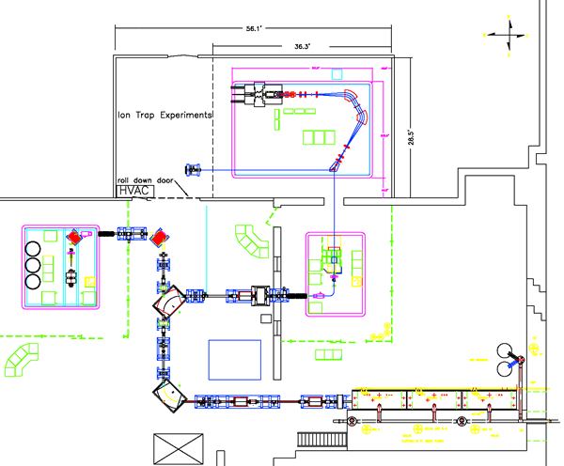
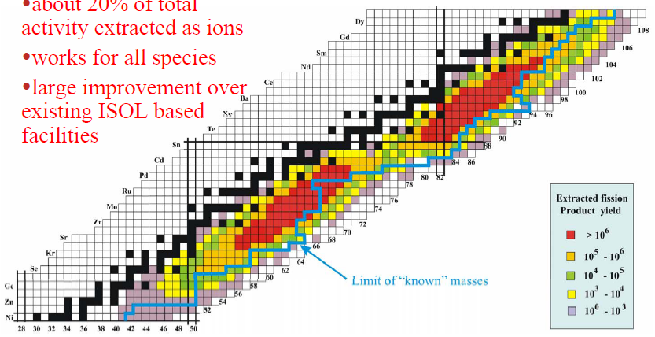
Accelerated spontaneous-fission fragments
CARIBU (CAlifornium Rare Ion Breeder Upgrade) – Argonne National Lab
~Ci ²⁵²Cf source
K.G. Leach
EBSS 2018: Nuclear Structure Experiment - II
Wednesday, June 27, 2018
Electroweak Interactions Group
Department of Physics
Colorado School of Mines
http://electroweak.mines.edu
CARIBU: https://www.anl.gov/phy/californium-rare-isotope-breeder-upgrade-caribu
Notes:
252Cf fission → n-rich isotopes → gas catcher + charge breeder → low-E beam; can reacc in ATLAS to higher E’s.
Species limited by fission distributions; some intense. Like ISOL, reacc ➔ high quality beams (in principle…).

Slide 24
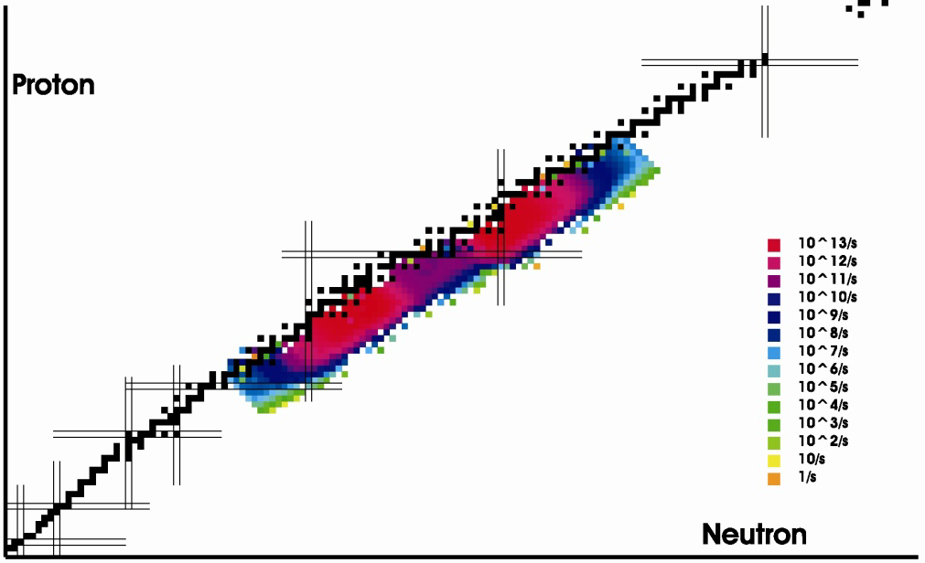
Photo-fission
²³⁸U Target
Fragment Separator
E- Linac
Ion Source
Post-Accelerator/ Experiment
ARIEL: www.triumf.ca/ariel
HLC/KGL

Slide 25
Nuclear structure (the how?)
Now for HOW we measure the nuclear properties of interest.
We’ll start at the bottom, touching (lightly!) on ground-state properties.

Slide 26
Ground-state properties
Masses
Mapping Nuclear Structure via Neutron Separation Energies

Slide 27
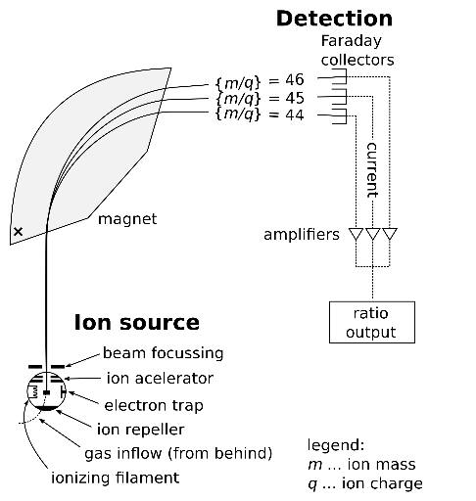
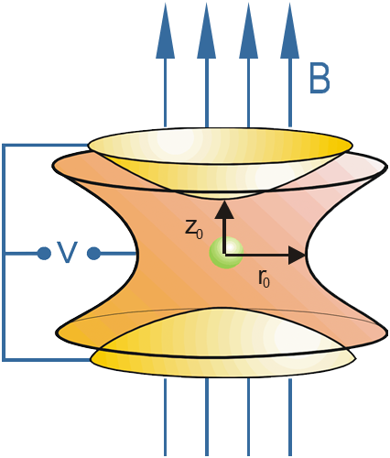
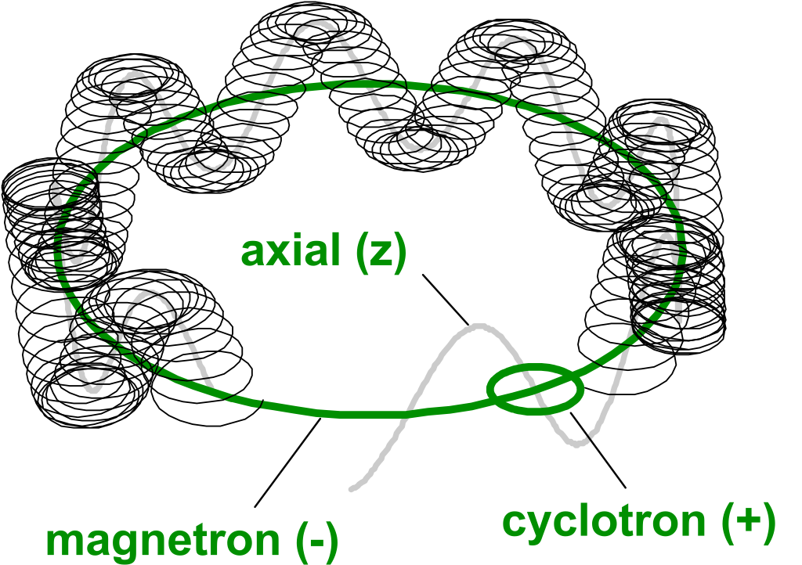
Mass measurements
Q-values
Decays
Kinematics
Dispersion
Spectrograph
$${Q=Σm}_{i}−Σm_{f}$$
ToF
Spectrograph
Multi-reflection (MR-TOF)
$$qvB=\frac{(γm_{0}){({L_{path}}/{ToF})}^{2}}{ρ}⇒m_{0}=\frac{ToF}{L_{path}}\frac{qBρ}{γ}$$
$$E=\frac{1}{2}mv^{2}=qeU \overset{⇒}{ } \frac{m}{q}∝t^{2}$$
Frequency
Penning trap
Storage rings
Ion source /
injection trap
Detector
Analyzer

Slide 28
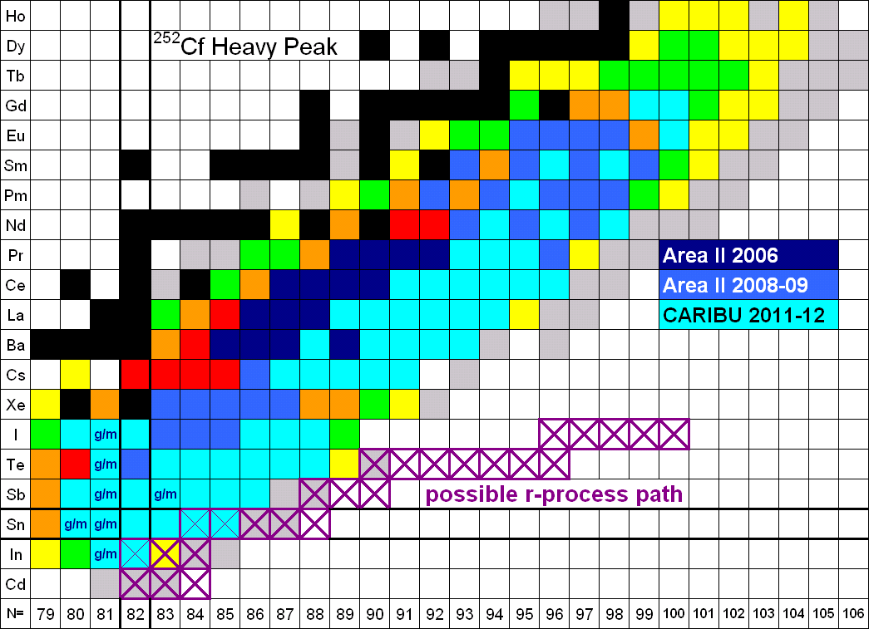
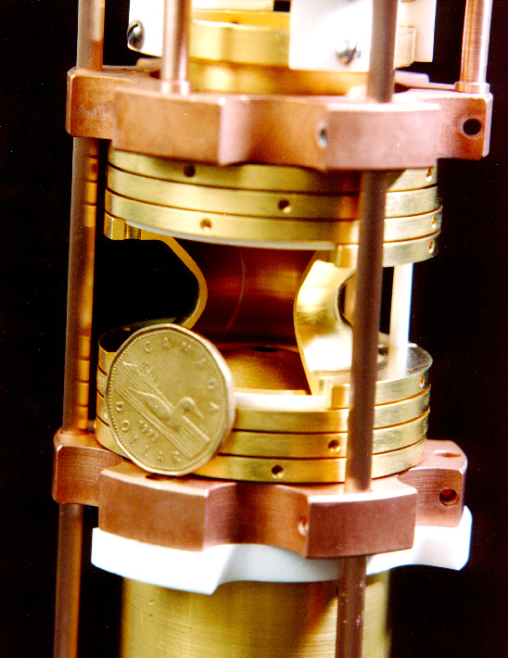
Mass measurements
Measurements with CARIBU beams at ANL with the Canadian Penning Trap (CPT) are filling in masses toward the astrophysically relevant r-process path
G. Savard, 2013 GRETINA workshop, ANL
HLC

Slide 29
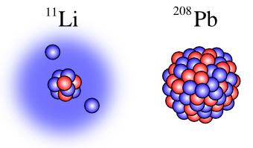
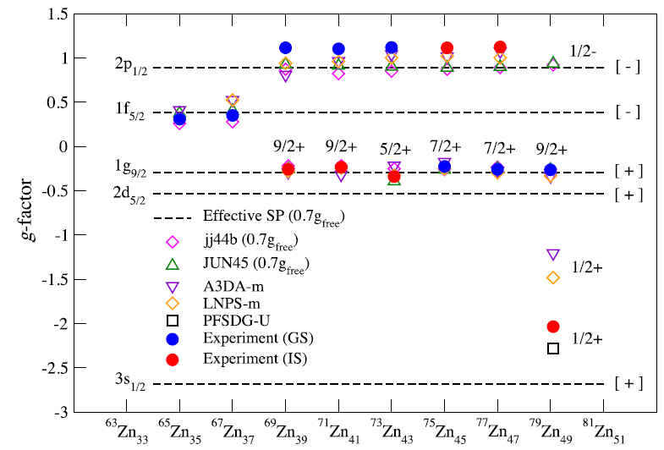
Ground-state properties
Masses
Nuclear matter and charge radii (e.g. skins, halos; isotope shifts)
Deformation: electric quadrupole (and higher) moments
Spin and parity: magnetic dipole moments
Decay
Wraith et al., PLB771, 385 (2017)
Notes:
Precision laser spec to measure isotope shifts (optical spectrum).

Slide 30
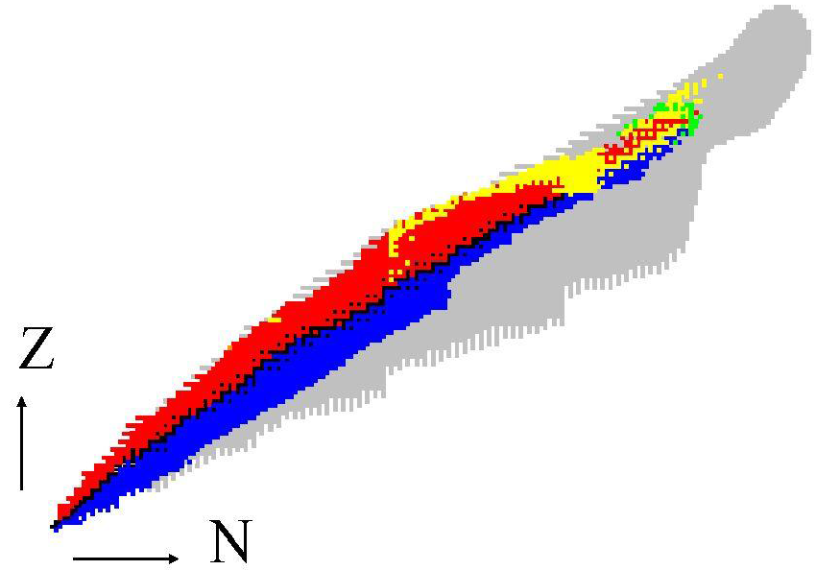
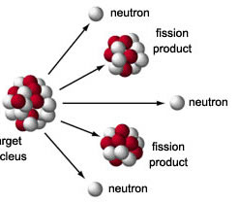
Ground-state decay
α decay
$${}_{Z}^{A}{\text{X}→}{}_{Z−2}^{A−4}{\text{X}\text{′}}+{}_{2}^{4}{\text{He}}$$
β⁺ decay
$${}_{Z}^{A}{\text{X}→}{}_{Z−1}^{A}{\text{X}\text{′}}+{}_{1}^{0}{{\text{e}}^{+}+}ν$$
EC decay
spontaneous fission
$${}_{Z}^{A}{\text{X}+{}_{−1}^{0}{{\text{e}}^{−}}→}{}_{Z−1}^{A}{\text{X}\text{′}}+ν$$
β⁻ decay
$${}_{Z}^{A}{\text{X}→\left(HF\right)+\left(LF\right)+xn}$$
$${}_{Z}^{A}{\text{X}→}{}_{Z+1}^{A}{\text{X}\text{′}}+{}_{−1}^{0}{{\text{e}}^{−}+\overline{ν}}$$

Slide 31
Ground-state decay
In addition to observing the decay mode itself, we can also deduce:
Half-life/branching ratio
Energies of emitted particles
Intensities of feeding to particular daughter states
Decays of *daughter excited/ground states (decay chain)
Decay can preferentially populate daughter states according to selection rules, revealing spin and parity information for daughter and/or parent

Slide 32
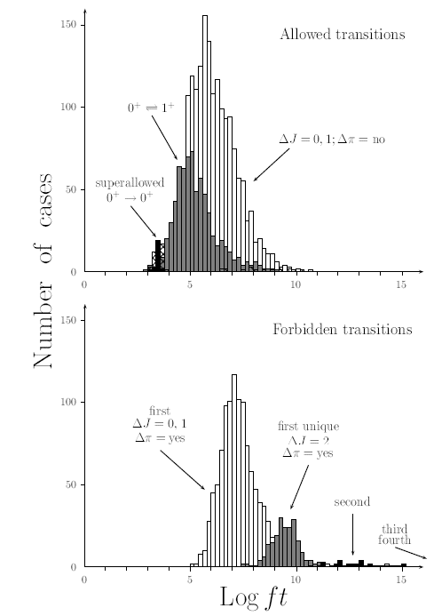
β-decay family
Log ft parameter [mentioned in Mon’s Fundamental Symmetries lecture] characterizes β decay
f = phase-space integral (function of Q-value)
t = partial decay half-life = t_{1/2}/BR
Tool for calculating log ft’s based on measured input values:
https://www.nndc.bnl.gov/logft/
Singh et al., NDS84, 487 (1998)

Slide 33
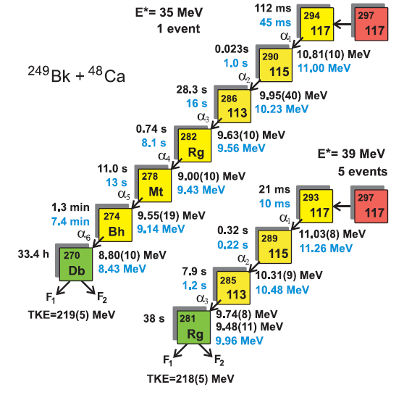
α decay – superheavies (cf. Stoyer lecture)
The heaviest nuclei decay via emission of α particles or by spontaneous fission
Since α’s and fission products are relatively easy to detect, even a single nucleus can provide significant information
Decay properties of element 117 alone, from only 6 events, provide experimental evidence supporting enhanced stability beyond Z = 111
Oganessian et al., PRL104, 142502 (2010)
HLC

Slide 34
α decay – not as heavy, but still super!
Although most prominent in heavy nuclides, α decay also occurs elsewhere on the nuclear chart
¹⁰⁸Xe
4.4 MeV
58 μs
¹⁰⁴Te
4.9 MeV
<18 ns
¹⁰⁰Sn
Only second observation of α decay to doubly magic daughter
Enhanced p-n interactions (α preformation factor)
Auranen et al., PRL121, 182501 (2018)
Notes:
Different selectivity in the process → low-L αλπηα emission is favored

Slide 35
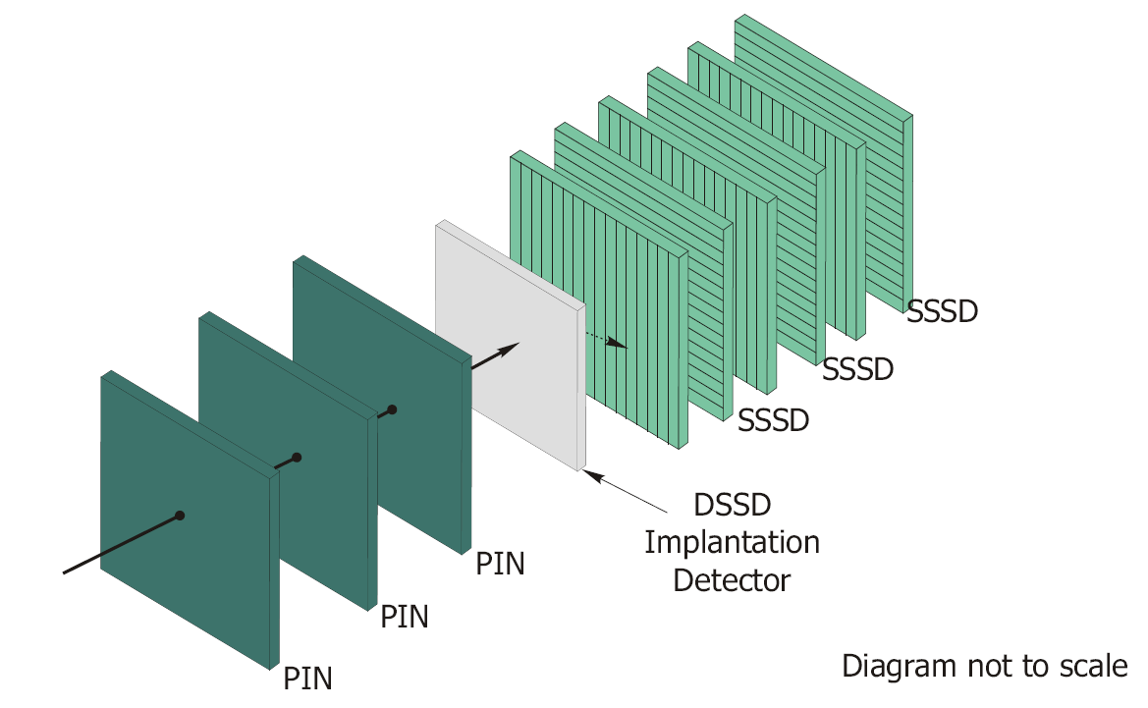
Implantation/decay
Decay particle
RIB or recoil
Nucleus of interest
Segmented detector provides position information
Implant in pixel; wait for decay (correlated in position and time)
BCS at NSCL
HLC/KGL

Slide 36
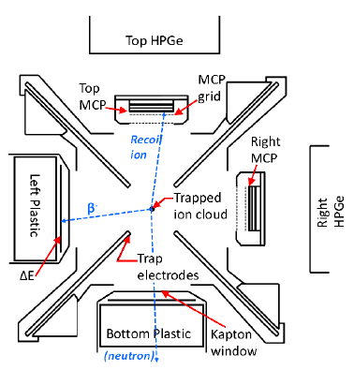
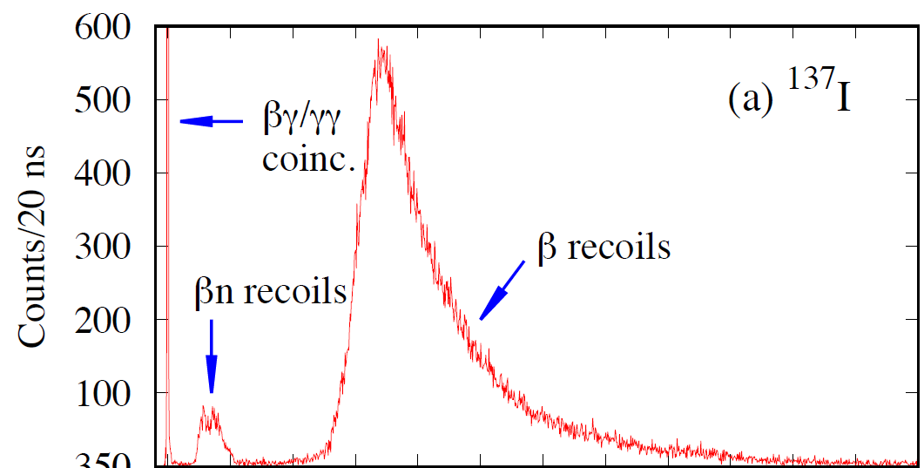
Other decay modes
Proton decay
Beta-delayed proton (βp) decay
Beta-delayed neutron (βn) decay
Two-proton decay
…and other exotica
Implantation/decay also an option for these
Beta-decay Paul Trap (BPT)
Czeszumska et al., to be published

Slide 37
Movin’ on up: Building a level scheme
So you have the ground state…what next? Build a level scheme! A lot of physics is packed into the excited states.
Where do you start if no excited states are known?
There are other experimental approaches to identifying/measuring properties of excited nuclear states; I will focus on γ-ray spectroscopy.

Slide 38
γ-ray spectroscopy
γ-ray spectroscopy is a popular tool in nuclear-structure research
Energies can be measured to better than 0.1% precision
Penetrating radiation, so detectors need not be within vacuum chamber
Covers many items on “The List”: energies, decay rates, spins, parities, lifetimes
Variety of detector types available [Ge, NaI(Tl), BGO, LaBr₃(Ce), CsI(Tl/Na), BaF₂…], depending on need
Energy precision?
Timing?
Efficiency?
Size?
Cost?

Slide 39
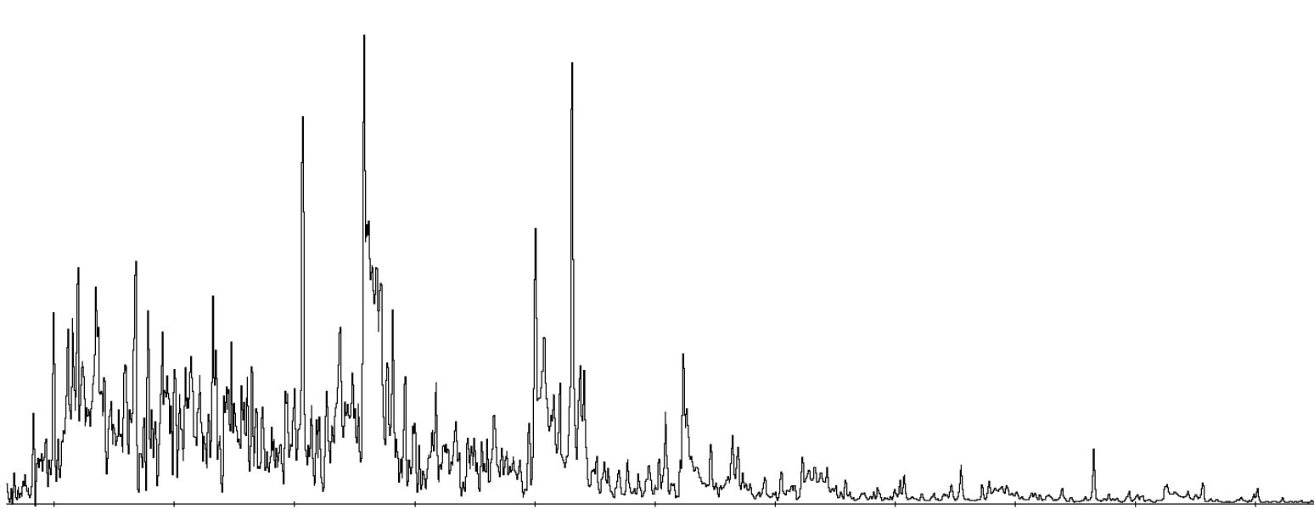
Movin’ on up: Building a level scheme
So you have the ground state…what next? Build a level scheme! A lot of physics is packed into the excited states.
Where do you start if no excited states are known?
Singles spectrum may be just a complicated jumble of γ rays of unknown origins.
Observe γ’s following reaction, but proof of which nucleus?

Slide 40
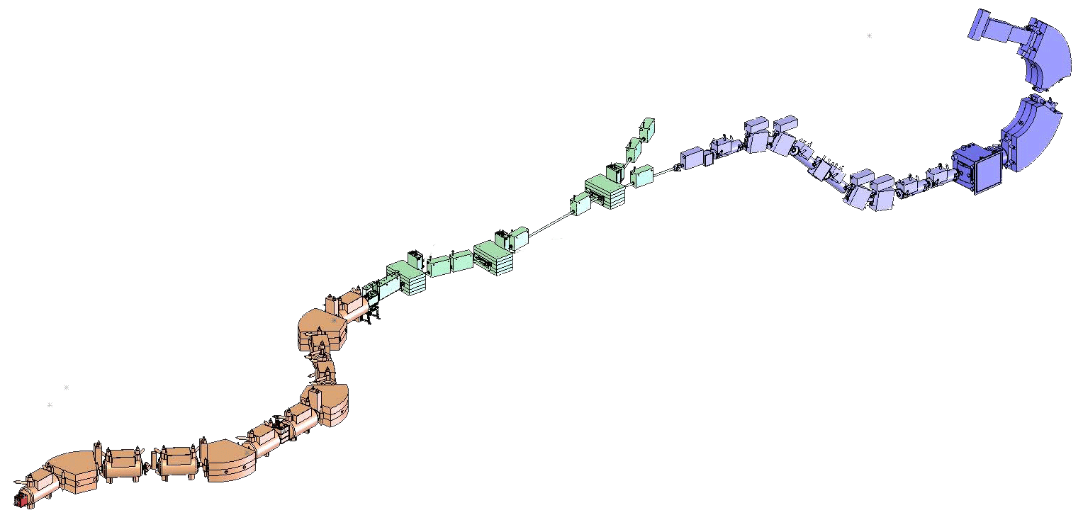
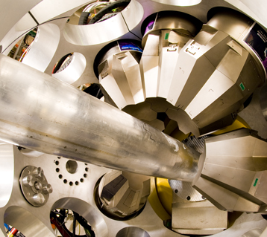
Building a level scheme
Reaction product identification S800 spectrograph
Identifying origins of γ rays
EM separators to disperse nuclides by species
Reaction target
281 mg/cm² ⁹Be
Primary beam: 140-MeV/u ⁸²Se³⁴⁺
A1900 fragment separator
Δp/p = 1%
Production target
423 mg/cm² ⁹Be
GRETINA
Notes:
E loss ~ Z^2; ToF ~ {A/Z, path length, rigidity}

Slide 41
Reaction product identification S800 spectrograph
TOF xfp
⁷¹Cu
⁷⁰Ni
Reaction target
281 mg/cm² ⁹Be
⁶⁹Co
TOF obj
A1900 fragment separator
Δp/p = 1%
Production target
423 mg/cm² ⁹Be
GRETINA

Slide 42
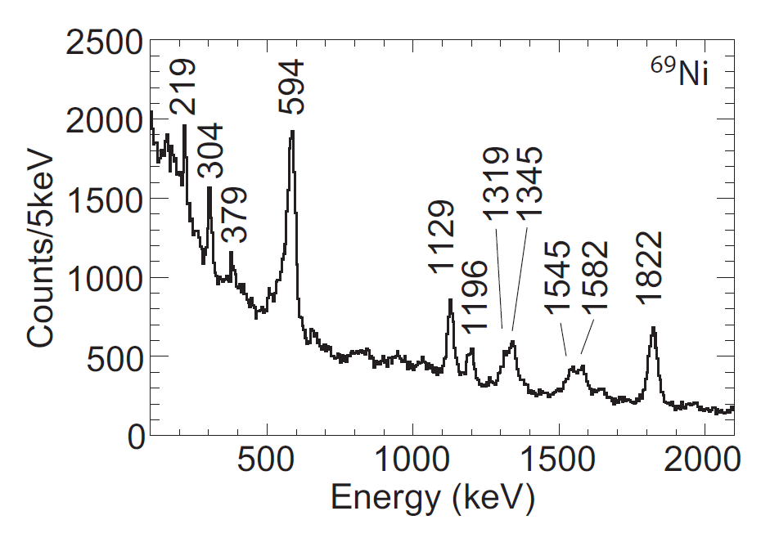
Gated on incident ⁷⁰Ni
Reaction product identification S800 spectrograph
⁶⁹Ni
⁶⁸Ni
⁶⁷Co
Reaction target
281 mg/cm² ⁹Be
A1900 fragment separator
Δp/p = 1%
Production target
423 mg/cm² ⁹Be
Recchia et al., PRC94, 054324 (2016)
GRETINA
Notes:
170ps for 594 causes low-E tail.
Secondary beam 10^5 ions/s.

Slide 43
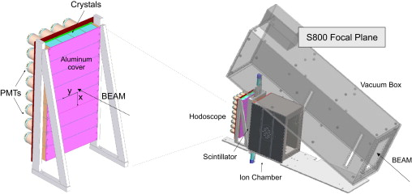
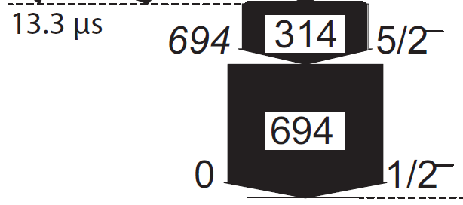
4x8 CsI(Na) array behind Al plate → delayed γ’s
Meierbachtol et al., NIM A652, 668 (2011)
Wimmer et al., NIMA769, 65 (2015)
Reaction product identification S800 spectrograph
Reaction target
281 mg/cm² ⁹Be
⁶⁷Ni
Recchia et al., PRC94, 054324 (2016)
A1900 fragment separator
Δp/p = 1%
Production target
423 mg/cm² ⁹Be
Recchia et al., PRC94, 054324 (2016)
GRETINA
Notes:
Worse resolution for CsI(Na) than Ge, but sparser spectrum. Different setting for 67Ni (vs 69Ni in GT)!
Purpose of expt: Characterize n s.p. strength in 67,69Ni via 1nKO. Spec. strengths deduced from the partial x-secs are used to ID and quantify n configs.

Slide 44
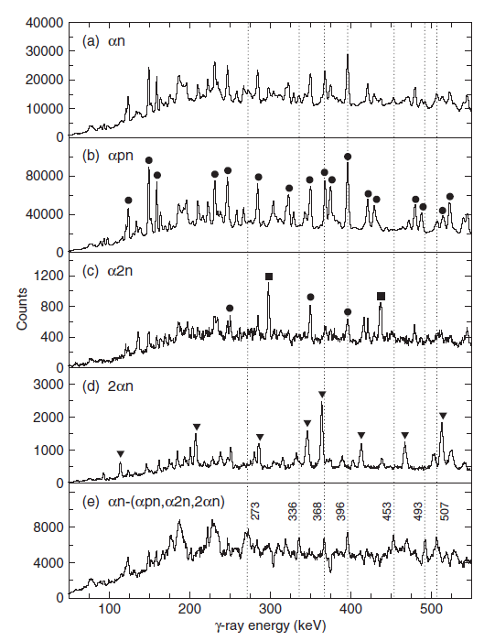
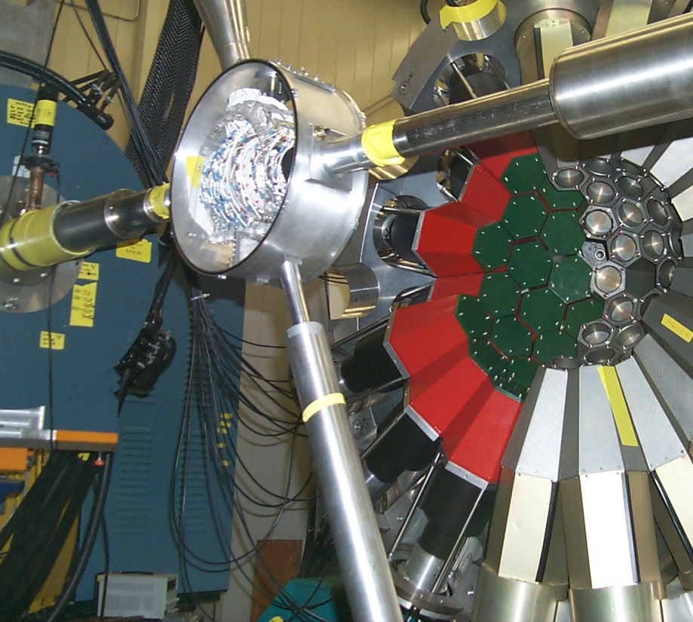
Building a level scheme
Identifying origins of γ rays
EM separators to disperse nuclides by species
Prompt particle (α,p,n) detection
⁶⁴Zn(⁶⁴Zn,αn)¹²³Ce
Smith et al., PRC86, 034303 (2012)
Notes:
Not 100% detection effs, so some scrambling of channels due to missed particles.

Slide 45
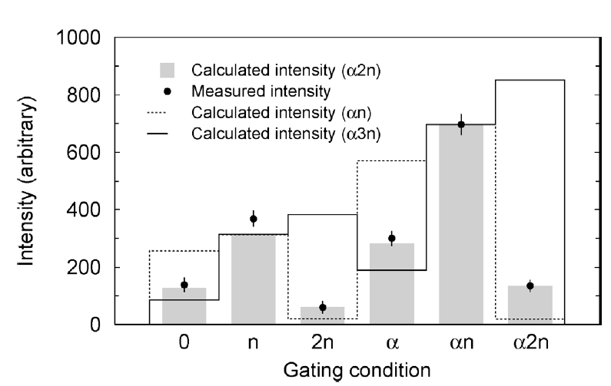
Building a level scheme
Identifying origins of γ rays
EM separators to disperse nuclides by species
Prompt particle (α,p,n) emission
⁶⁴Zn(⁶⁴Zn,α2n)¹²²Ce
Smith et al., PLB625, 203 (2005)
¹²²Ce not known at all prior to this measurement…including the g.s.
Notes:
Different channel from same experiment. Not even necessary for g.s. to be known to be able to ID excited states via gammas.

Slide 46
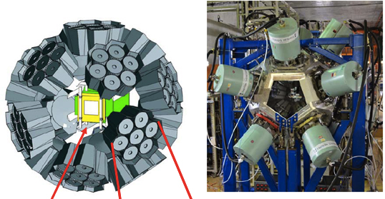
Building a level scheme
Identifying origins of γ rays
EM separators to disperse nuclides by species
Prompt particle (α,p,n) emission
Delayed γ’s following decay by β, α,…
Implant ID’d nuclide in pixel of DSSD
Await decay by particle emission in same pixel
Correlate detected γ’s with implant-decay event
EURICA at RIBF (RIKEN)

Slide 47
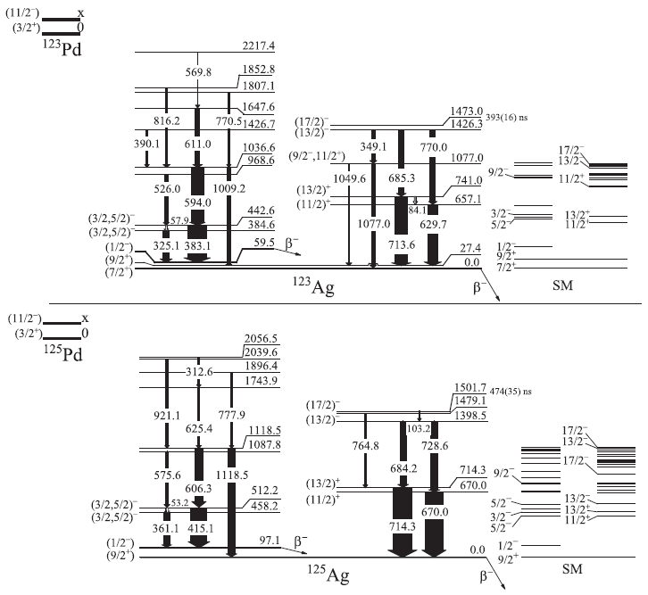
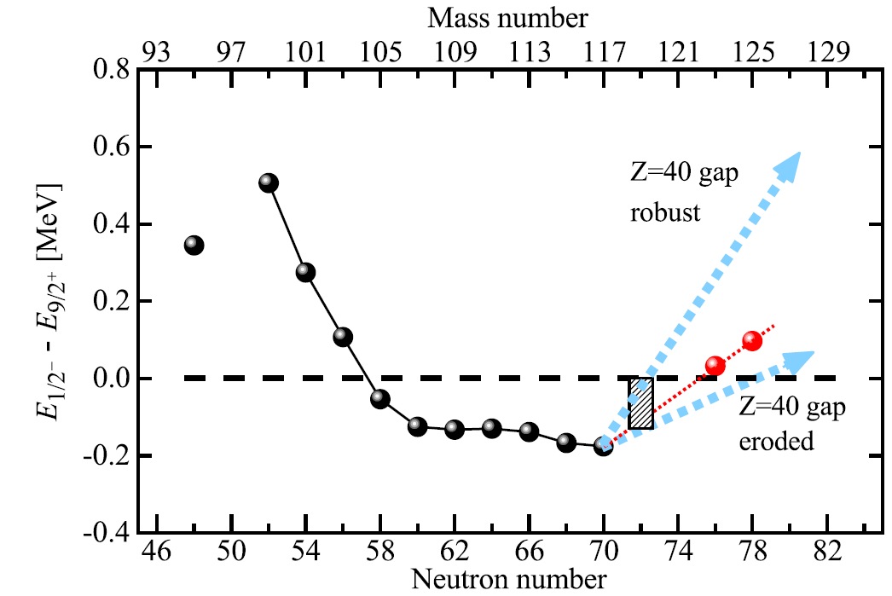
Building a level scheme
β-delayed γ’s <300 ms after ¹²³Pd implant
β-delayed γ’s <180 ms after ¹²⁵Pd implant
Chen et al., PRL122, 212502 (2019)
EURICA at RIBF (RIKEN)
Notes:
123,125Pd b- → Ag → Cd; can follow generations; also needn’t be only g.s. decay
Might not be unique if beta feeds above separation energy → bxn, bp modes

Slide 48
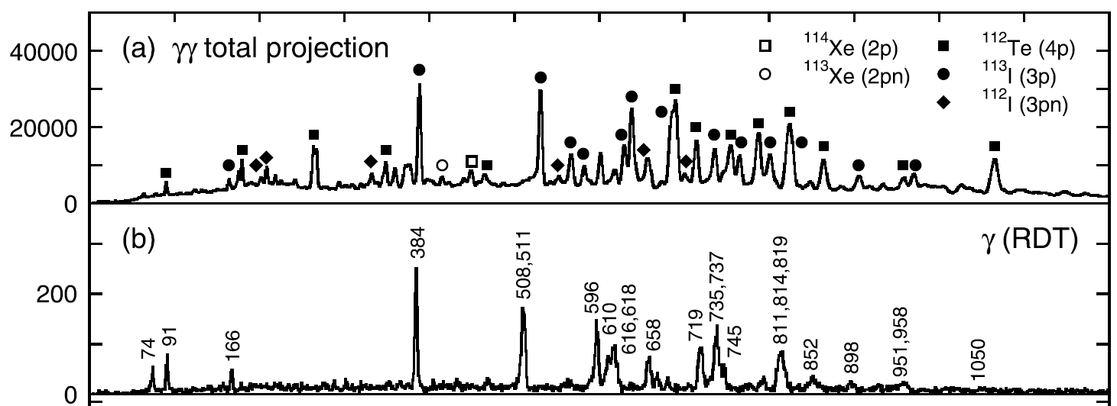
Building a level scheme
Identifying origins of γ rays
EM separators to disperse nuclides by species
Prompt particle (α,p,n) emission
Delayed γ’s following decay by β, α,…
Prompt γ’s preceding decay (recoil-decay tagging)
RDT can provide data on high-spin band structures beyond the proton dripline!
Wady et al., PLB740, 243 (2015)
Very sensitive—has been used down to cross sections of ~10 nb (¹⁸⁰Pb).
p decay
E_{p} = 969 keV
T_{1/2} = 17 μs
Rahkila et al., PRC82, 011303 (2010)
Notes:
Study collective properties via observed band structures → config ass’ts based on alignments (essentially I vs Egam).
Excited states can also particle decay, e.g. p and alpha from highly deformed bands in A~60 Ni region.

Slide 49
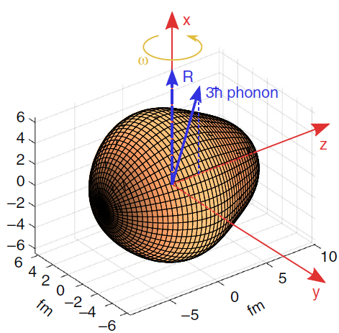
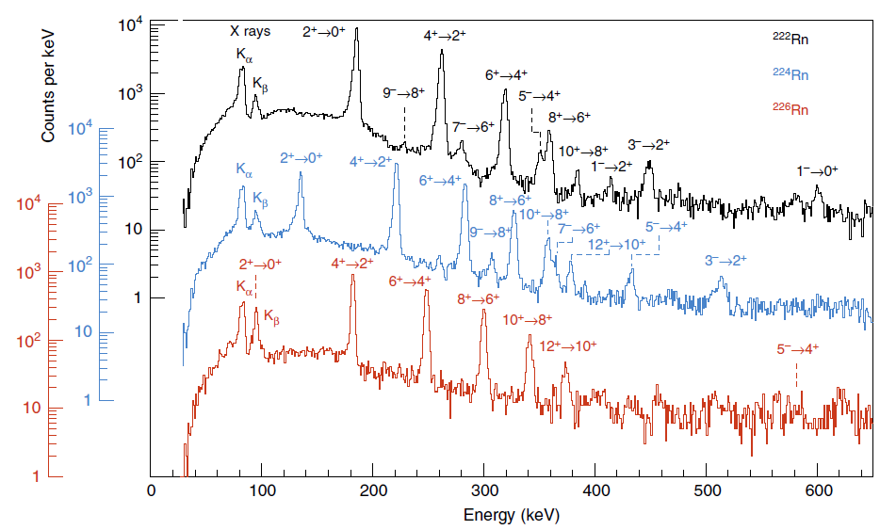
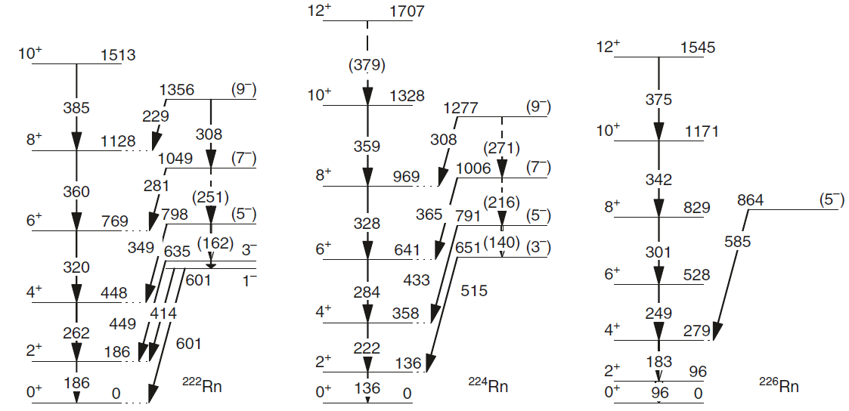
Building a level scheme
Identifying origins of γ rays
EM separators to disperse nuclides by species
Prompt particle (α,p,n) emission
Delayed γ’s following decay by β, α,…
Prompt γ’s preceding decay (recoil-decay tagging)
Coulex, transfer reactions
Butler et al., Nat. Comm. 10, 2473 (2019)

Slide 50
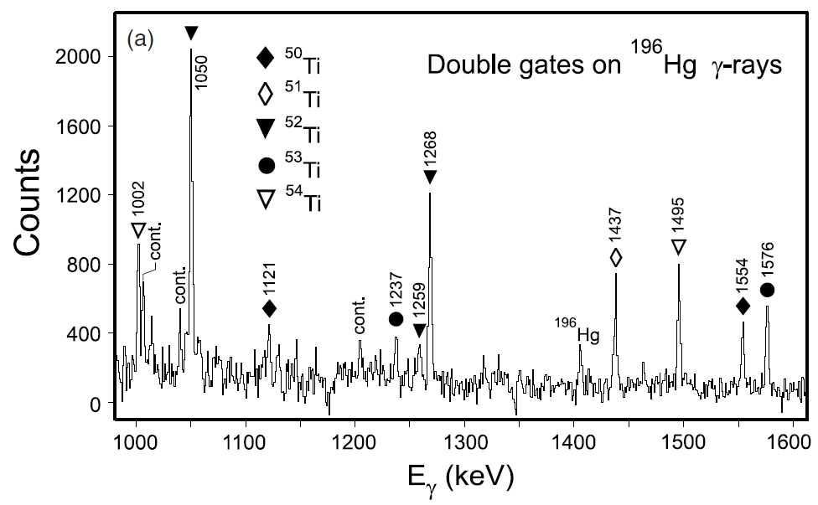
Building a level scheme
n-rich projectile
Identifying origins of γ rays
EM separators to disperse nuclides by species
Prompt particle (α,p,n) emission
Delayed γ’s following decay by β, α,…
Prompt γ’s preceding decay (recoil-decay tagging)
Coulex, transfer reactions
Cross-coincidences in multinucleon-transfer reactions
n-rich target
Broda, JPhysG32, R151 (2006)
Fornal et al., PRC72, 044315 (2005)
Notes:
N/Z equilibration

Slide 51
Building a level scheme
Placing γ’s in level scheme
E_{γ} matches ΔE_{x} of known levels
Arguments based on relative intensities, half-lives, systematics, theoretical expectations (dangerous! beware circular reasoning…)
γ−γ coincidences
Wady et al., PLB740, 243 (2015)
Notes:
Some gammas might be known through population by different mechanism (e.g. beta decay vs DIS); or, might be all new e.g. gg-RDT.

Slide 52
Building a level scheme
Placing γ’s in level scheme
γ−γ−γ (and higher-fold) coincidences even more sensitive by increasing P/T
Each additional E_{γ} condition comes at the cost of an ε_{γ} reduction in counts
(ε_{γ})² ~ 0.0001%
ε_{γ} ~ 0.1%
ε_{γ} ~ 0.1%
Large arrays, such as Gammasphere with ~100 Ge detectors: ε_{γ} ~ 10%
Used stand-alone, or in conjunction with auxiliary devices

Slide 54
Backups

Slide 55
ISOL Advantages and Disadvantages
Pros:
High intensity beams
Low-energy extraction from target
Excellent prospects for purity
Single-stage acceleration to MeV/A
Cons:
Target chemistry limits cases (and are complicated)
Ionization is a second stage, also limiting cases
High-energy reactions or implantation not possible
Half-lives limited to > few ms
KGL

Slide 56
In-Flight Fragmentation Advantages and Disadvantages
Pros:
In principle, no limit on which beams can be produced and ionized
Fast production and delivery
High-energy reactions and implantation
Cons:
Typically lower beam intensities
Stopped and Re-accelerated beams require a slow, complicated stopping stage
Control of initial beam properties not as precise as ISOL (ie. Energy spread, emittance, etc.)
A. Gade and B.M. Sherrill, Physica Scripta 91, 5 (2016)
KGL

Slide 57
What can we make? – Fragmentation
Figure: NSCL White Paper, 2006
Notes:
Fig.1.12, p.28

